Slide 1
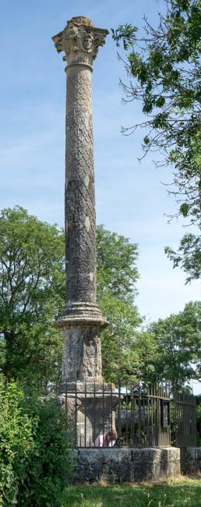
IDEA (EAGLE) & CIDOC-CRM
Köln 17.01.2018

Slide 2
Contents
Epigraphic Databases Online: a brief history
Issues of the current models
Resist the temptation to start all again
Attempts and failures with CIDOC-CRM

Slide 3
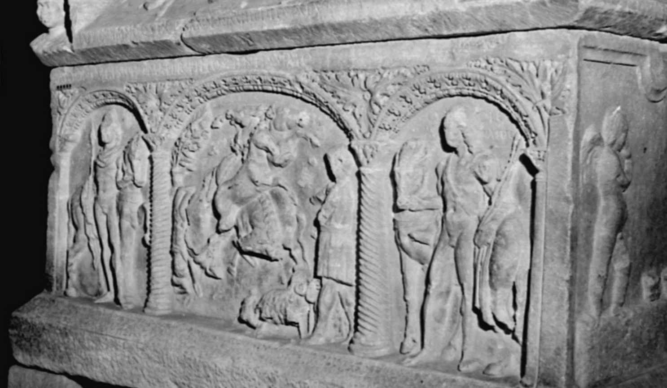
Epigraphic Databases
Before and After EAGLE

Slide 4
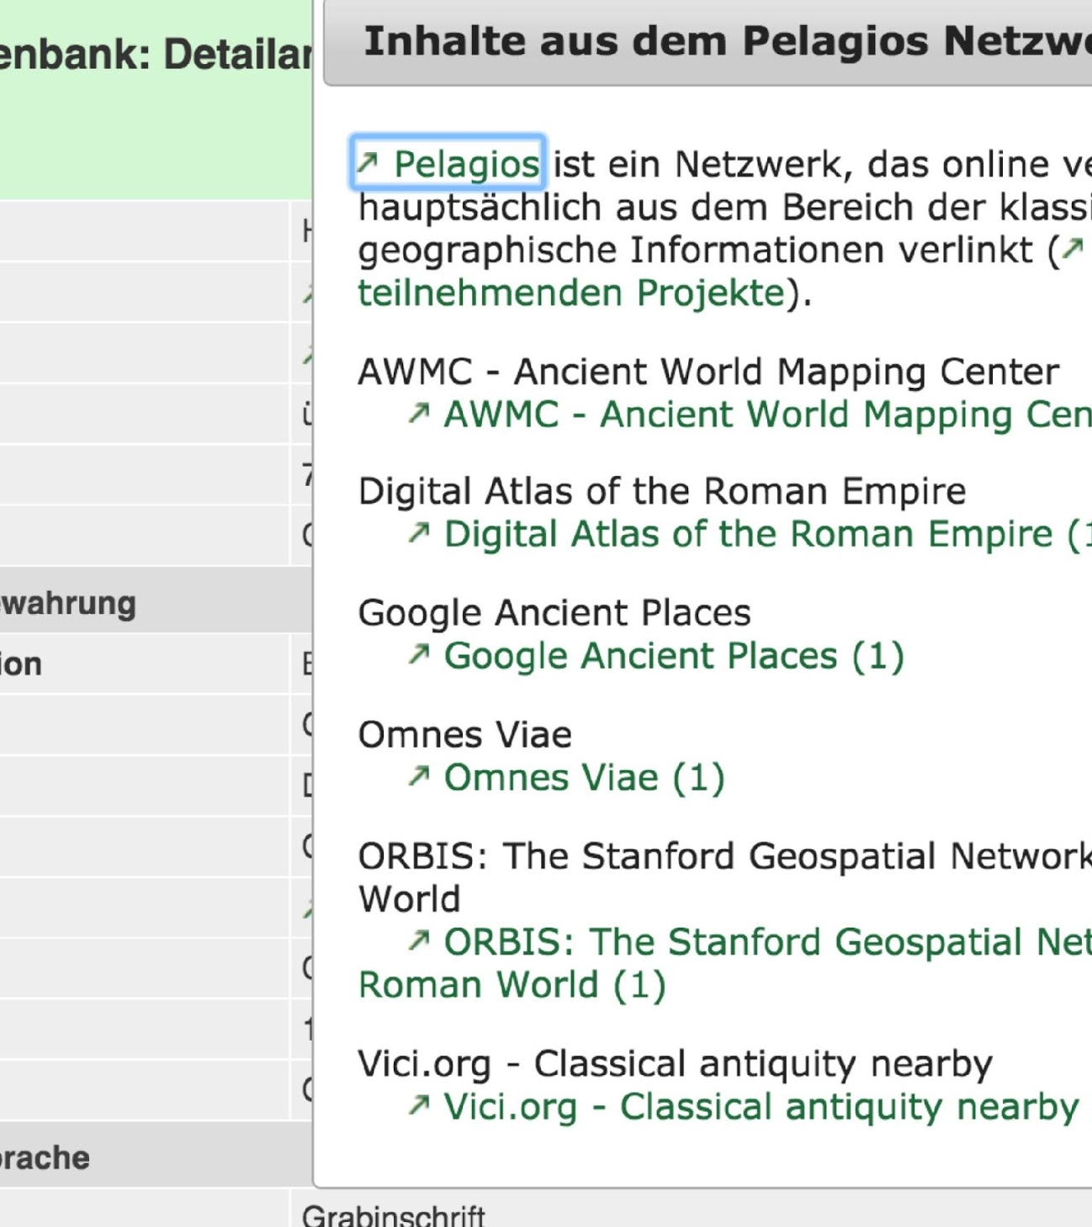
Epigraphik Database Heidelberg
covers some provinces declaring the status of work on each inscription
separate database for photos and texts
rich metadata
simplified text presentation
linked data from geographic database

Slide 5
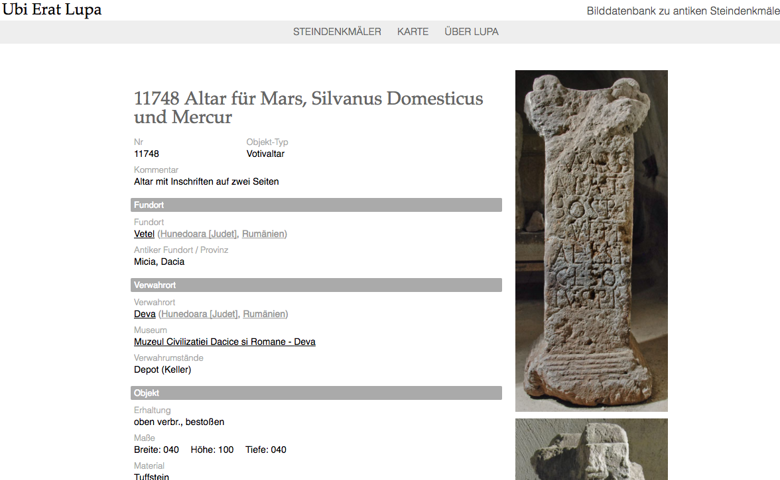
Ubi Erat Lupa
Focus on Photos of objects, i.e. statues as well as inscriptions:
text is part of the metadata
Very nice new website

Slide 6
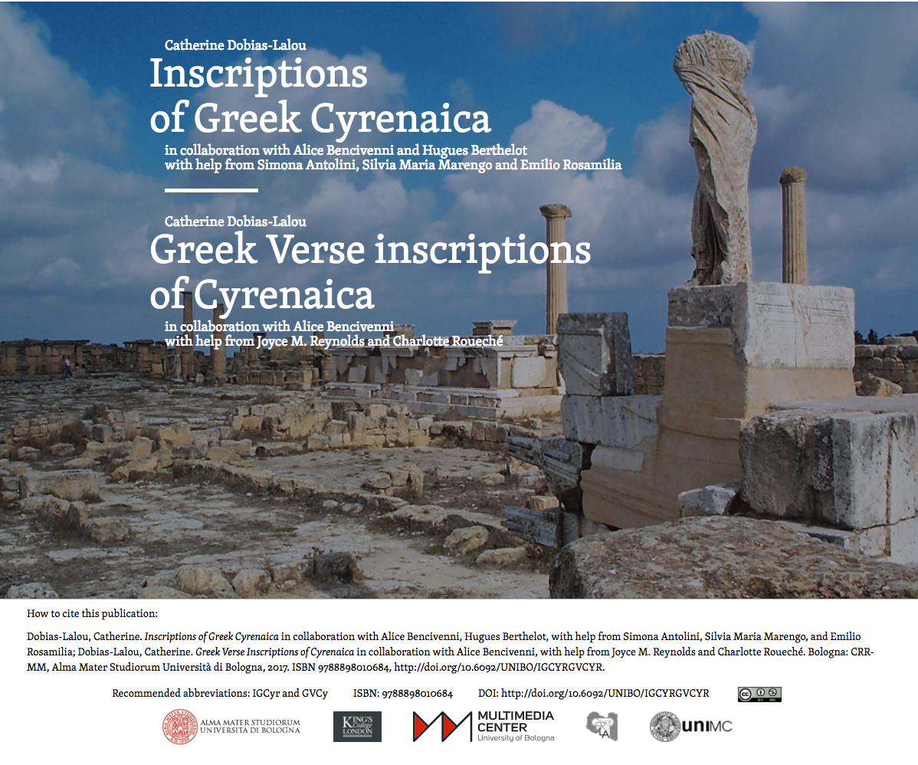
https://igcyr.unibo.it/

Slide 7
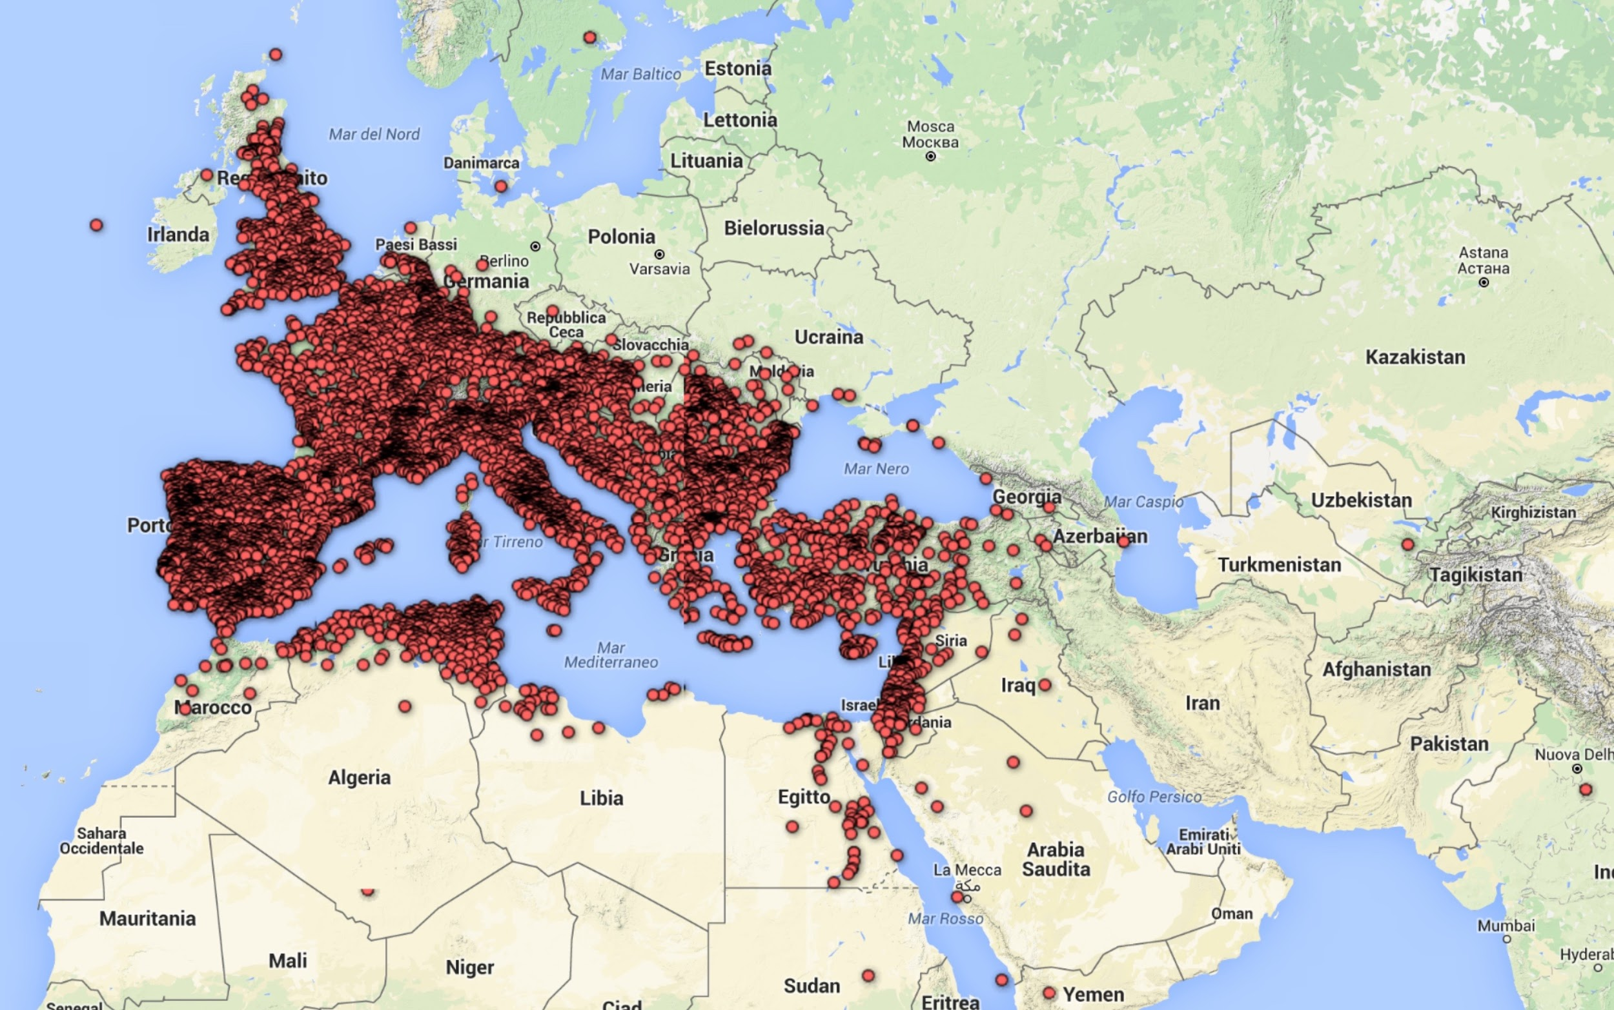
EDCS
extensive (un-complete) coverage
minimal data

Slide 8
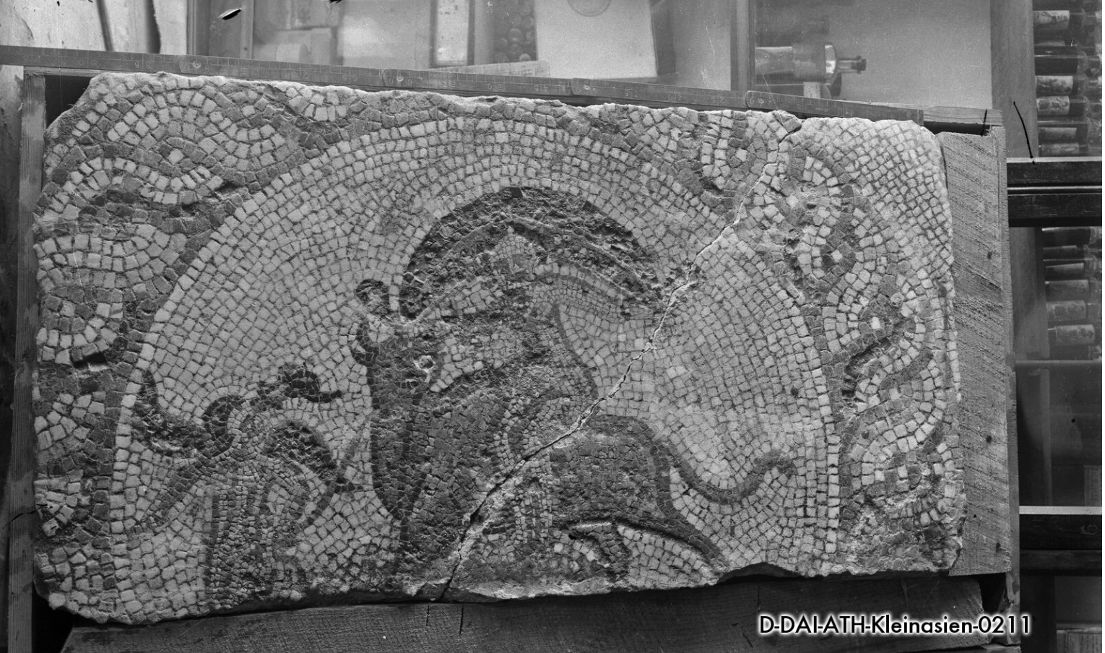
EAGLE Portal and Services

Slide 9
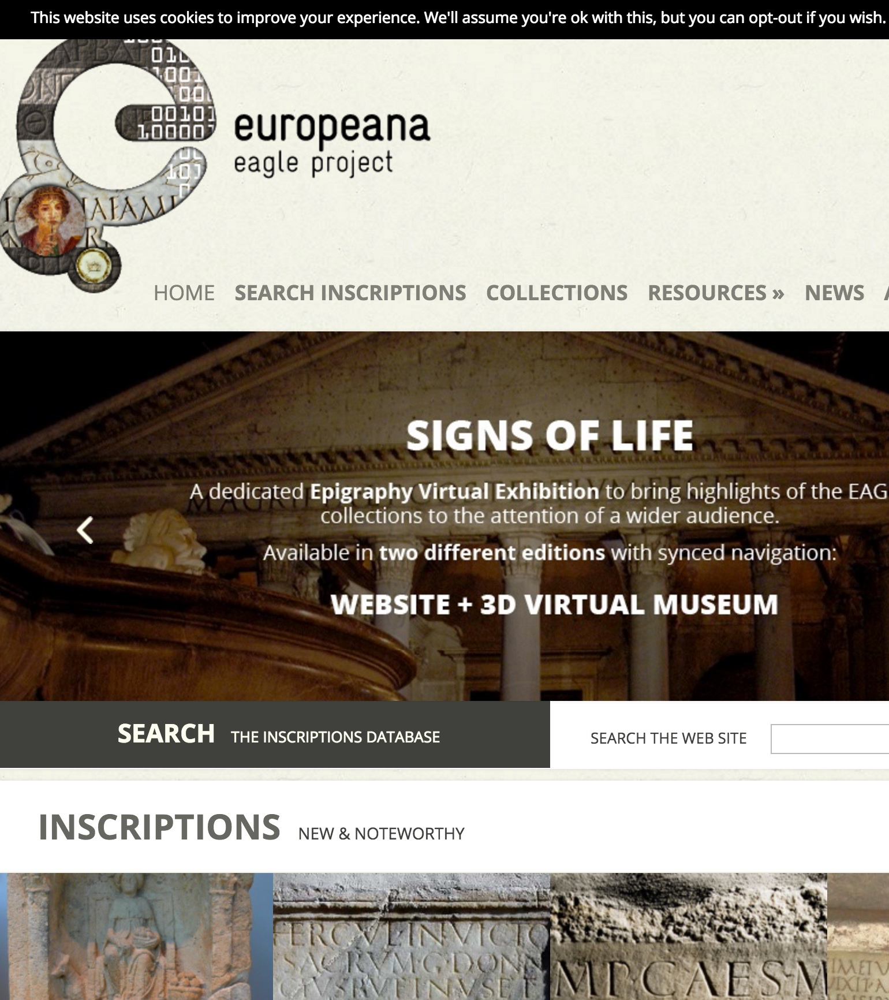
EAGLE portal
Set of resources
aggregates contents and delivers them to Europeana
Search of aggregated databases via image or string
virtual exhibition
wiki for translations of inscriptions
storytelling application
mobile apps
events, community and networks

Slide 10
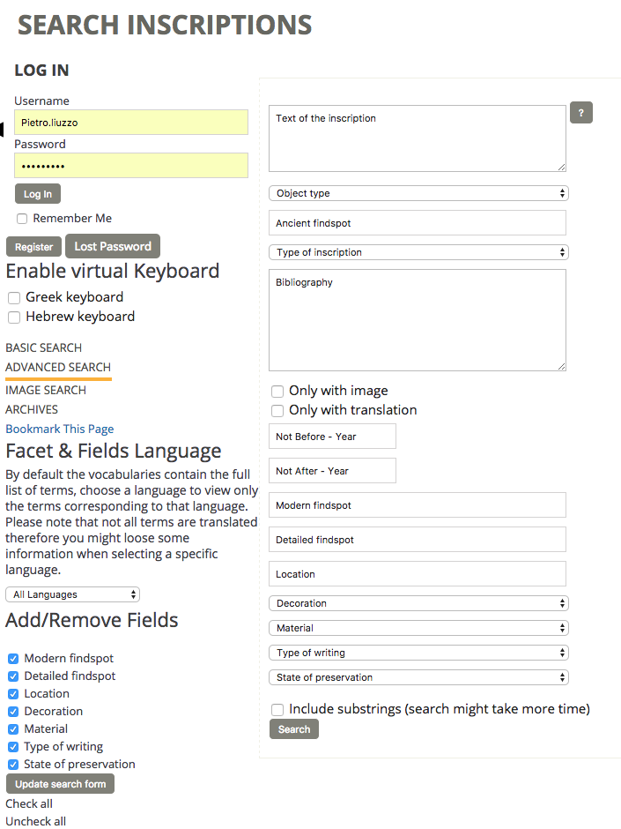
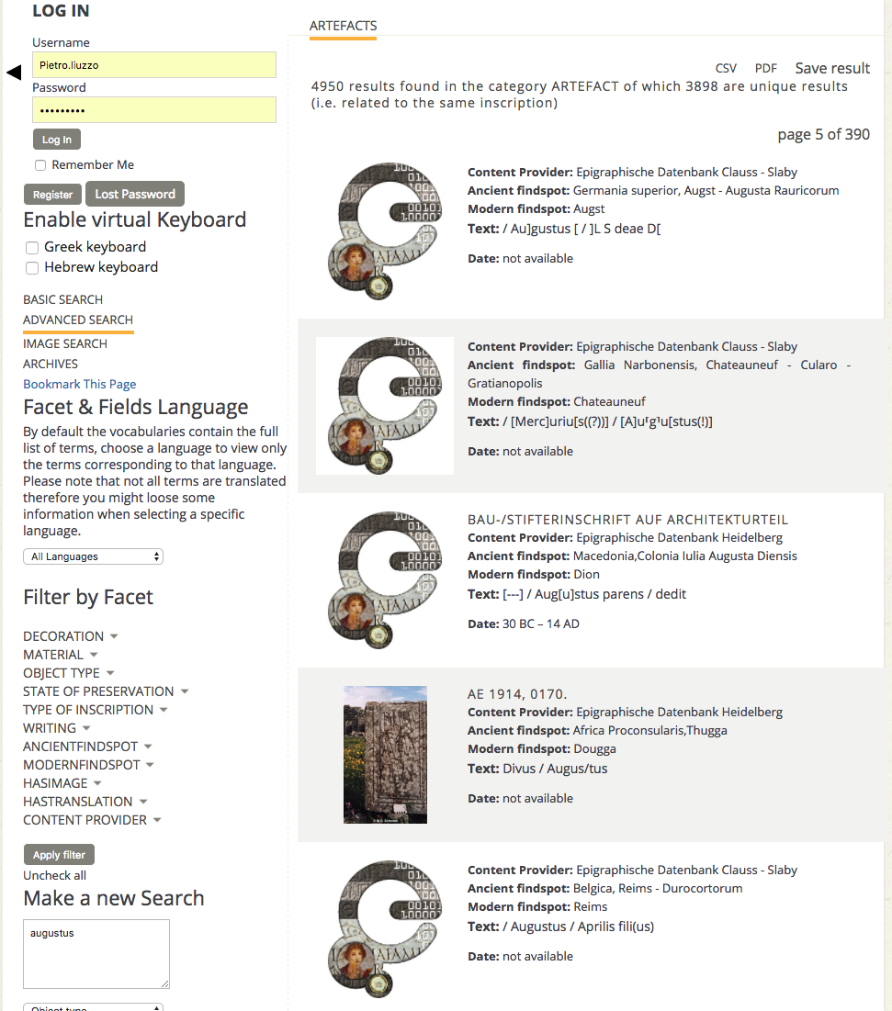

Slide 11
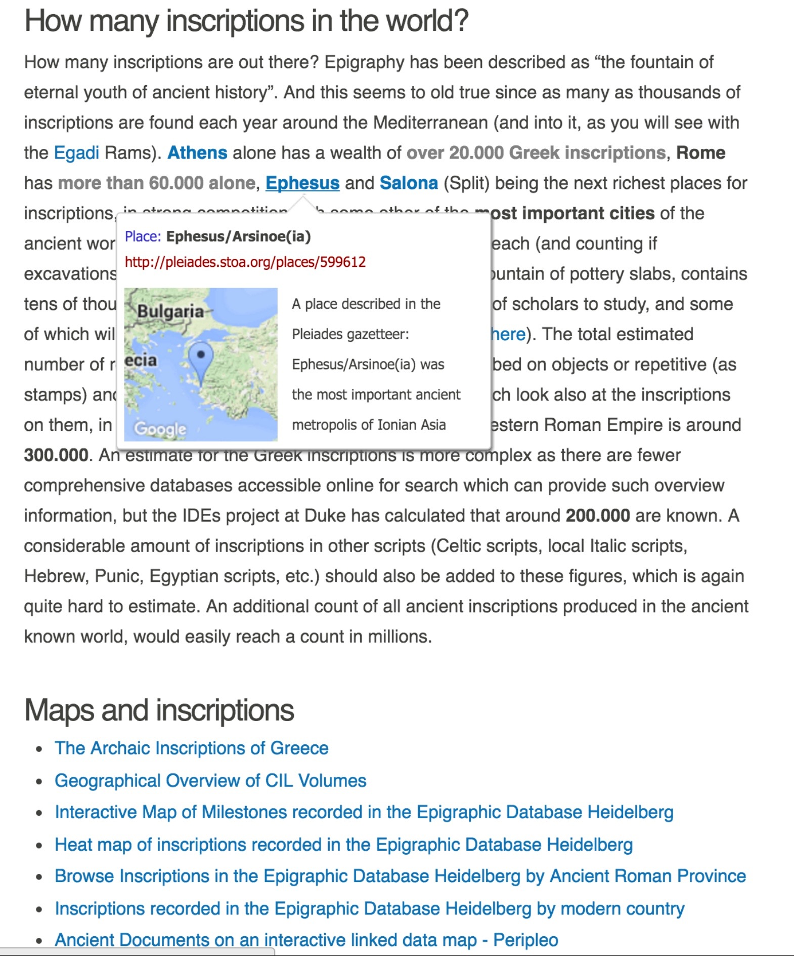
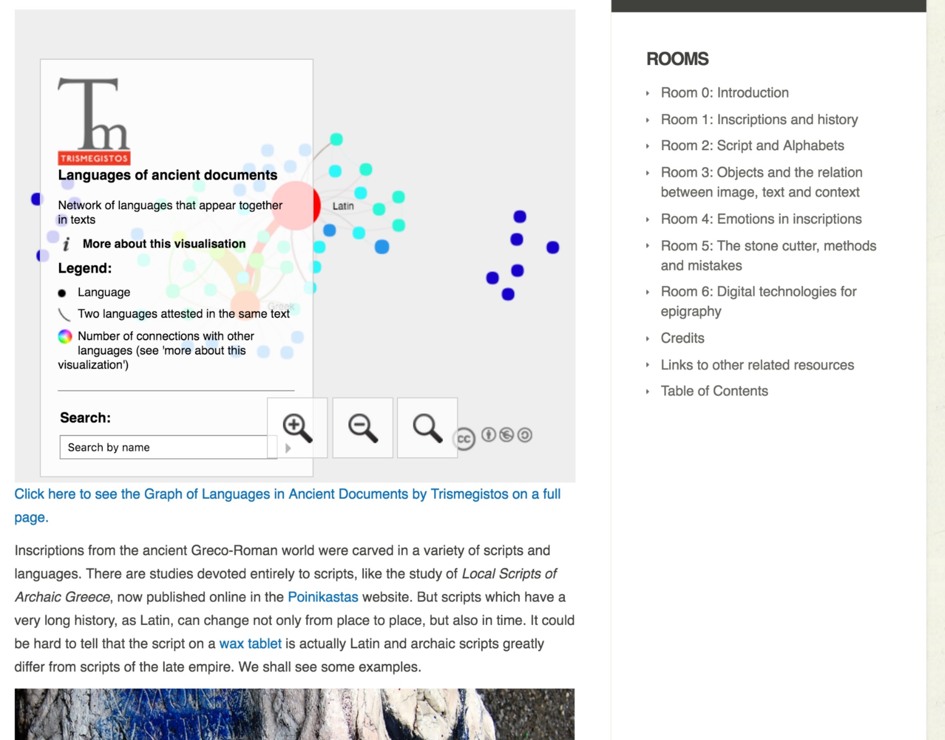
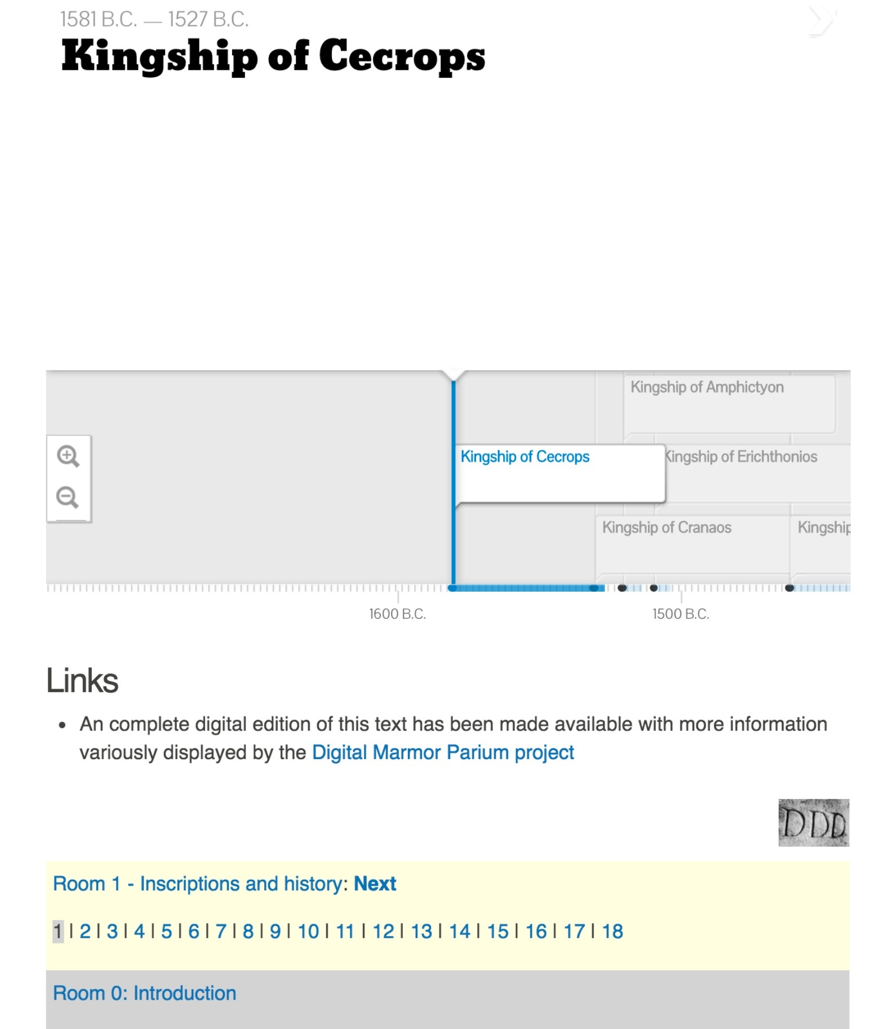
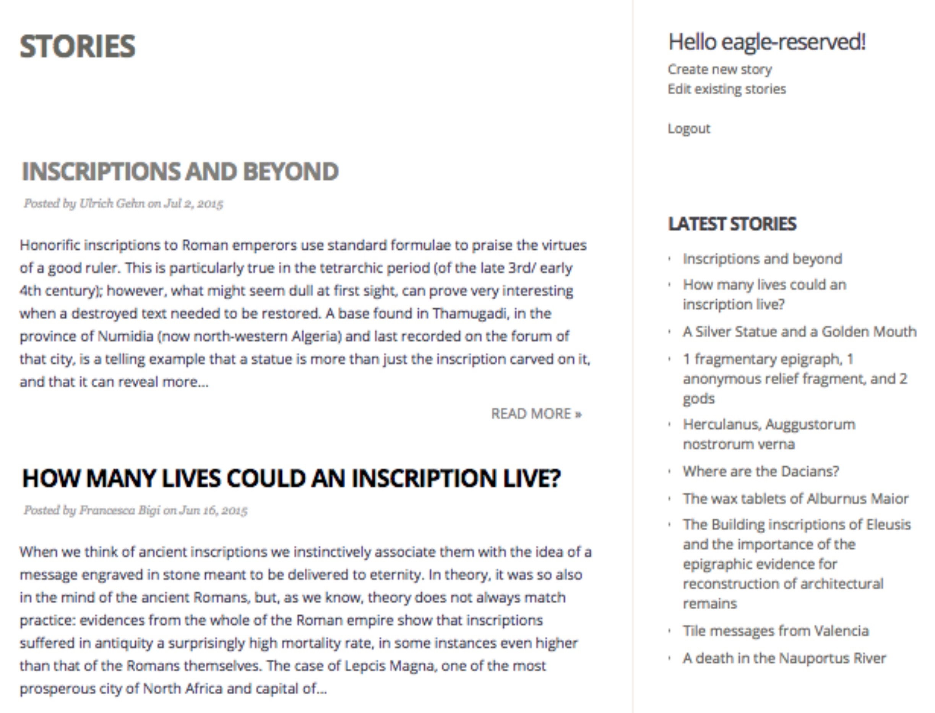

Slide 12
User Needs
Long term sustainability
Quick and nice publication (not necessarily online)
Interoperability, exchange, etc. are all extras.

Slide 13
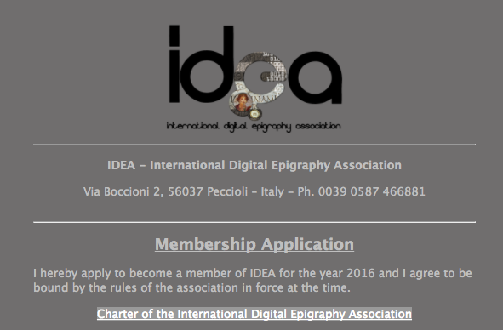
https://form.jotformeu.com/61524210874350

Slide 14
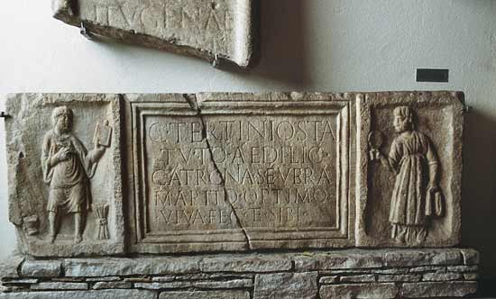
Some general issues with the current models

Slide 15
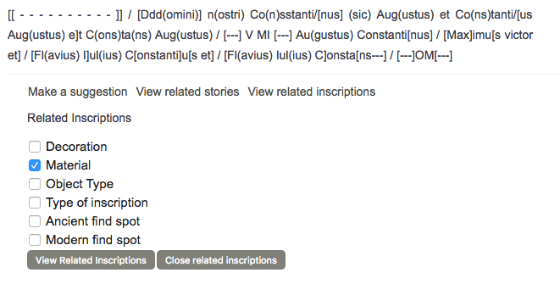

Slide 16
Can I contribute?
Yes, but………. And then…. So if you …… and by the time ….. But don't….. And when you are ready ….
????

Slide 17
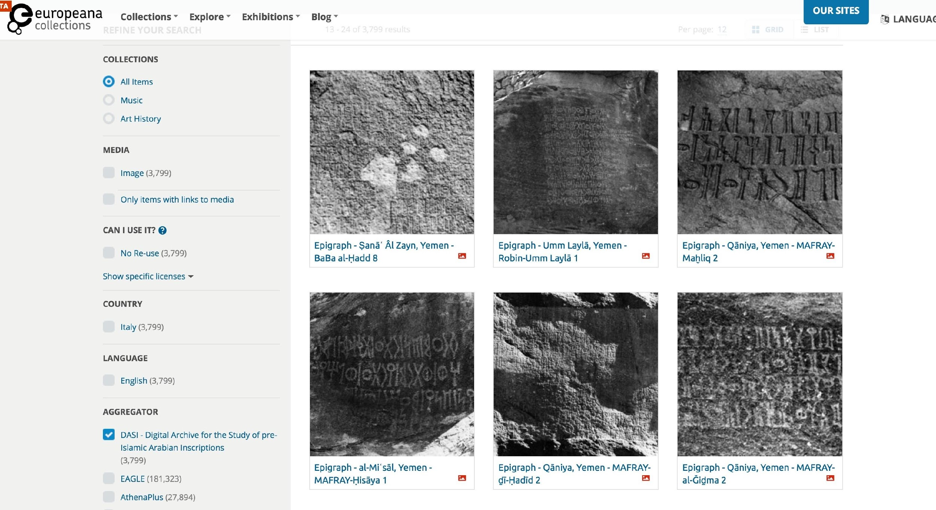
Europeana
Very nice!
Full of possibilities,
Rich in resources
cum grano salis

Slide 18
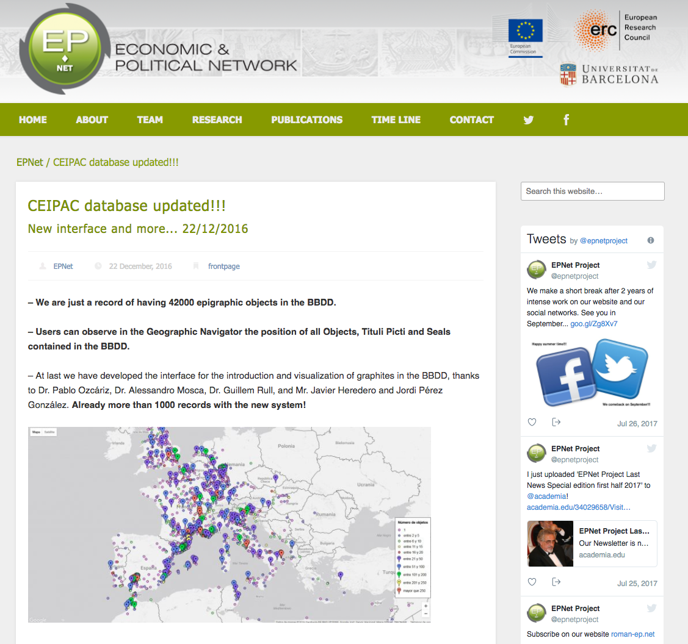
EPNet

Slide 19
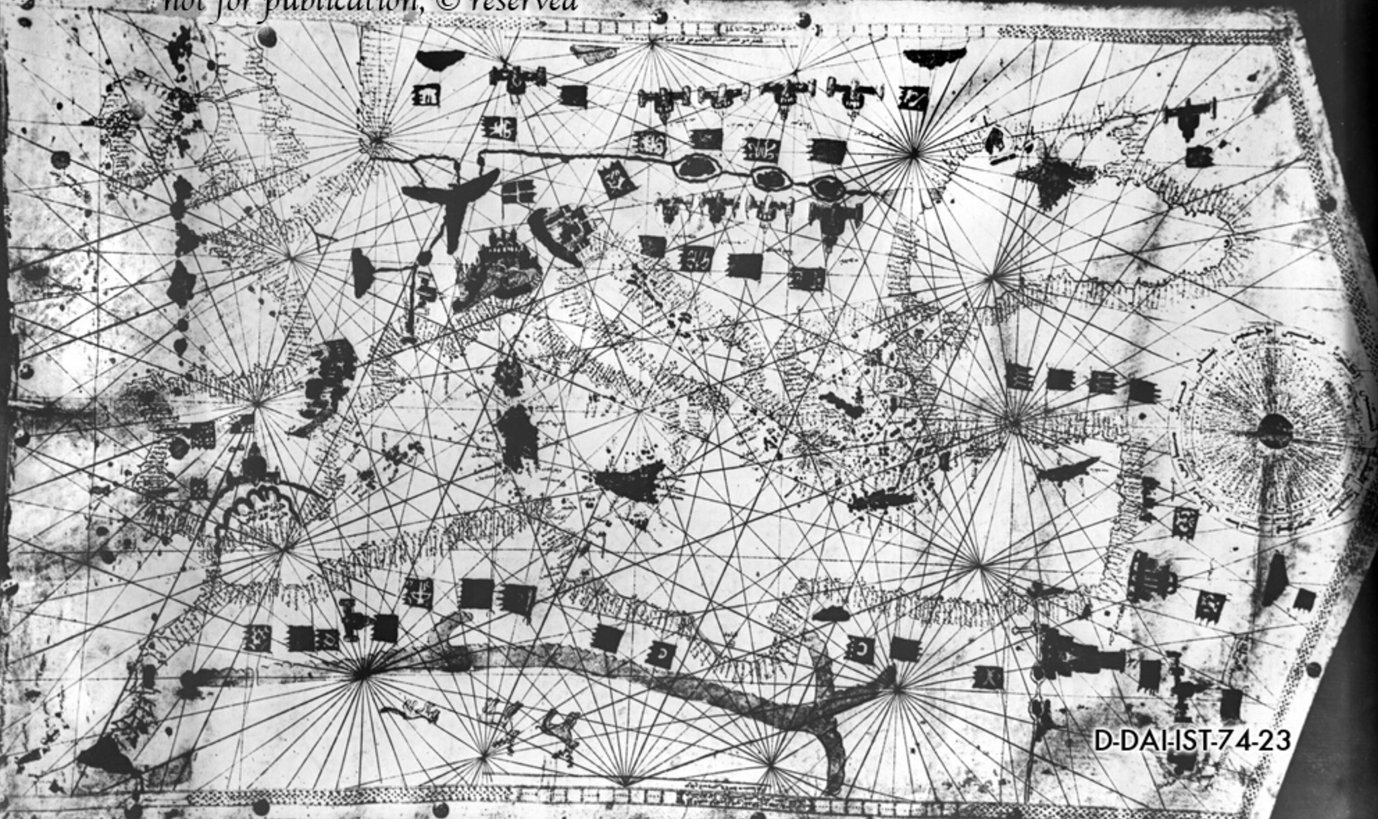
Other Examples and models

Slide 20
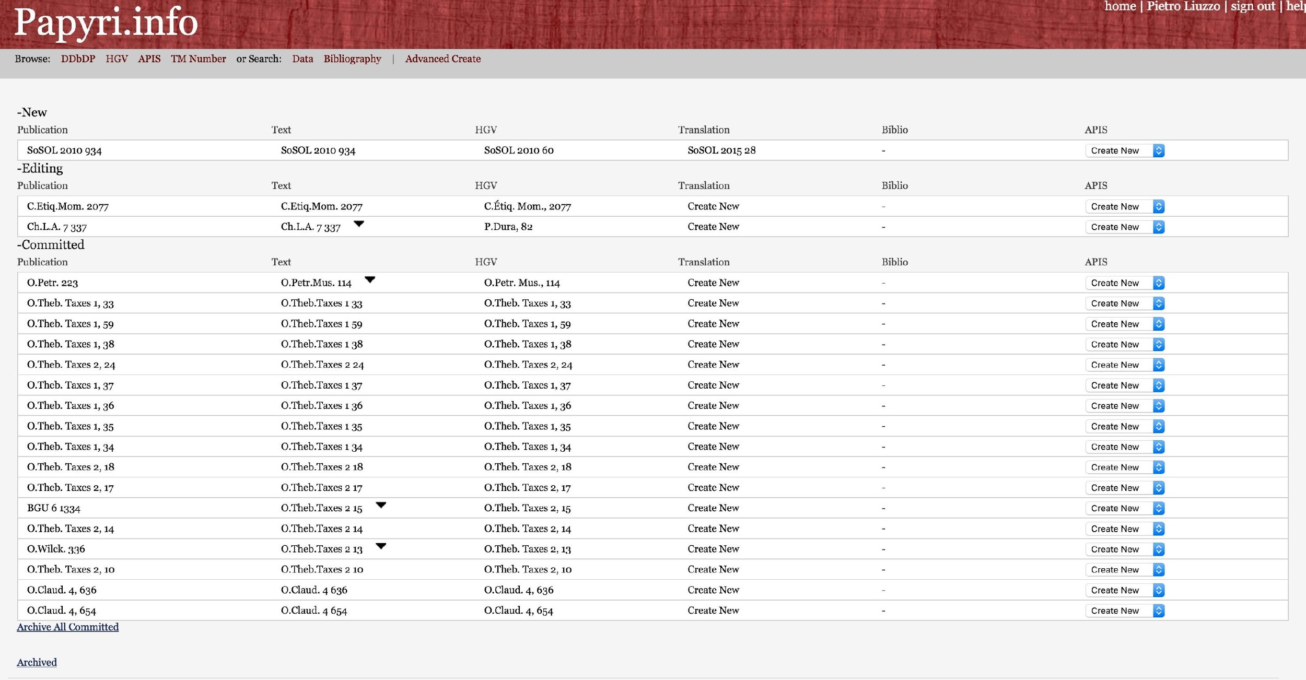

Slide 21
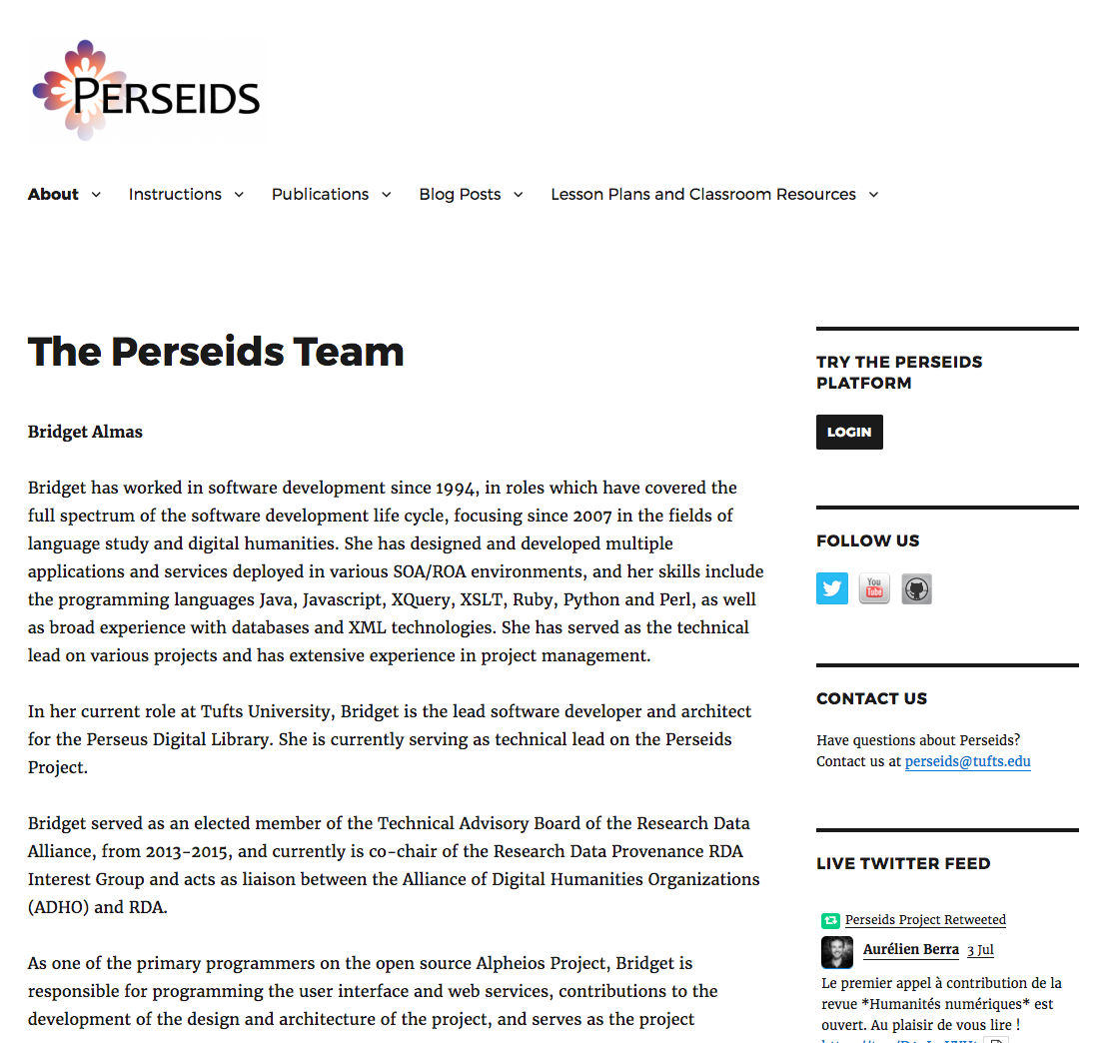

Slide 22
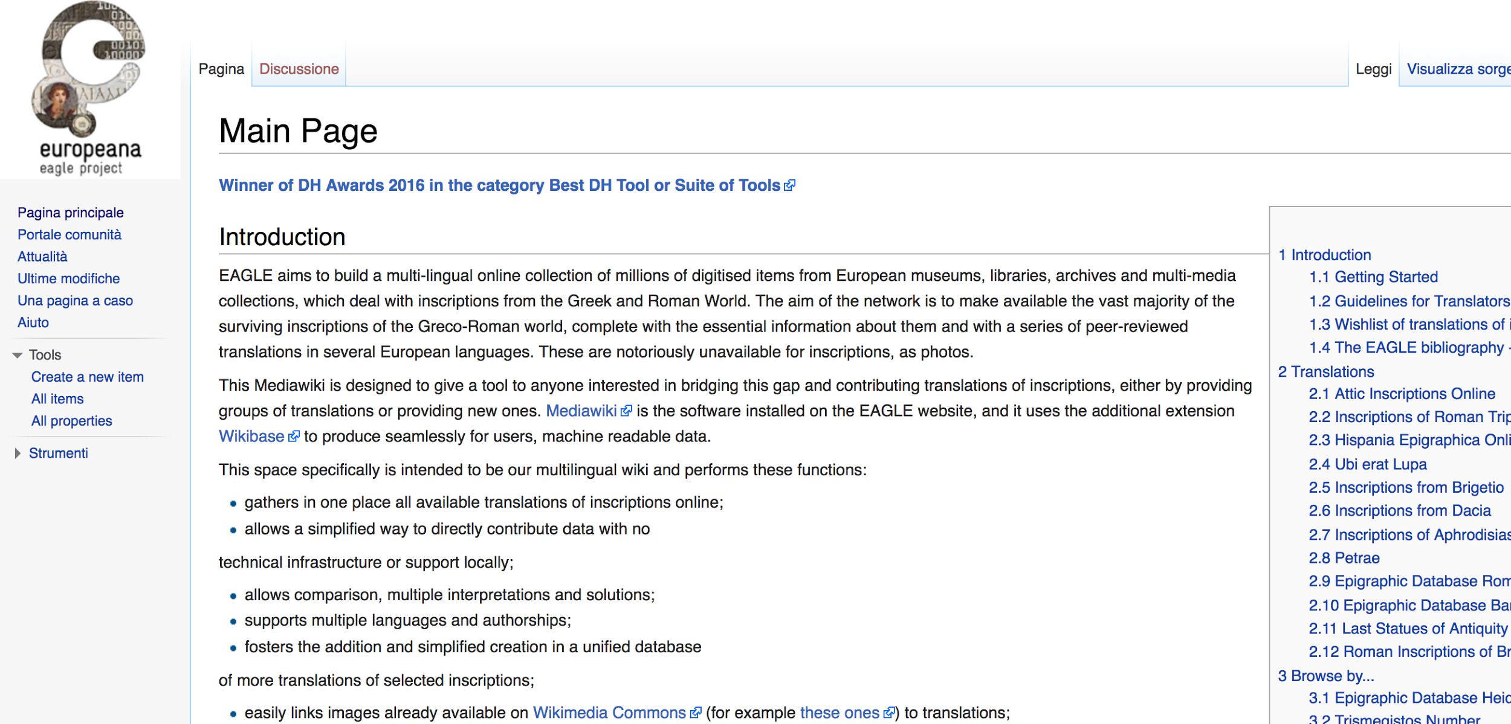

Slide 23
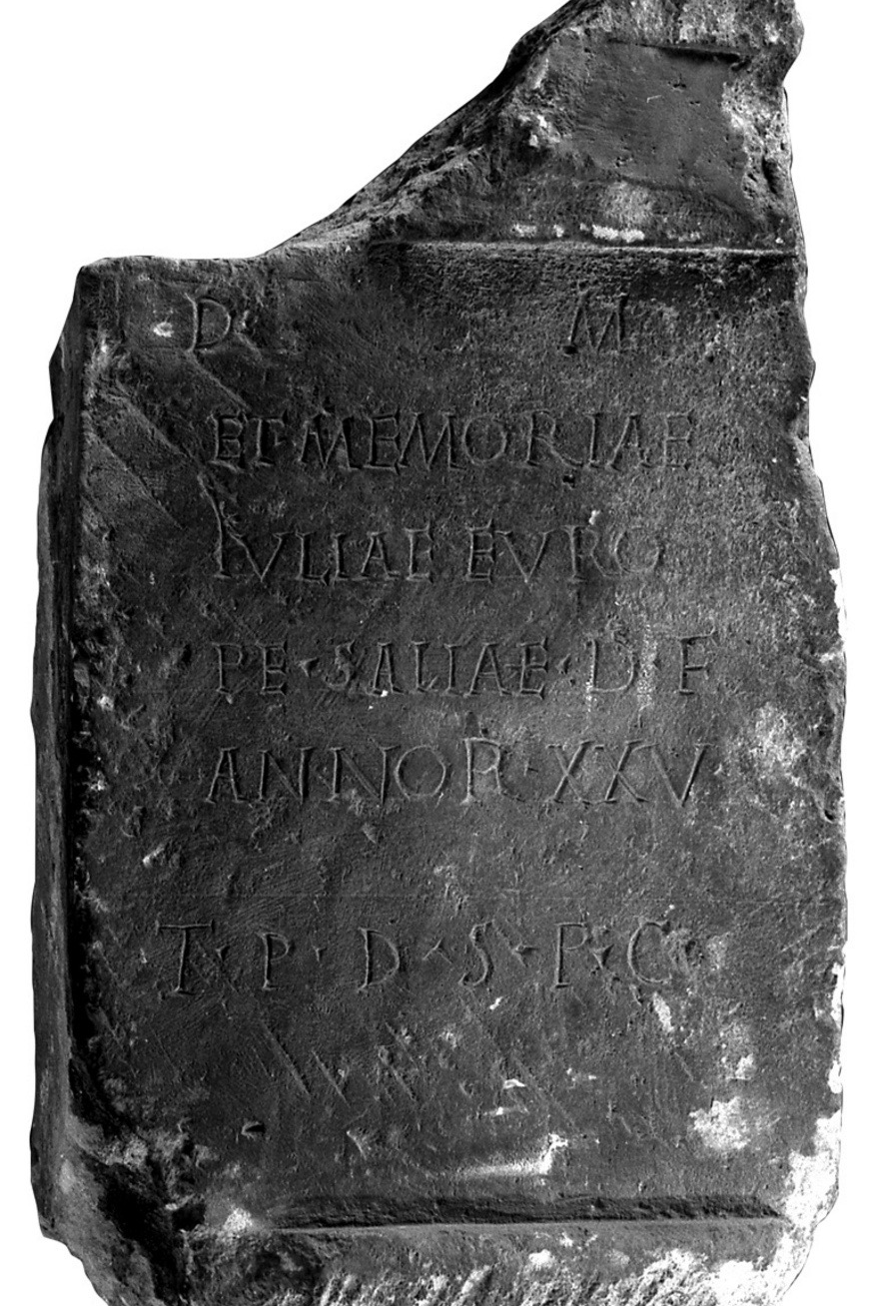
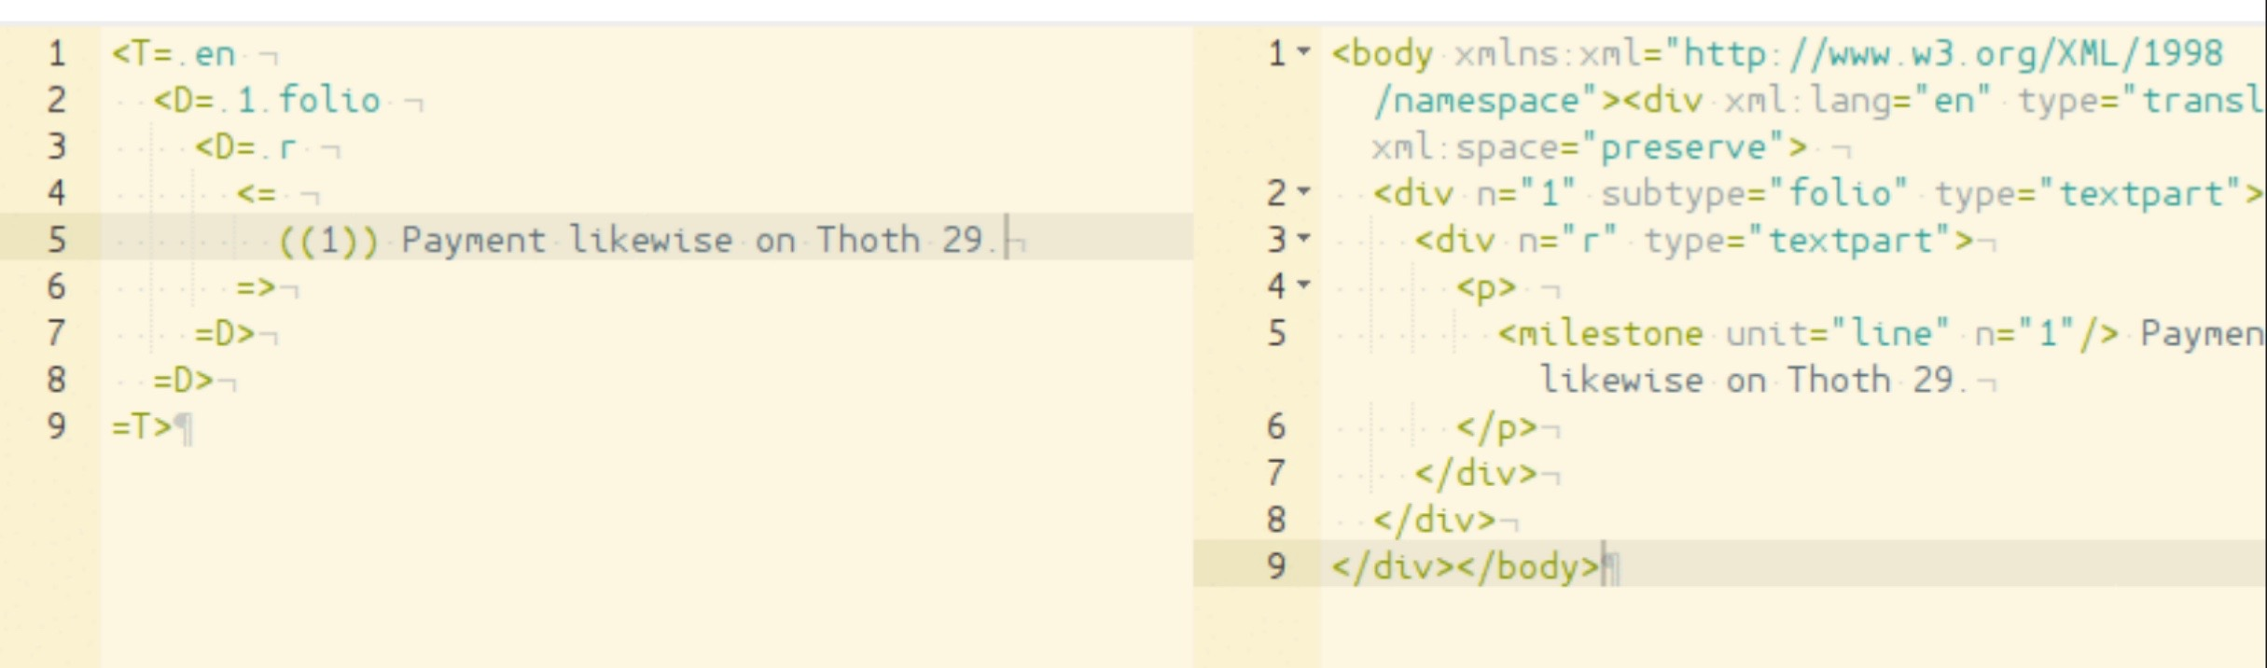
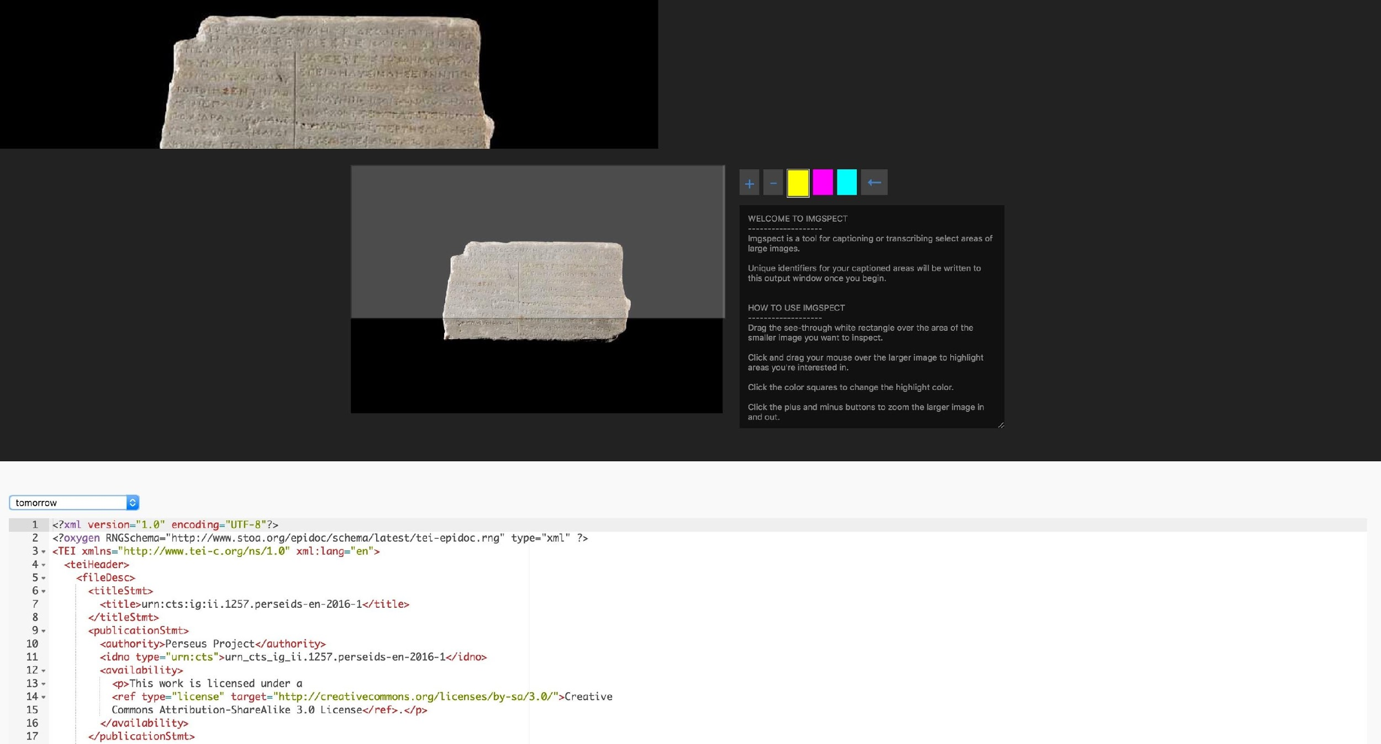
Image and text collaborative annotation

Slide 24
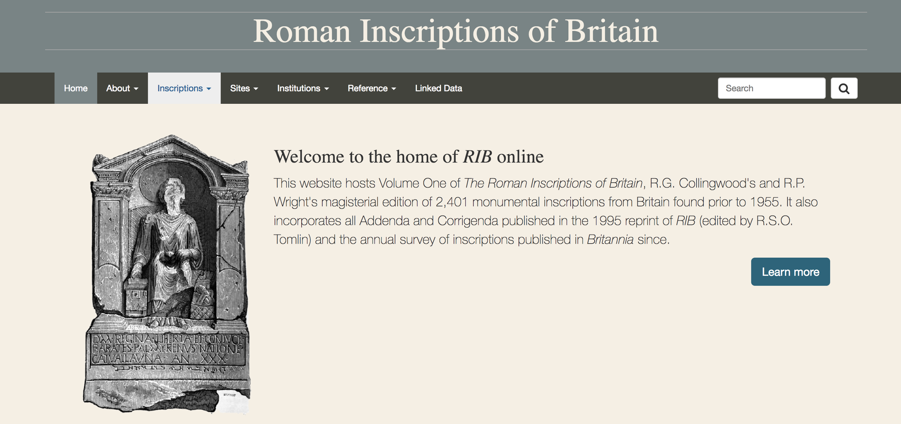

Slide 25
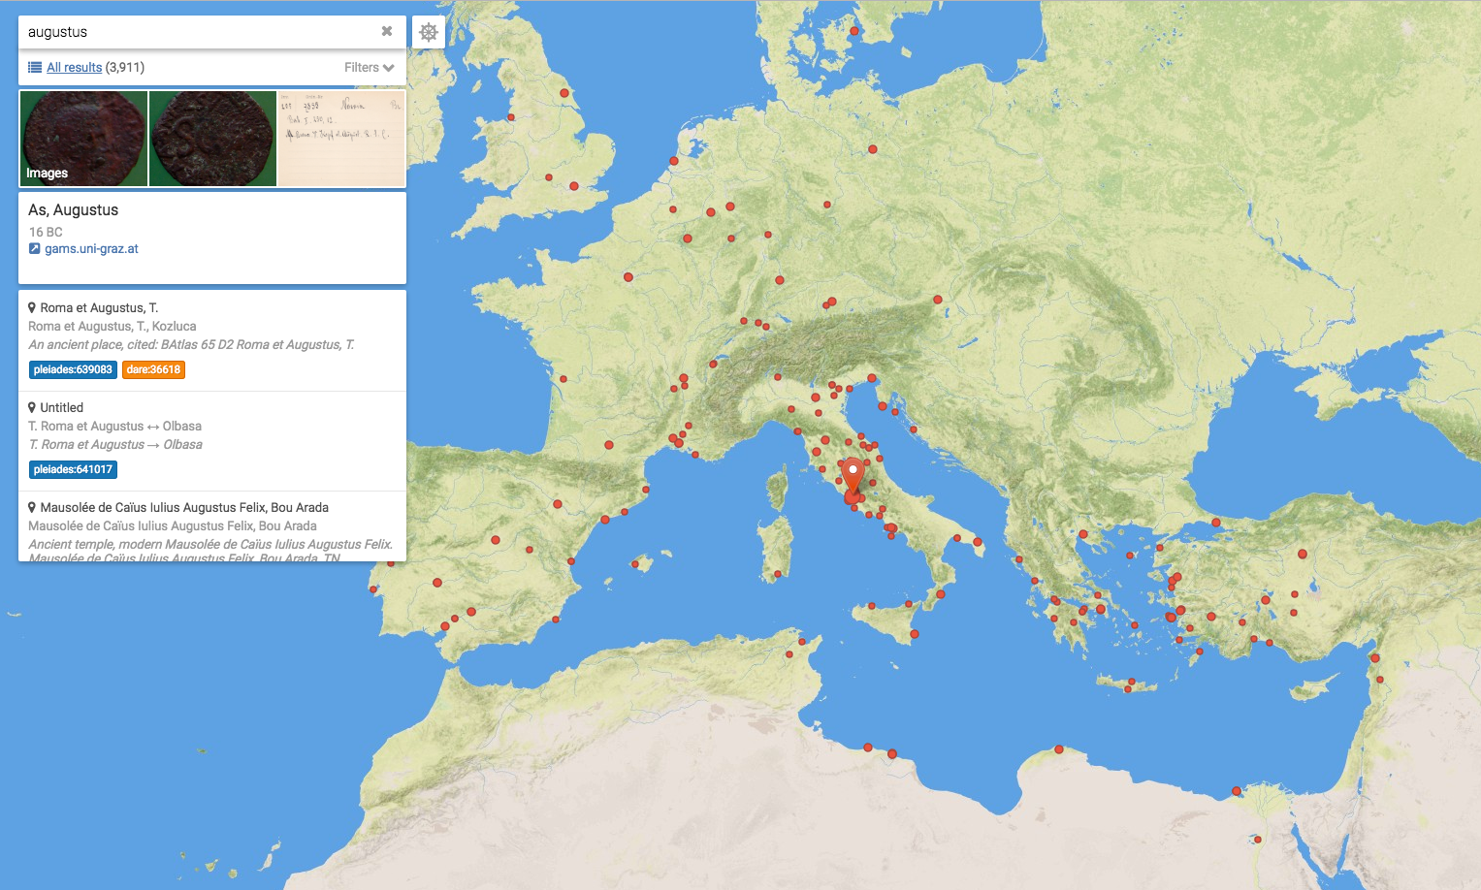

Slide 26
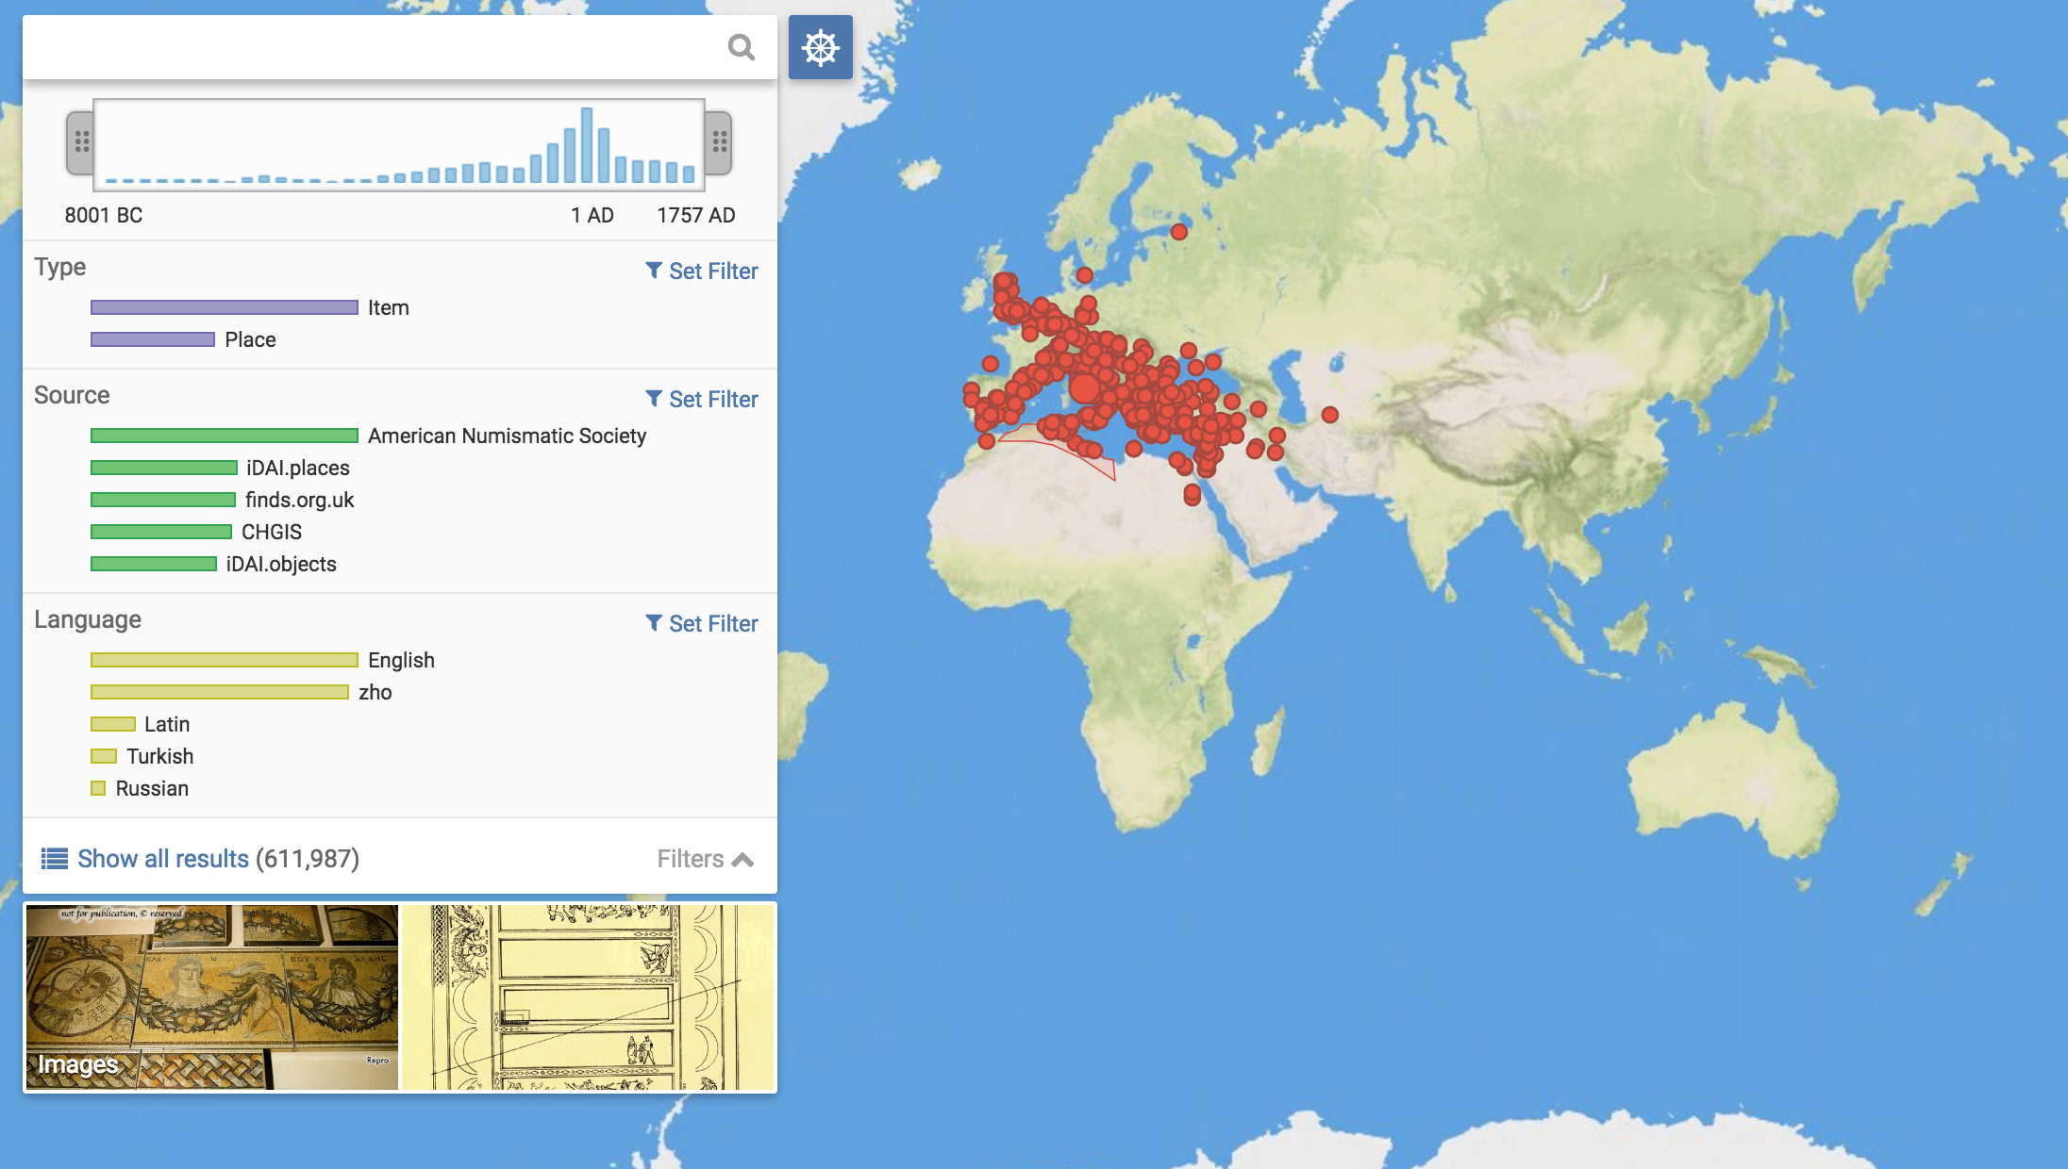

Slide 27
Desiderata kept simple and useful
easily collaborate in editing texts
relate contents to have multiple access points to the same core information collaboratively controlled
Compare, use data comprehensively and expand contents
facilitate storage and new project initiation, fostering diversity but following standards
improve quality and accuracy of research data to be made available for reuse

Slide 28
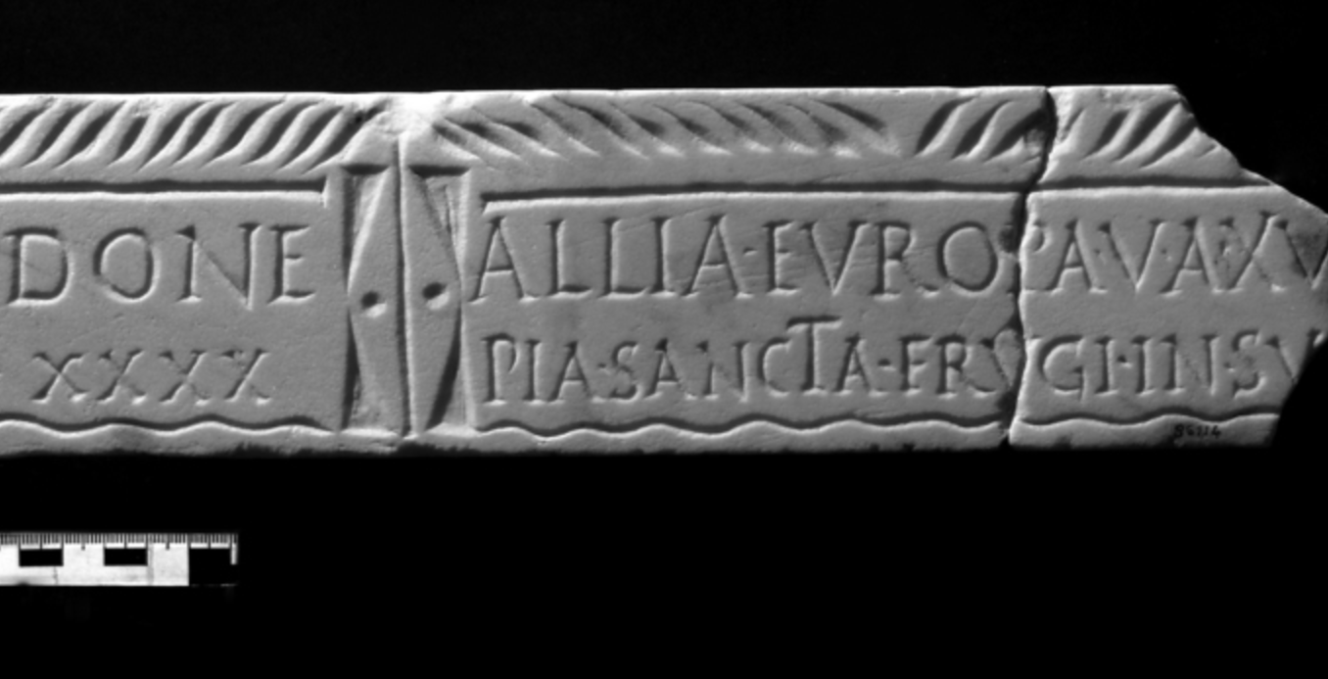
Resisting the temptation to start all again
IDEA API services and Ecosystems of resources

Slide 29
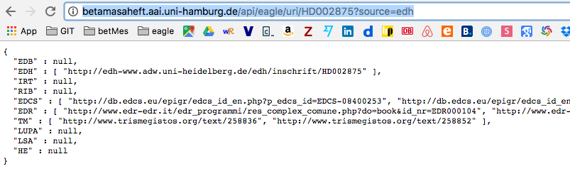
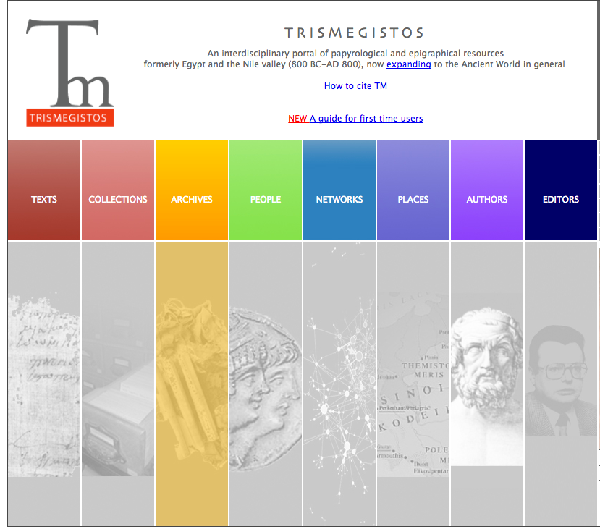
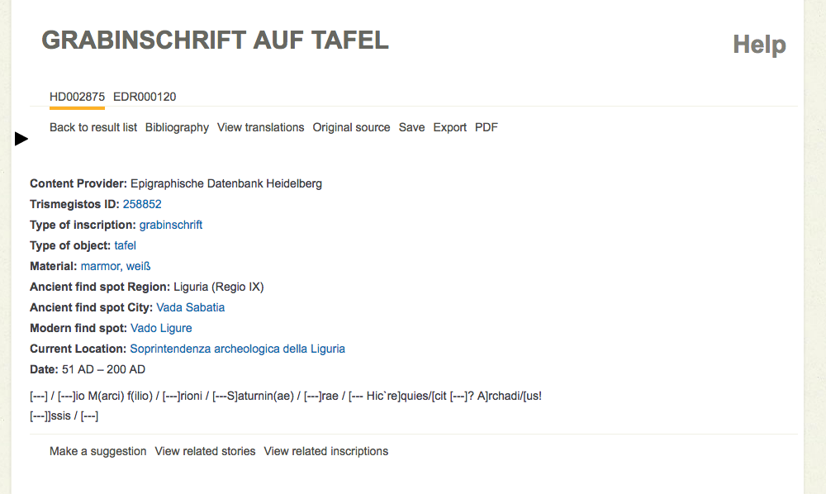
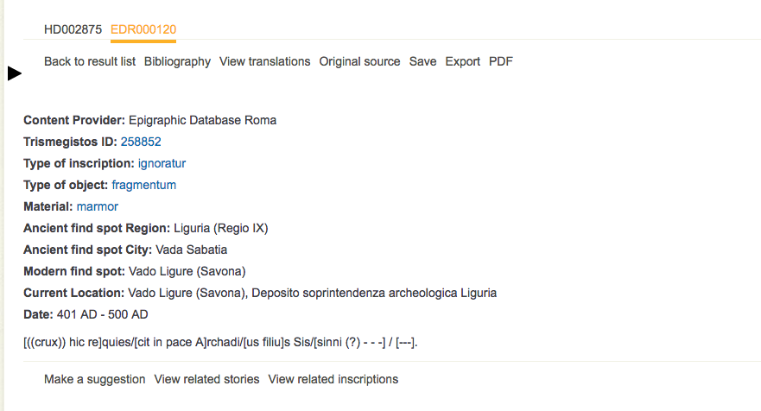
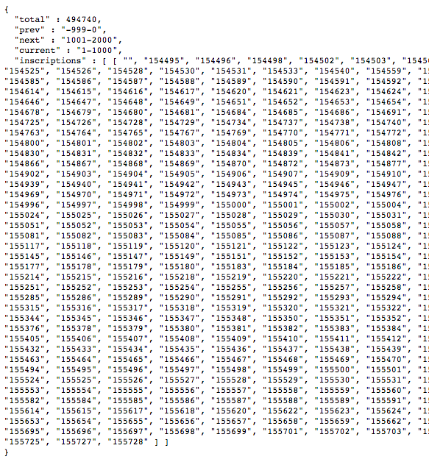
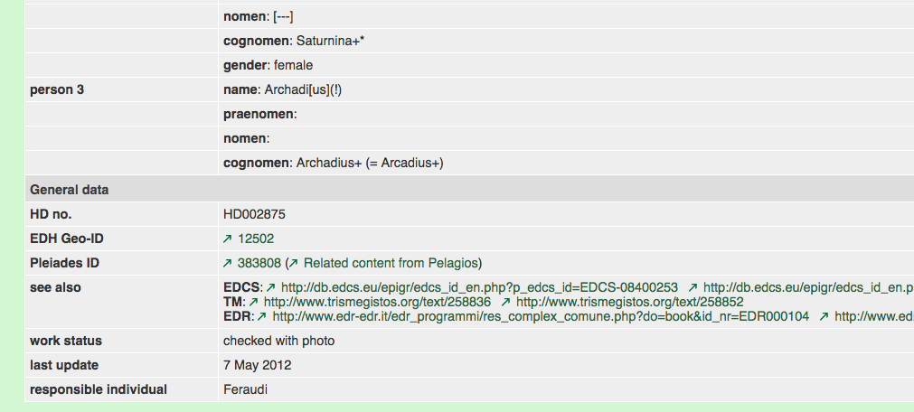
Disambiguation as a web service

Slide 30
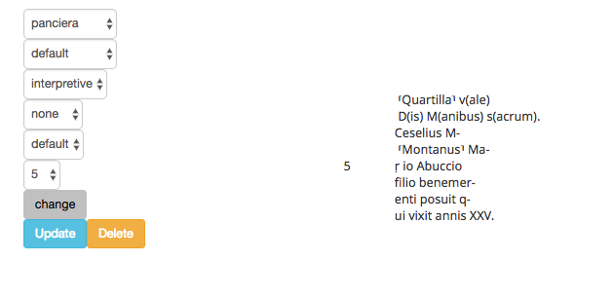
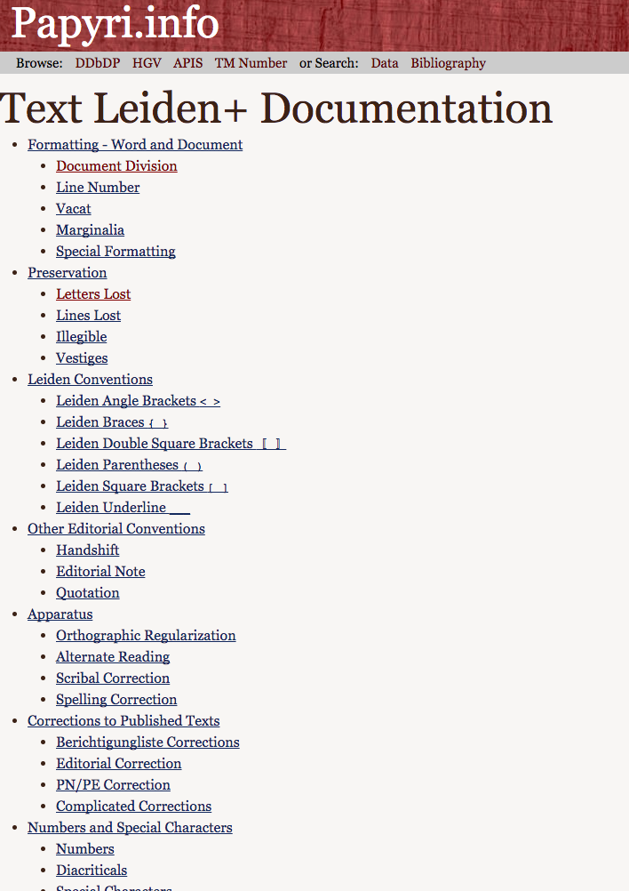
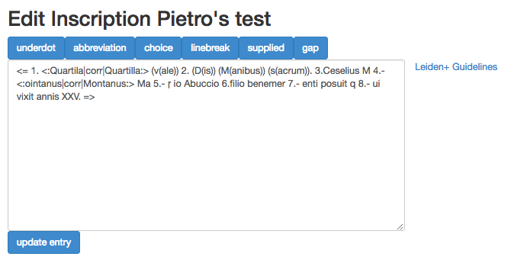

Slide 31
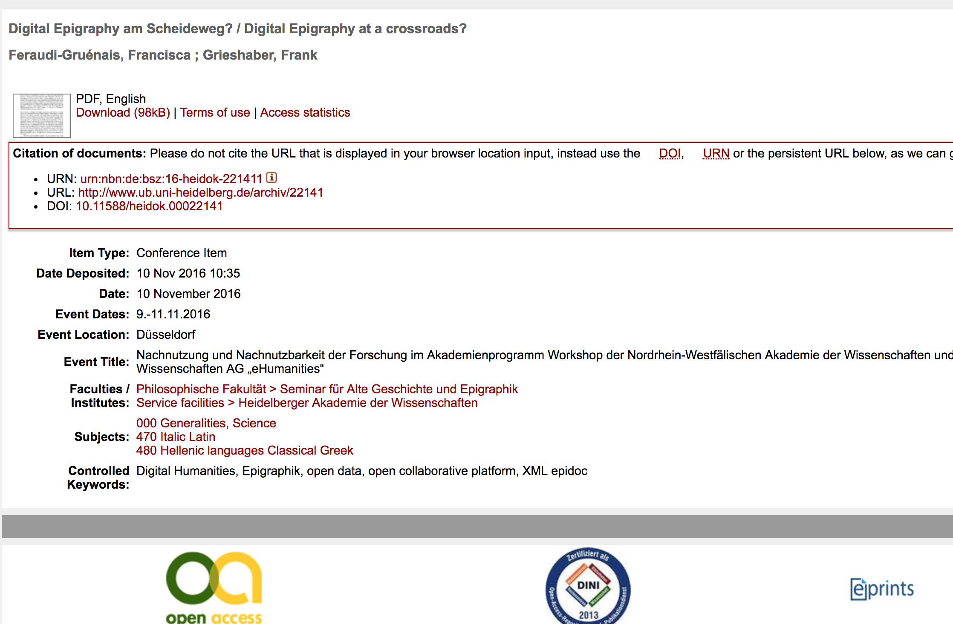

Slide 32
Attempts and failures with CIDOC-CRM
Perhaps we do need to start this all over again…

Slide 33
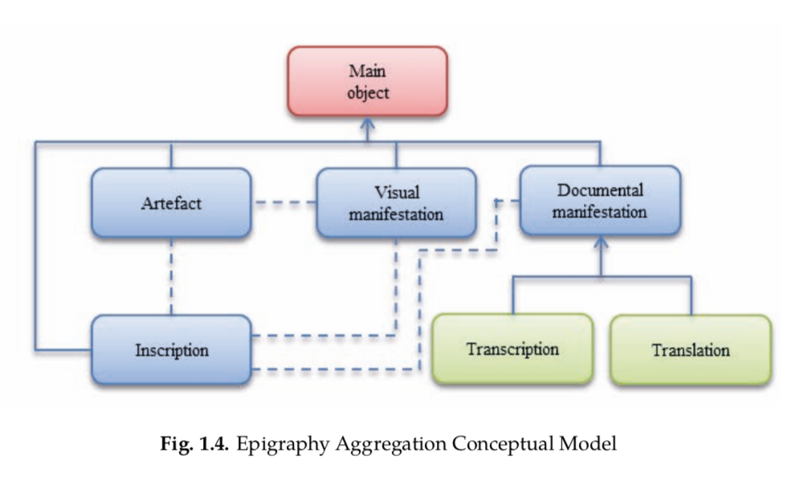
A Conceptual Model for inscriptions
Vittore Casarosa, Paolo Manghi, Andrea Mannocci, Eydel Rivero Ruiz, Franco Zoppi

Slide 34
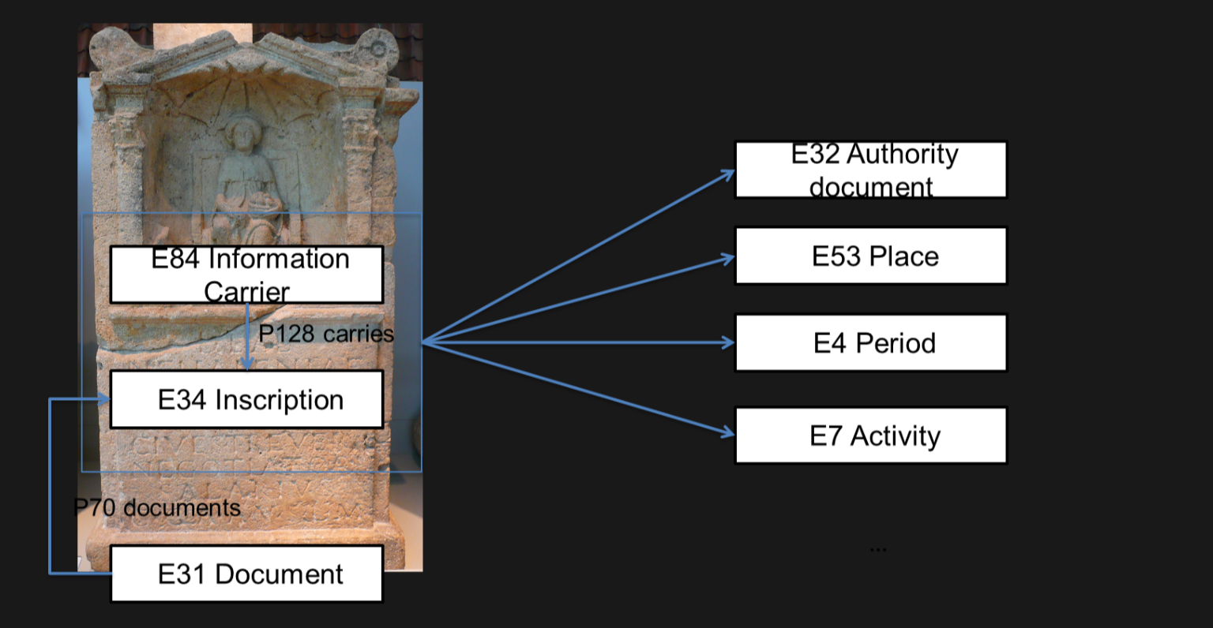
A Conceptual Model for Inscriptions
in order to try and provide a unified view, aimed at improving interoperability and exchange, a conceptual model of epigraphic entities was developed, based on CIDOC-CRM, to help describe in full detail common concepts and their relationships.
Vittore Casarosa, Paolo Manghi, Andrea Mannocci, Eydel Rivero Ruiz, Franco Zoppi

Slide 35
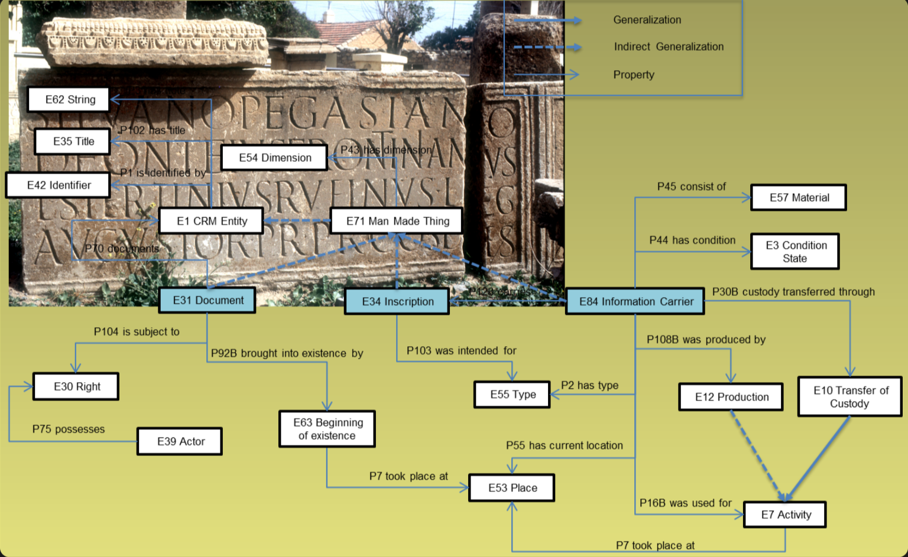

Slide 36
CRMtex: from particular to general
TX1 Written Text
“Subclass of E25 Man-Made Feature intended to describe a particular feature …”
“Epigraph”, “Engraving”: specific types of TX1 and TX2
From a presentation by Achille Felicetti and Francesca Murano ” CRMepi and CRMtex Updates”

Slide 37
CRMtex and text segments
To approximate text parts description
From a presentation by Achille Felicetti and Francesca Murano ” CRMepi and CRMtex Updates”

Slide 38
Why was the EAGLE CIDOC-CRM mapping done?
To have a distinctly object oriented standardized representation of the data beside the more text oriented one offered by the strict and standardized use of the TEI/EpiDoc guidelines
To interact more and better with museums
Because it would have been nice to have it for those using it
Because many member of the network had worked with this CRM before
(CIDOC-CRM 2014 conference paper with Valentina Vassallo and Eydel Rivero Ruiz)

Slide 39
Why was it never used?
The aggregator needed EDM, which already uses CIDOC-CRM classes and properties.
No one asked with a concrete use case to have a CIDOC-CRM only representation of some or part of the data
The user group involved in EAGLE, made of epigraphers in the first place was oriented to editions and databases functional to editions of new texts and the production of new data, a need much more intuitively and easily met by EpiDoc than by the CIDOC-CRM.
None of the museums (few indeed) we worked with insisted anyhow that we should provide some sort of standard CIDOC-CRM

Slide 40
Thank you very much
Pietro Liuzzo
pietro.liuzzo@uni-hamburg.de
IDEA, International Digital Epigraphy Association

