Slide 1
WP 14 Addressing Complexity
CRMarchaeo:
Modelling Context, Stratigraphic Unit, Excavated Matter
Martin Doerr, Sorin Hermon, Gerald Hiebel , Athina Kritsotaki, Anja Masur, Keith May, Wolfgang Smidle, Maria Theodoridou, Despoina Tsiafaki
Plakias, 19-22 August 2013

Slide 2
CRMsci: a Scientific Observation Model
E7 Activity
E13 Attribute Assignment
P2 has type
E55 Type
S5 Inference Making
S4 Observation
O11 observedProperty
S9 Property Type
O10 observed
Inspired by INSPIRE, OBOE
S8 Categorical Hypothesis Building
S6 Data Evaluation
E16 Measurement
P40 observed dimension
E54 Dimension
S7 Simulation-Prediction
O14 assigned dimension
O16 described
P39 measured
S1 Matter Removal
O17 has dimension
S19 Observable Entity
O1 diminished
S2 Sample Taking
E70 Thing
E5 Event
O3 sampled from
S10 Material Substantial
O5 removed
O2 removed
S13 Sample
S11 Amount of Matter
S14 Fluid Body
E18 Physical Thing

Slide 3
CRMarchaeo: Excavation Process Unit
Substance: doing
Identity: Actor, location, temporal coherence
Unity: begin/end (maybe documented)
Intentional, Declarative
P67 refers to
E29 Design or Procedure
E55 Type
SP6 Declarative Place
E7 Activity
P32 used general technique
technique
planned area
P33 used specific technique
E55 Type
Q11 approximates
for drawings before excavating
about where to excavate
SP2 Phenomenal Place
methodology
P32 used general technique
3D excavated area
AP3 excavated
E55 Type
AP6 occupied
P13 destroyed
A1 Excavation Process Unit
P125 used object of type
tools
constellation of Matter that happened
to be at the excavated place
P21 had general purpose
A9 Constellation of Matter
E55 Type
S10 Material Substantial
“find Solomon’s Temple”
AP5 cut
P17 was motivated by
A2 Stratigraphic Unit
AP4 produced surface
AP1 produced
AP2 discarded into
E73 Information Object
preserved part or
total of matter
research question
E26 Physical Feature
“surface”
S11 Amount of Matter
S11 Amount of Matter
“a basket”
“a heap”

Slide 4
CRMarchaeo: Stratigraphic Genesis
A process resulting in the displacement of a limited amount of matter which has settled into a relatively stable form, often a deposition, consisting of homogeneous parts.
E63 Beginning of Existence
E7 Activity
A4 Stratigraphic Genesis
A1 Excavation Process Unit
AP9 took matter from
AP7 produced SU
AP8 produced SI
AP1 produced
S10 Material Substantial
E26 Physical Feature
A3 Stratigraphic Interface
S11 Amount of Matter
A2 Stratigraphic Unit

Slide 5
CRMarchaeo: Discovery Event (draft)
A1 Excavation Process Unit
E5 Event
P9 consists of
E3 Condition State?
“positioning”
A8 Discovery Event
AP14 has found embedding
“state, refinement of position”
AP15 has found object
A7 Embedding
AP11 embedding of
AP12 embedding at
AP13 embedding in
E19 Physical Object
E53 Place
Context Stuff
“the Physical Object has a position at least
up to the point of discovery”
“reference space that is
relative to the Context Stuff”

Slide 6
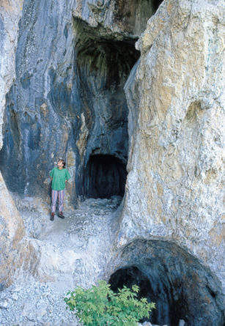
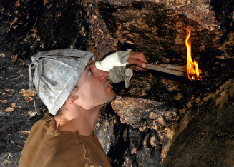
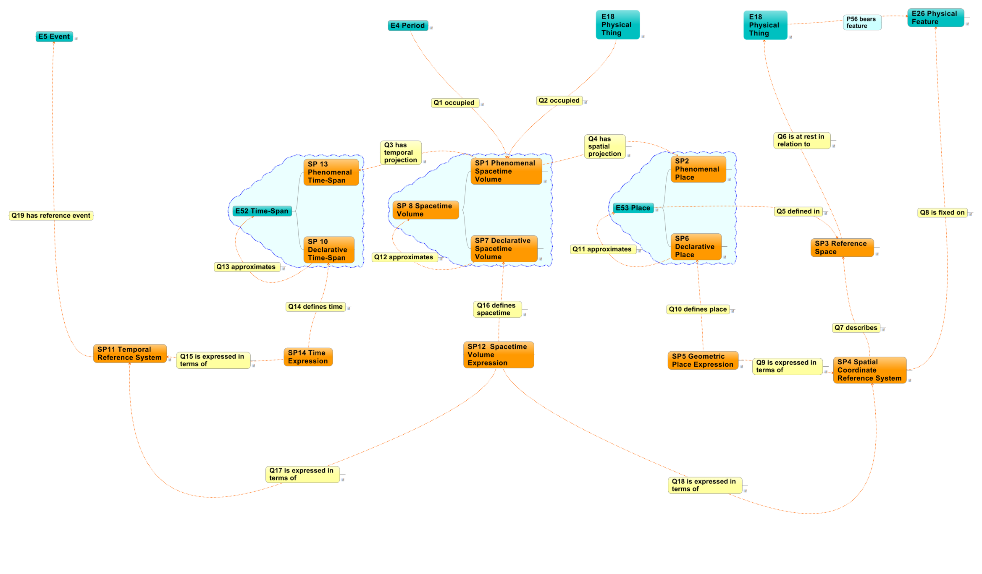

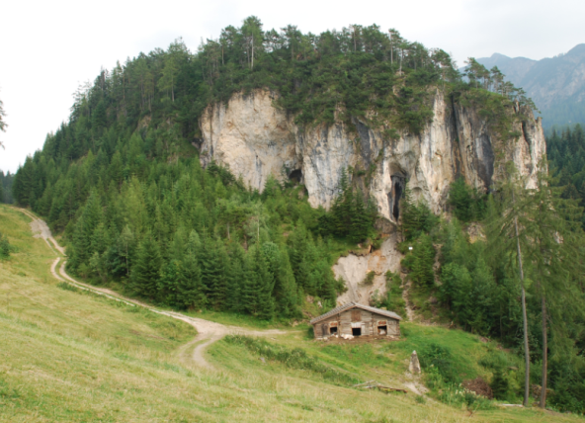
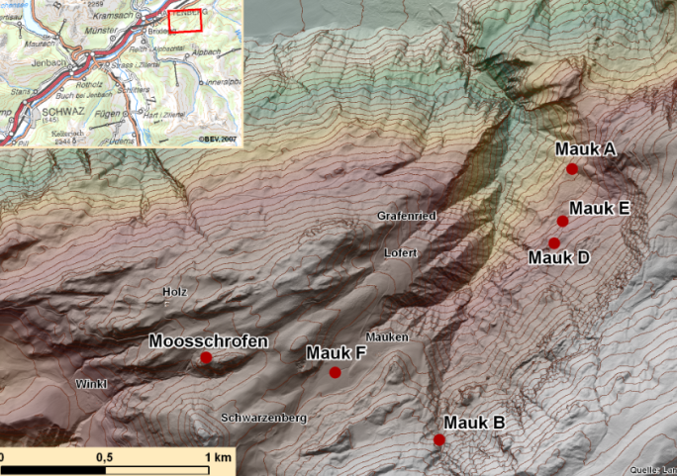
  Spatiotemporal extension CRMgeo
  1.1. Real world phenomena
  1. Phenomenal world
1.2. Space and time occupied by real world phenomena
2.2. Space and time defined by human expressions
  2. Declarative world
2.1. Human expressions to define space and time
(13.433 48.343,….
2780±35BP

Slide 7
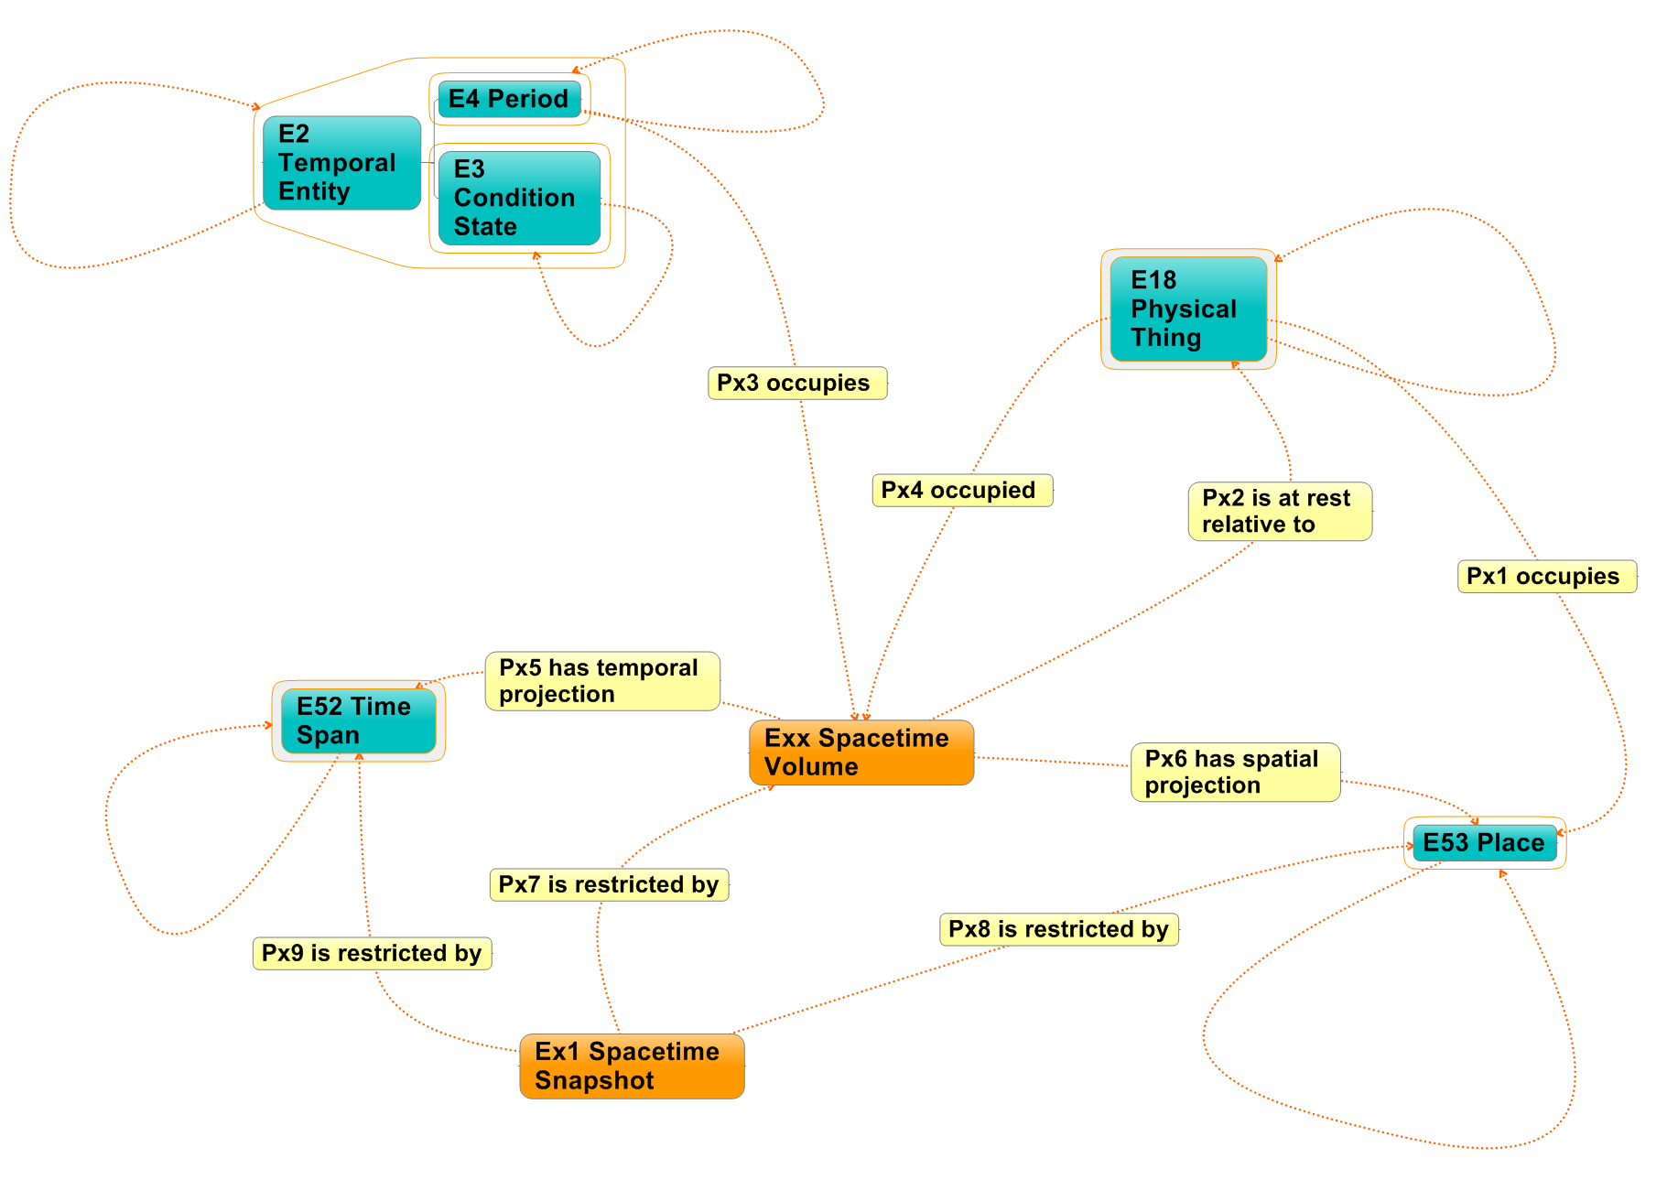

Slide 8
