Slide 1
Methodological tips for mappings to
CIDOC CRM
Maria Theodoridou, George Bruseker, Maria Daskalaki, Martin Doerr
FORTH - Institute of Computer Science
{bruseker, martin, maria}@ics.forth.gr
daskalakim@hotmail.com

Slide 2






The CIDOC Conceptual Reference Model (ISO 21127:2006) has been chosen as the core model for use in several Cultural Heritage projects
http://www.researchspace.org/
http://wiss-ki.eu/
http://www.parthenos-project.eu/
http://www.ariadne-infrastructure.eu/
http://americanartcollaborative.org/
http://www.itn-dch.eu/
Notes:
It aims to support the efforts of several EU projects in the domain of cultural heritage, digital humanities, linguistics, history and archaeology. The goal of PARTHENOS is to create a common ecosystem to support Humanities, Language and Cultural Heritage Research through smart and innovative tools, and to facilitate the use of digital technologies and methods in the sector.

Slide 3
CIDOC CRM extension suite
CIDOC-CRM
Few concepts,
high recall
Event
Thing
happened at
Actor
FRBRoo
was present at
Special concepts,
high precision
CRMinf
CRMsci
CRMgeo
PRESSoo
CRMba
CRMarchaeo
CRMdig

Slide 4
Mapping one schema to another
Foundational activity
    Convert data stored in existing (source) schemata to an expression in a form (rdf) compatible with CIDOC CRM and its extensions (target schema)
    It’s not a matching exercise, it’s not matching of terms, but interpreting relations
    It is a consideration of the meaning of the source and a re-expression of that in the target
    Common point of reference in interpreting source and target as being descriptions of the same reality
Goal
    Preserve as much as possible the initial ‘meaning’ of the data
    Enable information exchange and integration between heterogeneous sources of cultural heritage information

Slide 5
Mapping one schema to another
Source Domain:
Coin
Target Domain:
E22 Man-Made Object
Constant Node:
E58 Measurement Unit
gr
P43 has dimension
Source Path:
weights
Target Path:
Intermediate Node:
E54 Dimension
P91 has unit
P2 has type
Constant Node:
E55 Type
P90 has value
weight
Source Range:
WEIGHT
Target Range:
Literal

Slide 6
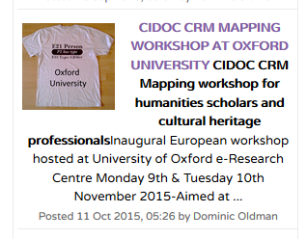
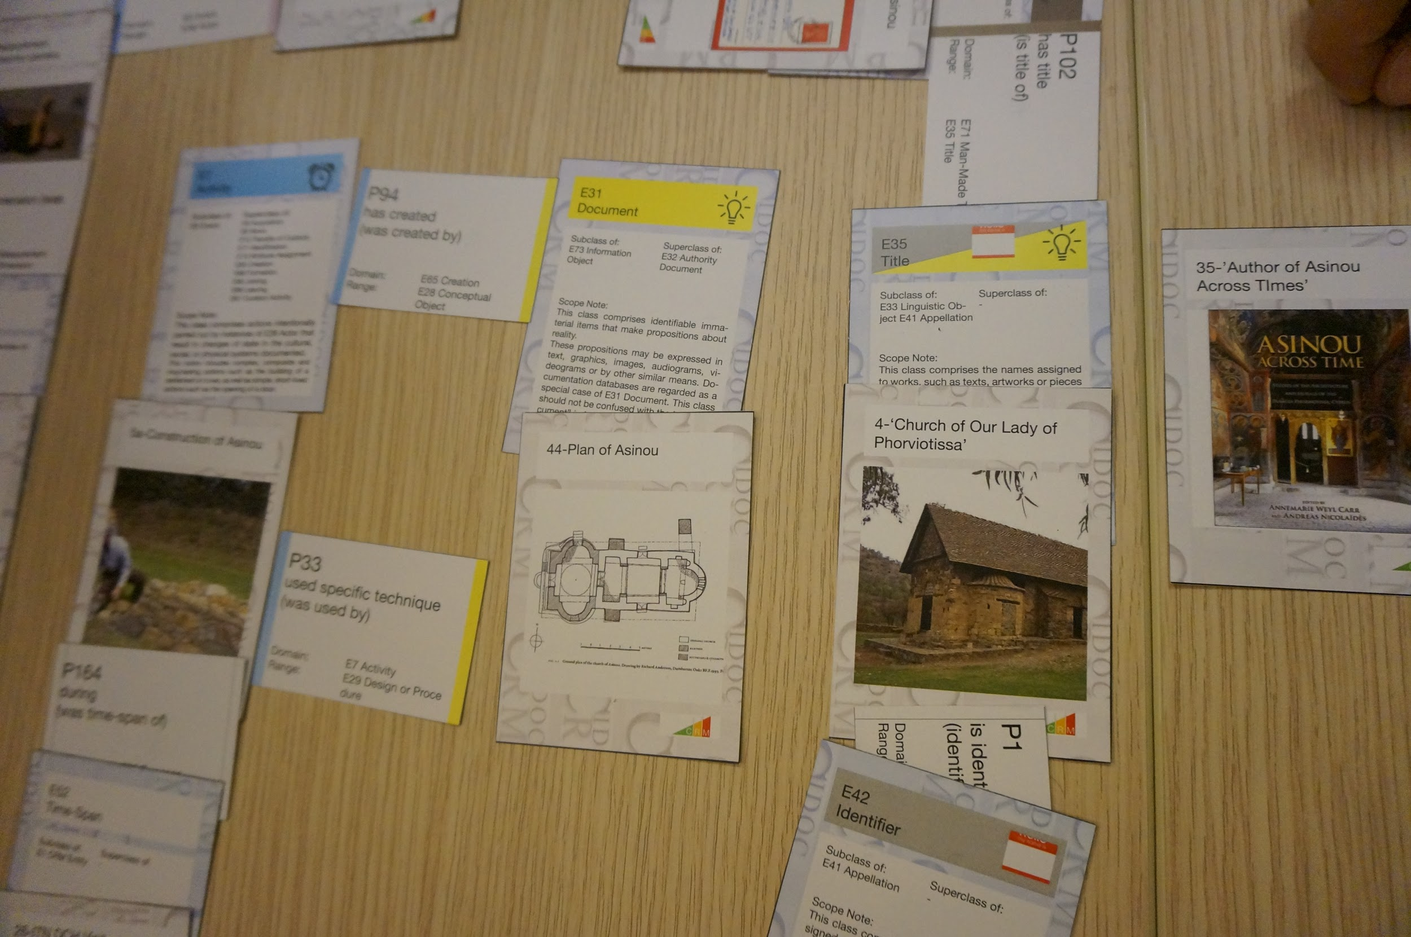
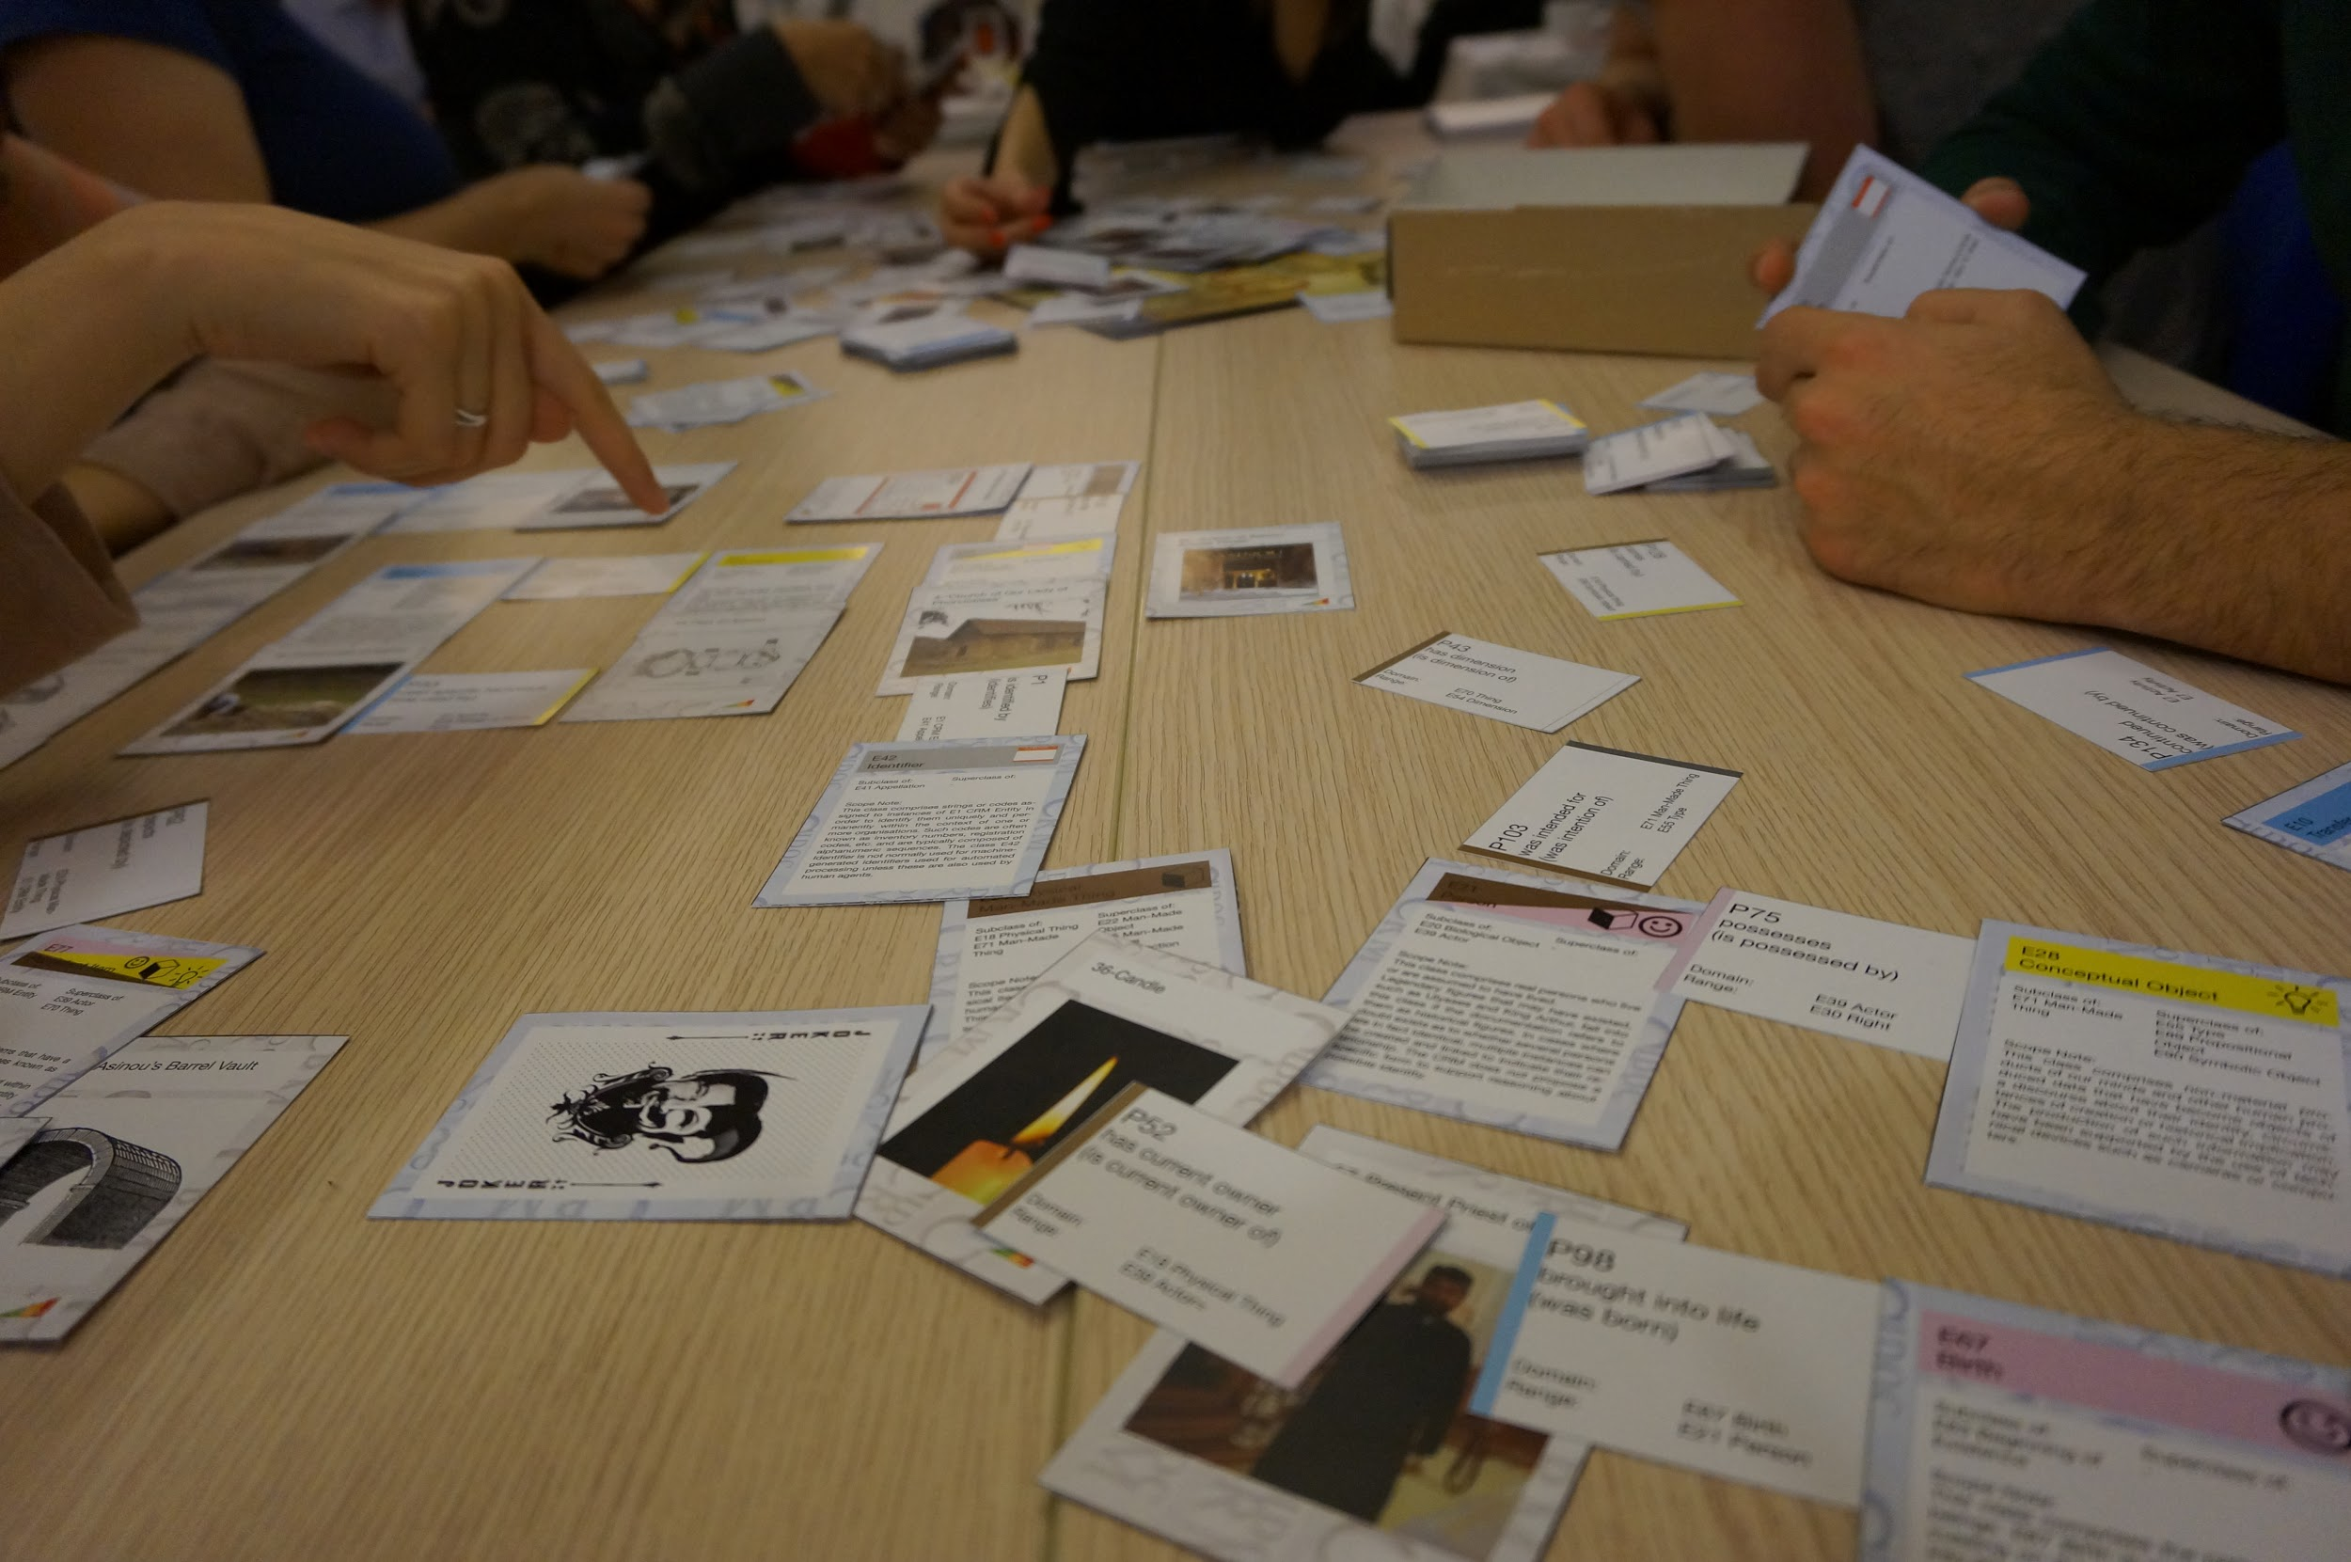
Mapping & Training Activities
Several mapping activities were initiated trying to convert existing schemata of Cultural heritage data to CIDOC CRM
    ARIADNE: diverse archaeological databases
    Research Space: British Museum and Rijksmuseum data
Training activities
    Research Space Workshops in Yale and in Oxford Universities
    ITN-DCH CIDOC CRM board game
    ARIADNE Summer Schools and Transnational Access

Slide 7
General Mapping Principles & Approach

Slide 8
Define primary domain
Define primary domain - typically represents the focus of interest
Identify the CIDOC CRM class that models it best
Is there a need for a new Class?
Do we need properties that are not available in CIDOC CRM?
The introduction of a new class should comply with the “Minimality” modelling principle of CIDOC CRM (CIDOC CRM, 2015):
“A class is not declared unless it is required as the domain or range of a property not appropriate to its superclass, or it is a key concept in the practical scope”

Slide 9
Define primary domain
Example: Two approaches for defining Coin
  Introduce a specialization of E22 Man-Made Object:
  Exx Coin subclass of E22 Man-Made Object
  Define the Type of E22 Man-Made Object:
  E22 Man-Made Object. P2 has type: E55 Type = “Coin”
To choose we need to answer the question:
Does the new class Coin have new properties that are
not available in E22?
Create a new Class, work with it and if it comes out that it has no new properties, revert to its CRM superclass

Slide 10
Practical Mapping Tips

Slide 11
Common database fields:
Local identifiers
We map local identifiers in relational database tables explicitly only if these identifiers are visible in the user interface and used in other documents as well. Alternatively, we use the local database identifiers only for generating URIs for the record instance, if the thing identified belongs to our holdings or was created/invented by us. Otherwise we better use a global authority.
Golden rules for identifiers:
they should be widely known for the item they identify
they should be related to those who can confirm the relation between the identifier and the identified (museum object identifiers)

Slide 12
Common database fields:
Local identifiers
only a local URI:
or
a local URI and an Identifier:
<COIN>
<ID>627</ID>
<COUNTRY_ID>1</COUNTRY_ID>
<FIND_SPOT_ID>242</FIND_SPOT_ID>
<FIND_MANNER_ID>2</FIND_MANNER_ID>
………………..
</COIN>
E22 Man-Made Object
http://www.oeaw.ac.at/coins/627
E22 Man-Made Object
E42 Identifier
http://www.oeaw.ac.at/coins/627
http://www.oeaw.ac.at/id/627
P1 is identified by

Slide 13
Common database fields:
Local identifiers
Whenever possible use a global authority
El Greco (Dominico Theotokopoulos)
VIAF:
or
GETTY ULAN:
E39 Actor
http://viaf.org/viaf/100215785/
E39 Actor
http://vocab.getty.edu/ulan/500010916

Slide 14
Common database fields:
Appellations
Label and Appellation are alternative implementations in rdf
For contemporary names (not historical) the use of rdfs:label + language attribute is sufficient
We use the E41 Appellation class only if there is need to assign some property to the Appellation

Slide 15
Common database fields:
Yes/No fields
Yes/No fields of relational databases are typically mapped to types.
Table name: Gefaesse (vessels) (E22 Man-Made Object)
Field name: GefFragmen: yes/no field
    If value of field is yes
    then Gefaesse.GefFragment maps to E55 Type fragment
E22 Man-Made Object
E55 Type
Vessel 1
P2 has type
fragment

Slide 16
Common database fields:
Implicit and contextual information
All the hidden constants, the common context information of a db, can be added as constant node information at a suitable object type, typically in the domain node.
Quite often semantics are built into
  the User Interface
  the queries
  values of the identifiers

Slide 17
Common database fields:
Implicit and contextual information
OEAW
Constant Node:
E40 Legal Body
Source Domain:
Coin
Target Domain:
E22 Man-Made Object
P50 has current keeper
Constant Node:
E58 Measurement Unit
gr
P43 has dimension
Source Path:
weights
Target Path:
Intermediate Node:
E54 Dimension
P91 has unit
P2 has type
Constant Node:
E55 Type
P90 has value
weight
Source Range:
WEIGHT
Target Range:
Literal

Slide 18
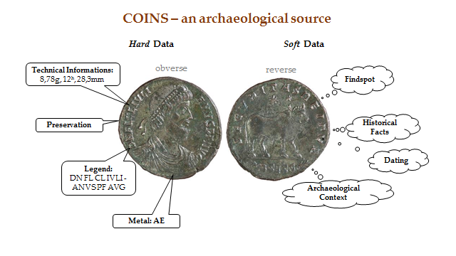
Common database fields:
Categorical vs factual info
Need to separate categorical and factual data
Inconsistent information:
  Find spot -> for a specific coin
  Historical facts -> for a category of coins

Slide 19
Common database fields:
Categorical vs factual info
Need to extend the model in order to support categorical production
(similar to FRBRoo
R26 produced things of type)
E22 Man-Made Object
MyCoin
P137 exemplifies
P108i was
produced by
E55 Type
AU from Rome
PC1 produced
things of type
E12 Production
production of coins AU

Slide 20
People:
Groups, Nationality, Origins
Nationality can be modeled as:
membership in an E74 Group = citizenship, social participation
an actor may join and/or leave the group (former, current member)
E67 Birth = provenance
E55 Type = behavior
suitable for ambiguous, fuzzy characterizations

Slide 21
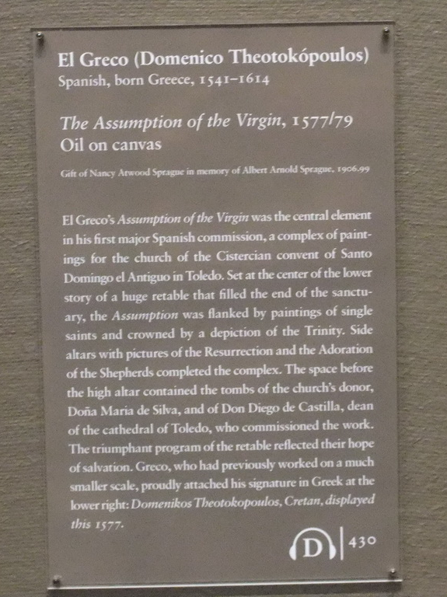
People:
Groups, Nationality, Origins
E39 Actor
http://viaf.org/viaf/100215785/
P2 has type
P98i was born
E55 Type
Spanish
E67 Birth
The birth of El Greco
P7 took place at
E53 Place
P107i is current or former member of
Greece
E74 Group
Cretan
Art Institute Chicago, Photo M. Doerr, 2010

Slide 22
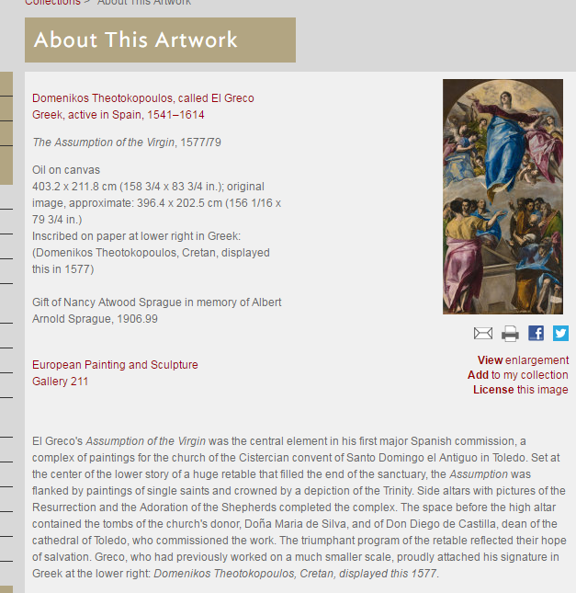
People:
Groups, Nationality, Origins
Art Institute Chicago
http://www.artic.edu/aic/collections/artwork/87479

Slide 23
People:
Accidental roles
Accidental roles are roles that do not characterize an actor independently from a particular context of activity. These roles are properties of the P14 carried out property but this cannot be represented in rdf.
They should NOT be assigned to the actor
E7 Activity
P14 carried out by (performed)
P14.1 in the role of
E55 Type
E39 Actor

Slide 24
Solution 1: Specializing P14 carried out by for each role suitable if we know a priory all the possible values
People:
Accidental roles
E7 Activity
E7 Activity
http://www.ics.forth.gr/Activity/2013HeraklionCRM-SIGmeeting
http://www.ics.forth.gr/Activity/2013MaladesPlantingOliveTrees
P14.1.1 carried out by as researcher
P14.1.2 carried out by as farmer
E39 Actor
http://www.ics.forth.gr/Actor/Doerr

Slide 25
Solution 2: Introducing class PC0 Typed CRM_Property and its subclass PC14 carried out by and properties P01 has domain and P02 has range
People:
Accidental roles
E1 CRM Entity
P02 has range (P02i is range of)
P01 has domain (P01i is domain of)
E7 Activity
PC0 Typed CRM Property
E7 Activity
http://www.ics.forth.gr/Activity/2013HeraklionCRM-SIGmeeting
http://www.ics.forth.gr/Activity/2013MaladesPlantingOliveTrees
P01 has domain
P01 has domain
PC14 carried out by
PC14 carried out by
http://www.ics.forth.gr/Actor/Doerr_as_Researcher
http://www.ics.forth.gr/Actor/Doerr_as_Farmer
P14.1 in the role of
P02 has range
P02 has range
P14.1 in the role of
E55 Type
E39 Actor
E55 Type
http://www.ics.forth.gr/Role/Researcher
http://www.ics.forth.gr/Actor/Doerr
http://www.ics.forth.gr/Role/Farmer

Slide 26
Solution 2: equivalence with CIDOC CRM definition
People:
Accidental roles
E7 Activity
E7 Activity
http://www.ics.forth.gr/Activity/2013HeraklionCRM-SIGmeeting
PC0 Typed CRM Property
http://www.ics.forth.gr/Activity/2013HeraklionCIDOC-CRM-SIGmeeting
P14 carried out by (performed)
P01 has domain
equivalent to
P14.1 in the role of
PC14 carried out by
http://www.ics.forth.gr/Actor/Doerr_as_Researcher
E55 Type
http://www.ics.forth.gr/Role/Researcher
P14.1 in the role of
P02 has range
E55 Type
E39 Actor
E39 Actor
http://www.ics.forth.gr/Role/Researcher
http://www.ics.forth.gr/Actor/Doerr
http://www.ics.forth.gr/Actor/Doerr

Slide 27
Solution 3: Add a note to each Activity with the Person’s role does not require any extension of the model
People:
Accidental roles
E7 Activity
E7 Activity
http://www.ics.forth.gr/Activity/2013HeraklionCRM-SIGmeeting
http://www.ics.forth.gr/Activity/2013MaladesPlantingOliveTrees
P14 carried out by
P2 has note
P2 has note
E39 Actor
http://www.ics.forth.gr/Actor/Doerr
Literal
Literal
The Activity was carried out by Doerr in the role of Researcher
The Activity was carried out by Doerr in the role of Farmer

Slide 28
Solution 4: Assign a type to each Activity does not require any extension of the model
People:
Accidental roles
E7 Activity
E7 Activity
http://www.ics.forth.gr/Activity/2013HeraklionCRM-SIGmeeting
http://www.ics.forth.gr/Activity/2013MaladesPlantingOliveTrees
P14 carried out by
P2 has type
E39 Actor
P2 has type
http://www.ics.forth.gr/Actor/Doerr
E55 Type
E55 Type
http://www.ics.forth.gr/Role/Research
http://www.ics.forth.gr/Role/Farming

Slide 29
People:
Accidental roles - Issuer
"Issuer" is an accidental role, does not characterize an actor independently from particular contexts of activity. Therefore the Actor does not have the type "Issuer" but the activity only has the type "Issuing“
Target Domain:
E22 Man-Made Object
P108i was produced by
Source Domain:
//COIN
E12 Production
p1
Source Path:
ISSUER_ID == PR_ID
P17 was motivated by
“gave order”
E7 Activity
ia1
E55 Type
P14 carried out by
Issuing
Source Range:
//ISSUER
Target Range:
E39 Actor

Slide 30
People:
Political office
Political office is modeled as an E74 Group with one member
an actor may join and/or leave the group (former, current member)
https://en.wikipedia.org/wiki/Alexis_Tsipras
Alexis Tsipras is the 185th and current Prime Minister of Greece, having been sworn in on 21 September 2015. He previously served as the 183rd Prime Minister of Greece from 26 January 2015 to 27 August 2015.
    E74 Group The Prime Minister of Greece
    P144i gained member by E85 Joining P143 joined E39 Actor Alexis Tsipras
    P4 has time-span E52 Time-Span 26 January 2015
    P146i lost member by E86 Leaving P145 separated E39 Actor Alexis Tsipras
    P4 has time-span E52 Time-Span 27 August 2015
    P144i gained member by E85 Joining P143 joined E39 Actor Alexis Tsipras
    P4 has time-span E52 Time-Span 21 September 2015

Slide 31
Places:
Countries
Geopolitical units map to a Period with type “State”, etc.
Map them as Place but the id has the name of the country plus a date, when this name of country was assigned.
  It is a snapshot that allows to be always in the right time space context.
always refer to a global authority e.g. TGN (falls within, overlaps, is identified by)

Slide 32
Places:
Imaginary Places
“Why hell is not a good place”
E53 Place represents always a real extent in space independent of time
An imaginary place can be represented as an E89 Propositional Object
The ambiguity between real and imaginary is an ambiguity of the phrase and not an ambiguity in the mind of the author of the phrase (as long as he is sane)
Alternatives should be made explicit: principle of recall over precision

Slide 33
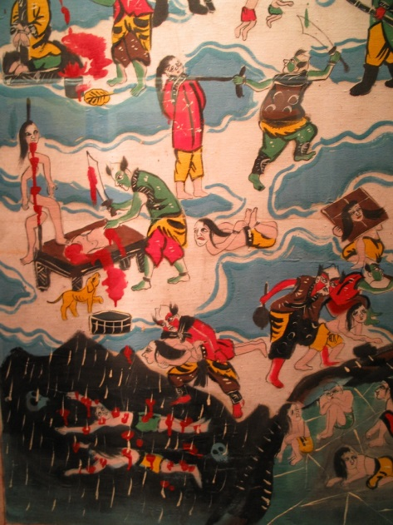
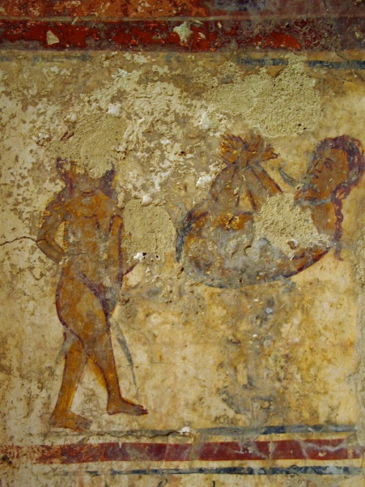
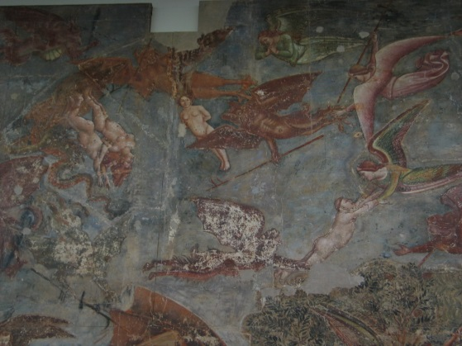
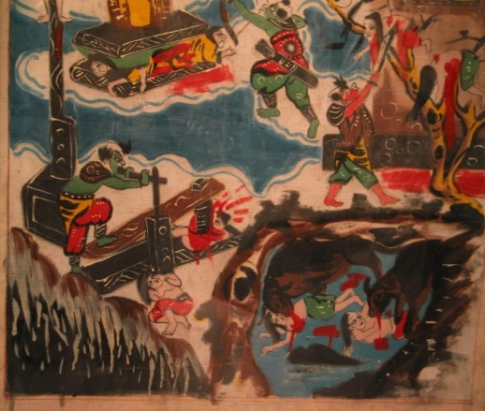
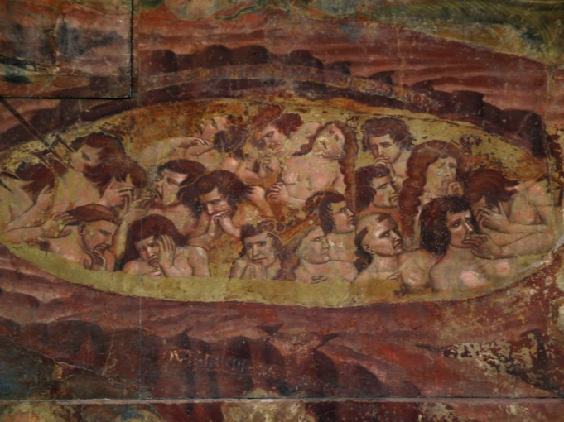
Places:
Imaginary Places
How many interpretations of hell?
Catholic Hell,
Pisa 13th century
Taoist Hell
Byzantine-Orthodox
Hell
Crete

Slide 34
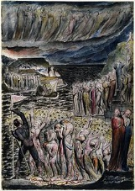
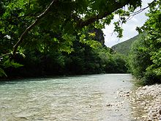
Places:
Imaginary Places
William Blake's depiction of "The Vestibule of Hell and the Souls Mustering to Cross the Acheron" in his Illustrations to Dante's "Divine Comedy“ object 5 c. 1824-27. The original for the work is held by the National Gallery of Victoria
Example taken from https://en.wikipedia.org/wiki/Acheron
E73 Information Object
E89 Propositional Object
Hell
The Vestibule of Hell and the Souls Mustering to Cross the Acheron
P67 refers to
E53 Place
Acheron

Slide 35
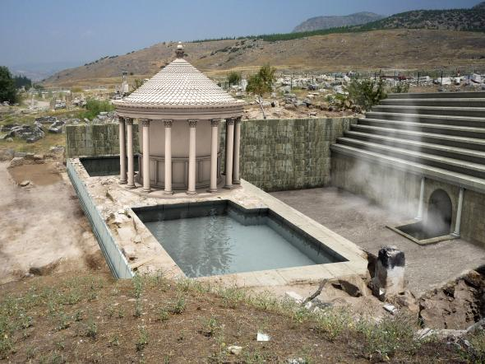
Places:
Imaginary Places
Now Italian archaeologists working at the Greco-Roman site of ancient Hierapolis (modern-day Pamukkale) in Turkey have uncovered that city's gate to the underworld.
Example taken from http://news.nationalgeographic.com/news/2013/04/130414-hell-underworld-archaeology-mount-olympus--greece/
E89 Propositional Object
E73 Information Object
P67 refers to
Entrance to Hell
Archaeologists Find a Classic Entrance to Hell
P140 was attributed by
E13 Attribute Assignement
possibly refers to
P141 assigned
E53 Place
ancient Hierapolis

Slide 36
Objects:
Pieces of a broken object
Pieces of a broken object are mapped as products of an event that destroyed the object and not as part_of.
  For provenance reasons
  For semantic clarity
As long as the object existed the respective pieces of matter were not distinct, had no identity
E22 Man-Made Object
E81 Transformation
Piece 1
P123 resulted in
destruction of object
P2 has type
P124 transformed
E22 Man-Made Object
E55 Type
broken object
fragment

Slide 37
Objects:
Pieces of a set
Pieces of a set are mapped as part of
  Chess set has parts: Chess board and chess pieces
Collective objects in the general sense, like a tomb full of gifts, a folder with stamps or a set of chessmen, should be documented as instances of E19 Physical Object, and not as instances of E78 Collection. This is because they form wholes either because they are physically bound together or because they are kept together for their functionality.
E22 Man-Made Object
E22 Man-Made Object
Chess set
P46 is composed of
Chess board
E22 Man-Made Object
Chess pieces

Slide 38
Conclusions
Always consult the reference document
Definition of the CIDOC Conceptual Reference Model
http://www.cidoc-crm.org/comprehensive_intro.html
Read carefully the scope note of the class and property that you intend to use.
Learning to use a formal ontology requires understanding the basic principles expressed in its scope, classes and relations
http://www.cidoc-crm.org/index.html
New site (available for testing)
http://new.cidoc-crm.org/

Slide 39

Conclusions
IF
ASK!

Slide 40
Thank you!
Maria Theodoridou
maria@ics.forth.gr

