Slide 1
Data Provision and Aggregation
Mapping Culture Semantically with CIDOC-CRM & 3M
CRM SIG
Maria Theodoridou
Foundation for Research and Technology – Hellas
Institute of Computer Science
Notes:
Overview of Mapping and Publishing Data

Slide 2
Synergy Reference Model
A reference model for a better practice of data provisioning and aggregation processes
An initiative of the CIDOC CRM Special Interest Group
It is based on experience and evaluation of national and international information integration projects
It defines a consistent set of business processes, user roles, generic software components and open interfaces that form a harmonious whole

Slide 3
Synergy Reference Model
Goals:
Describe the provision of data between providers and aggregators including associated data mapping components
Address the lack of functionality in current models
Incorporate the necessary knowledge and input needed from providers to create quality sustainable aggregations
Define a modular architecture that can be developed and optimized by different developers with minimal inter-dependencies and without hindering integrated UI development for the different user roles involved.
Identify, support or manage the processes needed to be executed or maintained between a provider (the source) and an aggregator (the target) institution
Support the management of data between source and target models and the delivery of transformed data at defined times, including updates

Slide 4
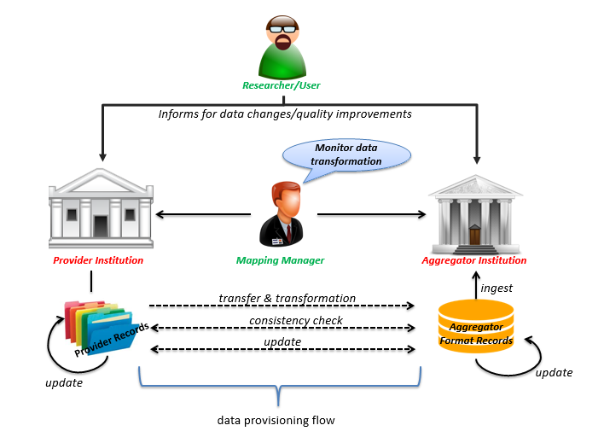
SYNERGY workflow

Slide 5
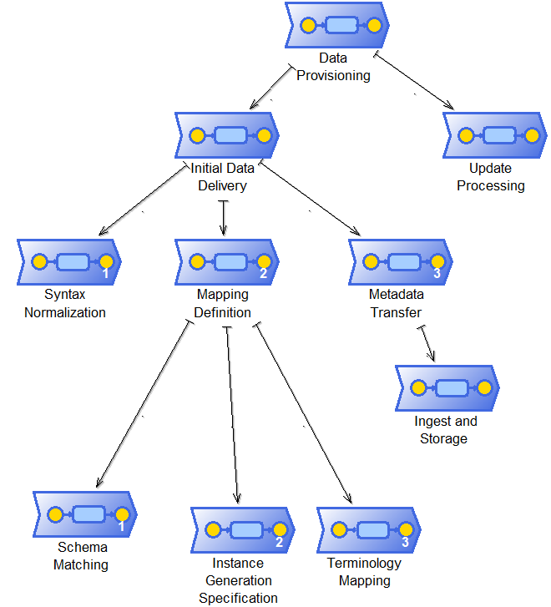
SYNERGY Process Hierarchy

Slide 6
X3ML
We implemented the X3ML data exchange framework which handles effectively and efficiently:
  the schema mapping
  the URI definition and generation
  the data transformation
steps of the data provision and aggregation process.

Slide 7
X3ML Framework Features
X3ML mapping definition language
  The schema mappings are expressed in a declarative way
  X3ML can be understood by non-technical people
  Keeps the schema mappings between different systems harmonized
  The schema matching and the URI generation policies comprise different distinct steps in the exchange workflow.
  X3ML is symmetric and potentially invertible
X3ML engine: clean core design of the engine and X3ML language
  Transparency
  Re-use of Standards and Technologies
  Facilitating Instance Matching
  Simplicity

Slide 8



X3ML Workflow
Domain Experts
IT Experts
CIDOC-CRM
Schema
Matching
URI generation specification
Terminology Mapping
DB2
Schema Matching
Definition file
DB2
DB1

Slide 9

Provider
Institution
Raw Metadata
Provider Schema Definition
Raw Metadata
Source Statistics
Source Analyzer
Syntax Normalizer
Target Schema Definition
Target Schema Validator
Effective Provider Schema
Source Syntax Report
Normalized Provider Metadata
Mapping Memory
Target Schema Visualizer
Source Schema Validator
Mapping Suggester
Source Schema Visualizer
Source Statistics
Source Analyzer
Schema Matcher
Provider Terminology
Aggregator Terminology
Schema Mapping Viewer
Instance Generation Rule Builder
Schema Matching Definition
Terminology Mapper
Mapping Definition
Terminology Mapping
Mapping Validation Report
Metadata Validator Transformer
Source To Target URI Association Table
Aggregator Format Records
Target Analyzer
Aggregator Statistics Report
Target Analyzer
Aggregator
Institution

Slide 10
X3ML Mapping Definition Language
X3ML is an XML based language designed on the basis of work that started in FORTH in 2006
X3ML emphasizes on establishing a standardized mapping description which lends itself to collaboration and the building of a mapping memory to accumulate knowledge and experience.
It was adapted primarily to be more according to the DRY principle (avoiding repetition) and to be more explicit in its contract with the URI Generating process.
X3ML separates schema mapping from generating proper URIs so that different expertise can be applied to these two very different responsibilities.

Slide 11
X3ML Mapping Definition Language
The X3ML structure consists of:
  a header that contains basic information (title, description, contact persons), the source and target schemata and sample record
  a series of mappings each containing
    a domain (the main entity that is being mapped) and
    a number of links which consist of a path and a range. Each link describes the relation (path) of the domain entity to the corresponding range entity.
Each entity-relation-entity of the source schema is mapped individually to the target schema and can be seen as a self-explanatory, context independent proposition.

Slide 12
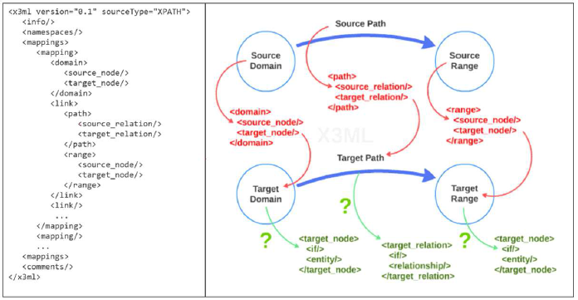
X3ML Structure

Slide 13
X3ML Structure
Source Domain:
Coin
Target Domain:
E22 Man-Made Object
Constant Expression Node:
E58 Measurement Unit
gr
P43 has dimension
Source Path:
weights
Target Path:
Intermediate Node:
E54 Dimension
P91 has unit
P2 has type
Constant Expression Node:
E55 Type
P90 has value
weight
Source Range:
WEIGHT
Target Range:
Literal

Slide 14
X3ML Constructs
X3ML supports 1:N mappings and uses the following special constructs:
intermediate nodes used to represent the mapping of a simple source path to a complex target path.
constant expression nodes used to assign constant attributes to an entity.
conditional statements within the target node and target relation support checks for existence and equality of values and can be combined into Boolean expressions.
“Same as” variable used to identify a specific node instance for a given input record that is generated once but is used in a number of locations in the mapping.
Join operator (==) used in the source path to denote relational database joins
info and comment blocks throughout the mapping specification bridge the gap between human author and machine executor.

Slide 15
X3ML - URI generation policy
The definition of the URI generation policy is a separate step and follows the schema matching
It is performed usually by an IT expert who must ensure that the generated URIs match certain criteria such as consistency uniqueness
A set of predefined URI generators (UUIDs, literals) and templates are available but any URI generating function can be implemented and incorporated in the system
In the X3ML definition, the target domain and all range entities must contain functions that will generate URIs or literals
The result of the schema matching and URI generation policy steps is a complete X3ML mapping definition file that will be fed to the X3ML engine for the transformation of the data.

Slide 16
X3ML Engine
The X3ML engine realizes the transformation of the source records to the target format
Input:
  source records (currently in the form of an XML document)
  the description of the mappings in the X3ML mapping definition file
  the URI generation policy file
Transforms the source records (XML document) into a valid RDF document which is equivalent with the XML input, with respect to the given mappings and policy.

Slide 17
X3ML Engine
Implemented in Java, producing a single artifact in the form of a JAR file which contains the engine software
  XStream8 for parsing XML-based documents
  Handy URI Templates to support the generation of valid URIs
  Jena10 for building the RDF output.
The source code is available under the Apache license at:
https://github.com/delving/x3ml
Originally implemented in the CultureBrokers project co-funded by the Swedish Arts Council and the British Museum.
Implementation is partially supported by the projects PARTHENOS (H2020 RI 2015-2019), ARIADNE (FP7 RI, 2013-2017), and LifeWatch Greece (NSRF 2012-2015)

Slide 18
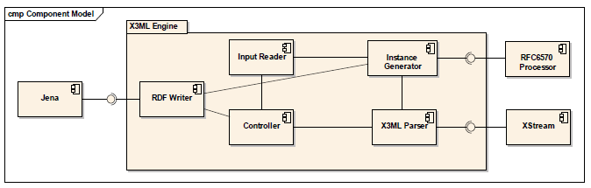
X3ML Engine - Components
The Input Reader component is responsible for reading the input data.
The X3ML Parser component is responsible for reading and manipulating the X3ML mapping definitions.
The component RDF Writer outputs the transformed data into RDF format.
The Instance Generator component produces the URIs and the labels based on the descriptions that exist in the mappings.
The Controller component coordinates the entire process.

Slide 19
X3ML Engine - Extensibility
Support of other types of input (RDF):
  RDF model (i.e. Jena, Sesame) as the basic construct
  Usage of SPARQL
  Enhancement of the Instance Generator component to carry the URIs from the source data to the target data.
Support of invertible X3ML mappings:
  Regenerate the data in the source dataset that led to the creation of each piece of data in the target dataset.
  X3ML mapping is viewed as an association between a “pattern” (Ps) in the source dataset with a “pattern” (Pt) in the target dataset.
  An X3ML mapping is a pair (Ps, Pt) of SPARQL graph patterns.
  A set of X3ML mappings M is invertible if and only if we can guarantee that whenever a pattern Pt is found in the target dataset, we can identify in a unique manner the pattern Ps that generated it.

Slide 20
X3ML Engine - Usage
The X3ML engine is being exploited by several European projects.
The ARIADNE project initiated several mapping activities using X3ML engine, to convert existing schemata of archaeological data to CIDOC CRM and its extension suite.
The ResearchSpace project has been using X3ML for the mapping and transformation of the Rijksmuseum, the British Museum, the Yale Center for British Art (YCBA) data, Getty, Frick, Canadian Heritage Information Network (CHIN).
X3ML engine is also being exploited by the transformation services of the Greek national implementation of the European LifeWatch infrastructure for biodiversity to transform biodiversity metadata/data such as Darwin Core formats to a CIDOC CRM family semantic models.
The PARTHENOS project

Slide 21
X3ML Engine - Evaluation
Synthetic data based on the ARIADNE Project data was provided as input to the X3ML engine.
  Three X3ML mapping files containing 10,100 and 1000 mappings
  4 XML input files containing 10,100,1000 and 10000 records.
Conclusions:
  The overall time depends on both the number of mappings and the size of the input.
  As the size of the input increases the overall time that is required increases as well.
  The total number of output records is the total number of input records multiplied with the number of mappings (i.e. 10 input records with 10 mappings will produce 100 output records).
  The execution time is affected equally by the number of the mappings and the records, and it is related with the number of the links that are created during the transformation process.

Slide 22
X3ML Engine - Evaluation

Slide 23
Conclusions
X3ML Data Exchange Framework is based on the X3ML mapping definition language and the X3ML engine
X3ML Data Exchange Framework solves a number of problems that have to do with managing and aggregating heterogeneous data by:
  Supporting the cognitive process of mapping and the schema mappings are expressed in a declarative way.
  Keeping the schema mappings between different systems harmonized.
  Separating the schema matching and the URI generation policies
X3ML Data Exchange Framework is being used by a significant number of European Projects
X3ML Engine will be extended in order to support other types of input and invertible X3ML mappings

Slide 24
CIDOC CRM Mapping Repository
Published schema matching definitions are available at:
http://www.ics.forth.gr/isl/3M-PublishedMappings/
The schema matching definition (Version 1.0) format is available:
http://www.ics.forth.gr/isl/mapping_technology/xsd/x3ml/x3ml_v1.0.xsd
The Mapping Memory Manager (3M) is available:
http://www.ics.forth.gr/isl/3M/
Domain experts are able to easily understand & edit X3ML mapping files
You are kindly invited to send us your schema matching definition.

Slide 25
ResearchSpace Workshops
CIDOC CRM Mapping workshop for humanities scholars and cultural heritage professionals
Supported by the Yale Center for British Art and Yale University
10th - 12th August 2015, Yale University, New Haven, USA
CIDOC CRM Mapping workshop at Oxford University
Inaugural European workshop hosted at University of Oxford e-Research Centre
9th - 10th November 2015
Some feedback from the recent USA workshop:
“This was SO helpful…I have already made better decisions this week as we develop our collections online presence”
“Thank you so much! This was an excellent event. It came at the perfect time for my project, and has given me practical methods for moving forward with my data mapping and transformation”.
“I had a blast and learned a lot!”

Slide 26
Thank you!

