Slide 1
Conceptual Spaces: Organising Geographical Knowledge
Franco Niccolucci, Paola Ronzino, Achille Felicetti

Slide 2
Spaces in Time
A named region may correspond to different space extents according to what we mean:
    Language
    Culture
    Politics
    Administrative borders
  Additionally, when talking about the past, the area may have undetermined or fuzzy borders

Slide 3
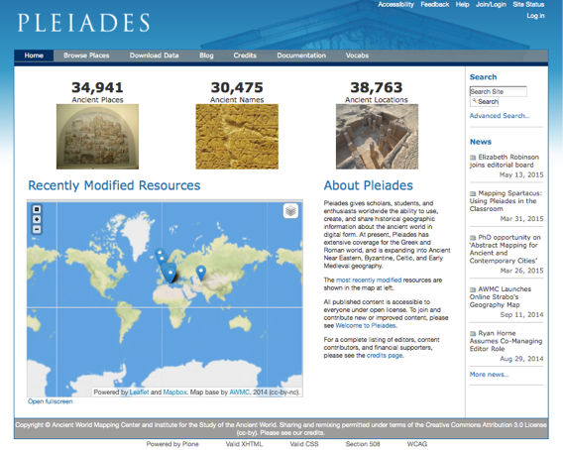

Slide 4
Pleiades Gazetteer
Historical gazetteer
  Coverage: Greek and Roman world
  Expanding into Ancient Near Eastern, Byzantine, Celtic, and Early Medieval geography
To use, create, share, and map historical geographic information about the ancient world
To associates names and locations in time providing structured information about quality and provenance
Pleiades Graph: names and locations collected into conceptual bundles (places) and associated with other geographically connected places
http://pleiades.stoa.org/

Slide 5
Places
Actually Pleiades (and most gazetteers) is based on a conceptual definition of place as contained in sources, so there are three levels:
  A place (possibly ancient) described in a source
  A place as perceived by humans
  A place geographically determined on the Earth or a representation like a geographic system
They should be modeled differently

Slide 6
Conceptual Places
Conceptual places are a mental construct: they may correspond to
Actual places: Prato
Unknown places: the tomb of Alexander the Great
Dubious places, but quoted in sources: Atlantis; Ararat, the landing place of Noah’s Arch
Imaginary places: Peter Pan’s Neverland island
It is proposed to introduce a new CRM class Conceptual Place

Slide 7
A bit of additional confusion
What is a place?
For Pleiades, a place is constructed by human experience, i.e. it is the way they perceive and describe places
There is a terminological mismatch: what the CRM calls E53 Place is a ‘Location’ in the Pleiades terminology
For the CRM, the pleiades:place is closer to the concept of space-time volume

Slide 8
Pleiades Data Model
Place resources: provide a descriptive and conceptual context for geographic, toponymic, bibliographic, and temporal information. This is the primary entity in the Pleiades database model. Pleiades place resources represent conceptual places.
Name resources: record the details of modern and historical geographic names, including the languages and scripts in which they are attested.
Location resources: record information about measureable spots and areas on the earth's surface
Reference Citations: actionable citations of primary or secondary literature and data (both in print and online) that underpin or expand upon the information contained in Pleiades.
Temporal Attestations: Assertions that a name or location was in active use during a particular period in history, together with assessments of confidence concerning those assertions.
Positional Accuracy Assessments: Documents that describe the methods, precision, and accuracy of spatial data used in location resources.

Slide 9
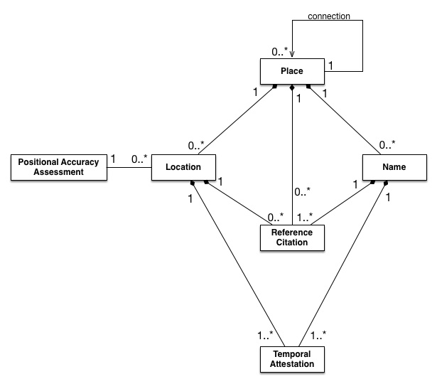
Pleiades Data Model

Slide 10
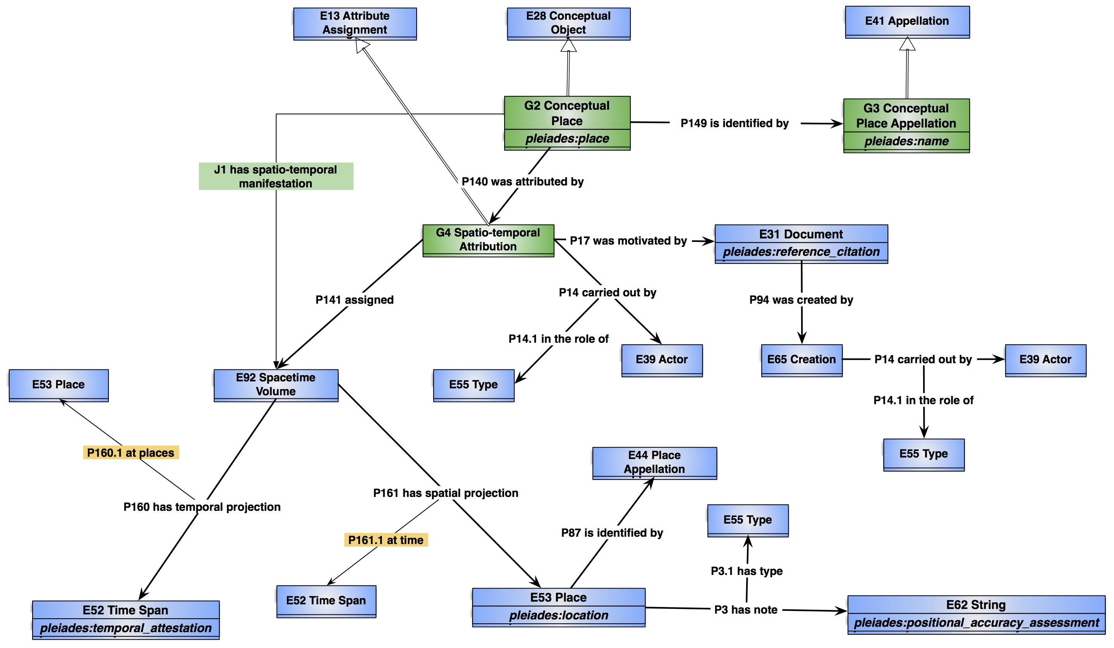
Pleiades and CIDOC CRM

Slide 11
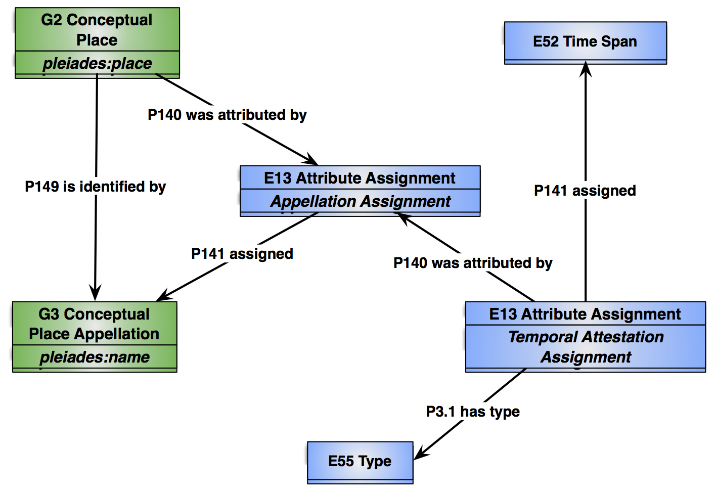
Naming

Slide 12
Pleiades Connections
Direct place-to-place relationships allowing the construction of geographic hierarchies and networks
Rivers to seas, roads to towns, towns to ethnic regions or provinces
  Nîmes aqueduct geographically connected with the spring at Ura Fons, with the Pont du Gard, and ultimately with the city of Nemausus
  Ledus river, Lattara, the Taurus/Volcarum Stagna, and the Gallicum Mare
Coarse-grained relationship
  Does not extend to cover more general notions of proximity (e.g., "nearness", "between").
Adjoining areas (open water?) TBD

Slide 13
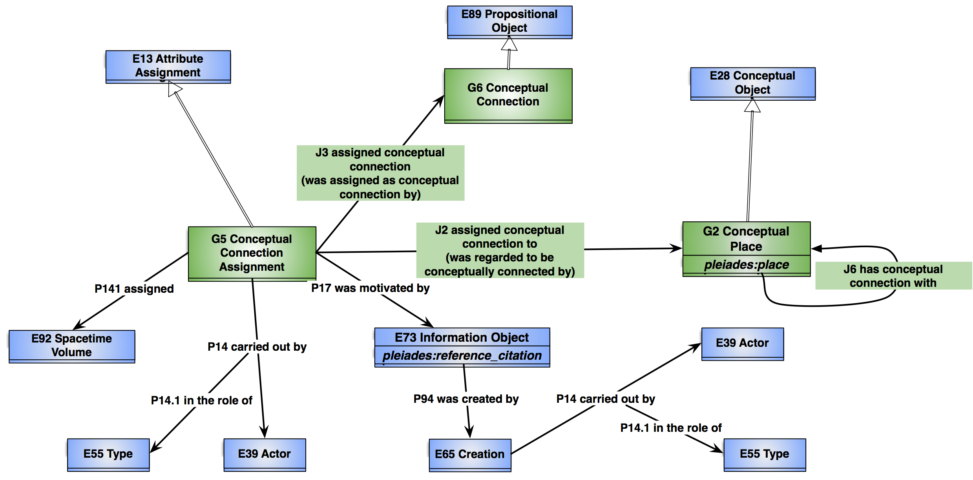
Connections

Slide 14
What next?
Exploring other Pleiades concepts
Completing the reconciliation of Pleiades and the CRM
Analyzing the named time period foundations
Analyzing the archaeological implications, and how archaeological theory affects all of the above

