Slide 1

The SYNERGY Reference Model of Data Provision and Aggregation
Current Contributors: Martin Doerr, Gerald de Jong, Konstantina Konsolaki, Barry Norton, Dominic Oldman, Maria Theodoridou, Thomas Wikman
Foundation for Research and Technology – Hellas (FORTH)
Institute of Computer Science (ICS)
Information Systems Laboratory (ISL)

Slide 2
Outline
Introduction
Process Model
  User Roles
  Process Hierarchy
  Processes
  Data Objects
  IT Objects

Slide 3
Introduction

Slide 4
Introduction (1/3)
Goal:
  Describe the provision of data between providers and aggregators including associated data mapping components
  Address the lack of functionality in current models (OAIS) and practice (all European research infrastructures and some DLs)
  Incorporate the necessary knowledge and input needed from providers to create quality sustainable aggregations

Slide 5
Introduction (2/3)
Assumption:
  Distribution of responsibilities:
    Provider:
      Curates his resources
      Has knowledge to verify record contents
      Provides in regular intervals updates (push or pull)
    Aggregator:
      Provides the homogeneous access to the integrated data
      Has mechanisms for recognizing (potential) co-references across all provided data
      Can coordinate processes of recognizing and correcting inconsistencies between all involved parties (end-user, aggregator, provider).
Challenge:
  Define a modular architecture that can be developed and optimized by different developers with minimal inter-dependencies and without hindering integrated UI development for the different user roles involved

Slide 6
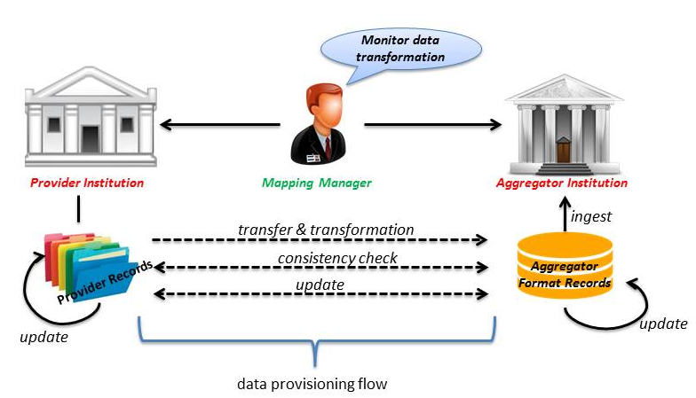
Introduction (3/3)

Slide 7
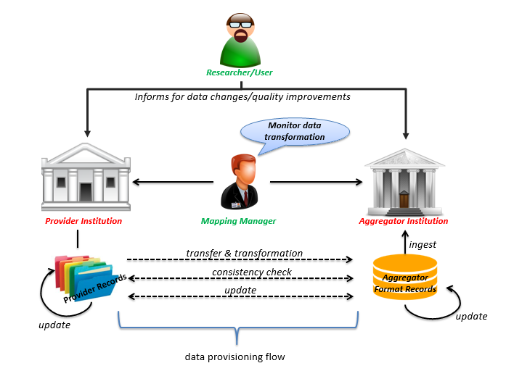
Introduction (4/4)

Slide 8
Process Model
User Roles

Slide 9
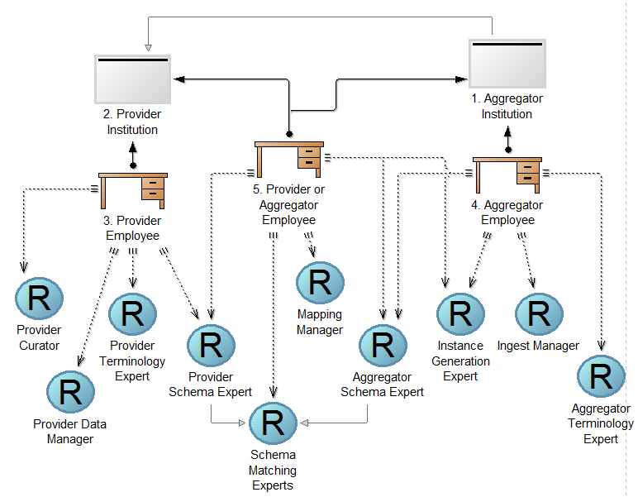
User Roles (1/6)
Organizations
Performers
Roles

Slide 10
User Roles (2/6)
User Roles:
  Primary User Roles: The managerially responsible members from the Provider and the Aggregator Institution that agree to perform the data provisioning of the providers’ local information systems to the aggregator’s integrated access system.
  Secondary User Roles: The experts whose knowledge or services contribute to the implementation and realization of the data provisioning process.

Slide 11
User Roles (3/6)
Primary User Roles:
    Provider Institution: An institution (a.k.a. source systems) that maintains collection management systems or content management systems, that constitute institutional memories. They are used for primary data entry.
    Provider Curator: The curator of the source systems. They have the knowledge about the meaning of their data in the real world (if anybody has it), or know who knows, or know how to verify it.

Slide 12
User Roles (4/6)
Primary User Roles:
  Aggregator Institution: It maintains an Integrated Access System (a.k.a. target systems), which provides a homogeneous access layer to multiple local systems. The origin of the information it manages are the Provider Institutions it maintains a business relation with. It may not produce new content except for co-reference resolution information.
  Mapping Manager: The actor responsible for the maintenance of the data transformation process from the provider format to the aggregator format. He may belong to the provider or aggregator institution or both, or be in a superior position to both.

Slide 13
User Roles (5/6)
Secondary User Roles:
  Provider Data Manager: The responsible for managing the IT systems of the provider and handling data assets, in contrast to the responsible for entering content. In particular, the responsible for sending data to the aggregator.
  Provider Terminology Expert: The curator, maintainer or other expert of one of the terminologies which the provider institutions use as reference in the local system.
  Provider Schema Expert: The curator(s), researcher(s) and/or data manager(s) of the Provider Institution who are responsible for the data entry into their local systems.
  Aggregator Schema Expert: The expert(s) for the semantics of the schema employed by the aggregator.

Slide 14
User Roles (6/6)
Secondary User Roles:
  Schema Matching Experts: Source schema experts and a target schema expert collaborate in order to define a schema matching, which is documented in a schema matching definition file.
  Instance Generation Expert: The expert of the aggregator, normally an IT specialist, who is responsible for maintaining the referential integrity of the (meta)data in the Integrated Access System and who knows how to generate from provider data valid instance definitions, such as URIs, additional labels and data values for the Integrated Access System.
  Aggregator Terminology Expert: The curator, maintainer or other expert of one of the terminologies that the aggregator uses as reference in the Integrated Access System.
  Ingest Manager: The responsible for receiving data from the provider and ingesting data into the target system.

Slide 15
Process Model
Process Hierarchy

Slide 16
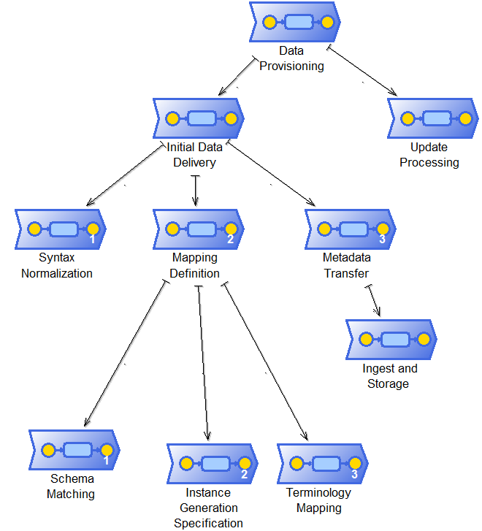
Process Hierarchy

Slide 17
Process Model
Processes

Slide 18
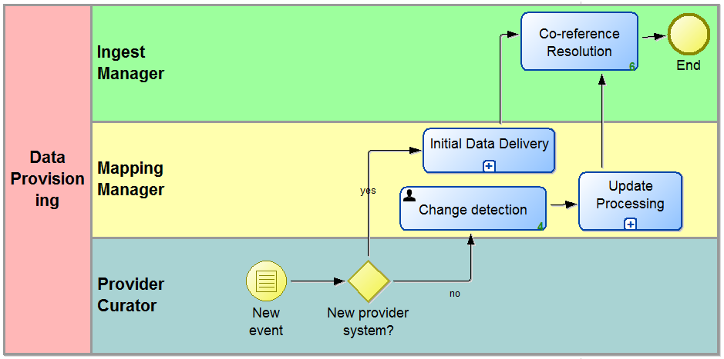
Data Provisioning Process
The Data Provisioning process which deals with the selection and scheduling of data, including co-reference resolution and updates. A Mapping Manager may be responsible for this task.
Notes:
The mapping process is the starting point of our model.
In case a new provider arrives, we proceed to the Data Delivery sub process and then the co-reference resolution task takes place. The Data Delivery sub process contains the syntax normalization, the mapping definition and also the metadata transfer sub process. During the co reference resolution task the ingest manager tries to resolve that multiple identifiers denote the same real world thing or object of discourse (co-reference resolution). The main goals are to ensure referential integrity, which is the heart of information integration, and to reduce the number of URIs in use for the same thing.
Otherwise, in case a new provider didn’t occurred the change detection task takes place. During this task the mapping manager monitors the transferred data in order to detect changes that occurred in the source and target systems and the employed terminologies. Afterwards, the update processing sub process takes place and finally we proceed again to the co-reference resolution task.

Slide 19
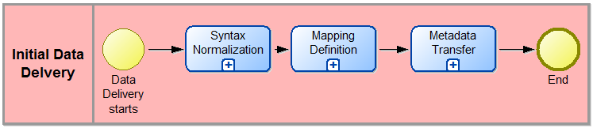
Initial Data Delivery Sub-Process
Initial Data Delivery breaks down into:
  Syntax Normalization
  Mapping Definition
  Metadata Transfer
Notes:
The Data Delivery sub process contains the syntax normalization, the mapping definition and also the metadata transfer sub processes.
Syntax Normalization: Since data transformation tools can only deal with a limited set of standard data structures, any non-standard forms must be converted to a standard one. After syntax normalization, we expect all data structures relevant for the transformation to be in a standard form.
Mapping Definition: The mapping definition, i.e., specification of the parameters for the data transformation process, such that complete sets of data records can automatically be transformed, manual exception processing notwithstanding. This includes harmonization between multiple providers.
Metadata Transfer: The actual transfer of data until a first consistent state is achieved. This includes transformation of sets of data records submitted to the aggregator, the necessary exception processing of irregular input data between provider and aggregator, ingestion of the transformed records into target system and initial referential integrity processing possibly on both sides.

Slide 20
Provider
Institution
Raw Metadata
Provider Schema Definition
Raw Metadata
Source Statistics
Source Analyzer
Syntax Normalizer
Target Schema Definition
Target Schema Validator
Effective Provider Schema
Source Syntax Report
Normalized Provider Metadata
Mapping Memory
Target Schema Visualizer
Source Schema Validator
Mapping Suggester
Source Schema Visualizer
Source Statistics
Source Analyzer
3Meditor
Schema Matcher
Provider Terminology
Aggregator Terminology
Schema Mapping Viewer
Schema Matching Definition
Instance Generation Rule Builder
Terminology Mapper
Mapping Definition
Terminology Mapping
Mapping Validation Report
Metadata Validator Transformer
Source To Target URI Association Table
Aggregator Format Records
Aggregator Statistics Report
Target Analyzer
Aggregator
Institution

Slide 21
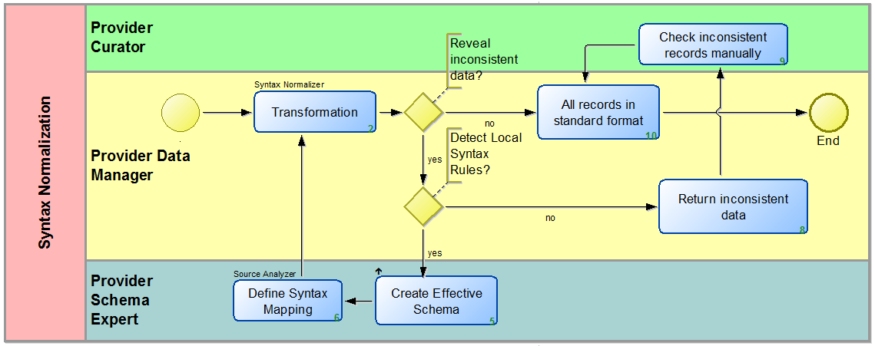
Syntax Normalization
Syntax normalization aims to convert all data structures relevant for the transformation in a standard form since data transformation tools can only deal with a limited set of standard data structures and thus any non-standard form must be converted to a standard one.
Notes:
Since data transformation tools can only deal with a limited set of standard data structures, any non-standard forms must be converted to a standard one, i.e., RDBMS, XML, RDF OWL or at least spreadsheets. In particular XML is so powerful that virtually any user invented syntax can be normalized to XML.
The syntax normalization task uses the syntax normalizer tool and it is supervised by the provider data manager. This process may reveal inconsistent data that need to be mended. In case local syntax rules exist the provider schema expert create the effective schema, define the syntax mapping and transforms the data. This process continues until all records are converted into a standard format.
On the other hand, there will be a residual of cases so complicated to describe by rules, that manually rewriting is more effective. This is not a reason not to proceed. Inconsistent data are returned to the provider in order to manually review and correct them.

Slide 22
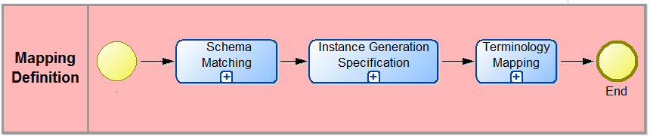
Mapping Definition
Mapping Definition consists of the:
Schema Matching
Instance Generation Specification
Terminology Mapping
The Mapping Manager may be responsible for issuing and coordinating these tasks.
Notes:
The mapping definition process contains the Schema Matching, the Uri Generation Specification and the Terminology Mapping sub-processes.

Slide 23
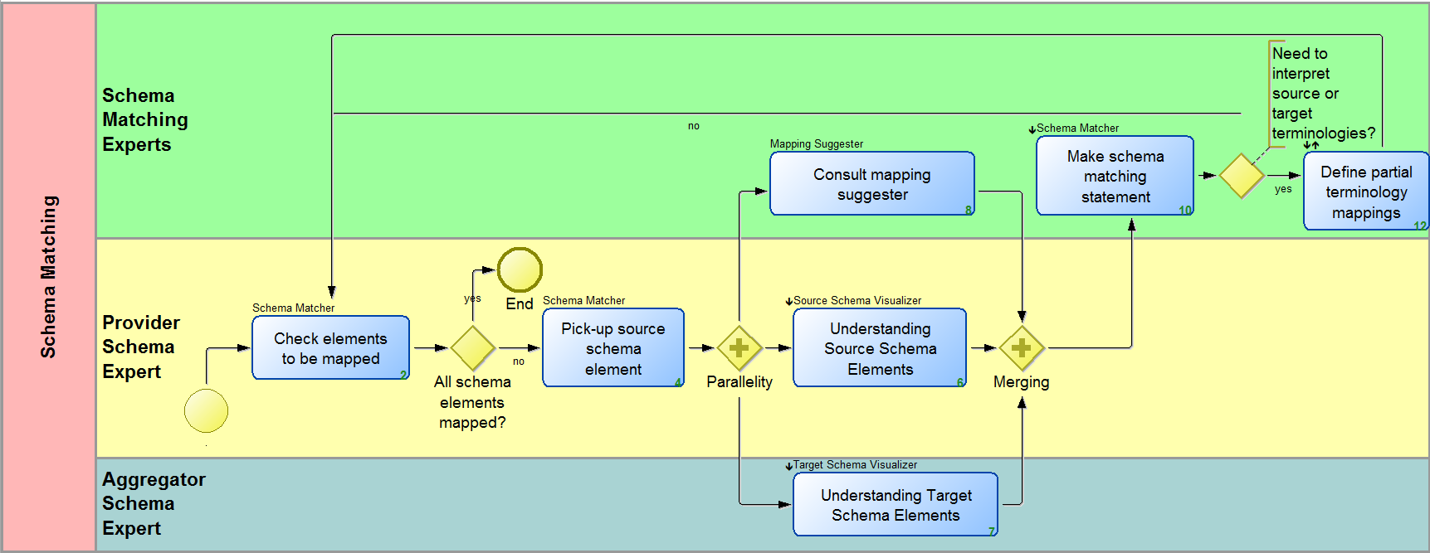
Schema Matching
The source schema experts together with a target schema expert define a schema matching which is documented in a schema matching definition. This definition must be human and machine readable and is the ultimate definition of the semantic correctness of the mapping.
Notes:
Source schema experts and a target schema expert define a schema matching, which is documented in a schema matching definition file. This file must be human and machine readable.
In order to do so, the schema matching process repeats till all source schema elements are well understood and mapped to target paths. Therefore also the target schema must be well understood. Both tasks need two independent tools to visualize source and target schema and source metadata records. Adequate navigation and viewing techniques must allow for overviews and understanding of details.
This may also be supported by tools suggesting mappings (automated mapping).
The matching may need to interpret source or target terminologies in order to re-solve data dependent mappings. In the schema matching definition, we generally foresee mapping conditions that a term in the source record is equal to or unequal to a constant, or a narrower term of a constant. This may be expressed in terms of source or target terminology. In order to resolve these specifications at record transformation time, partial terminology mappings of source and target terminology must exist.

Slide 24
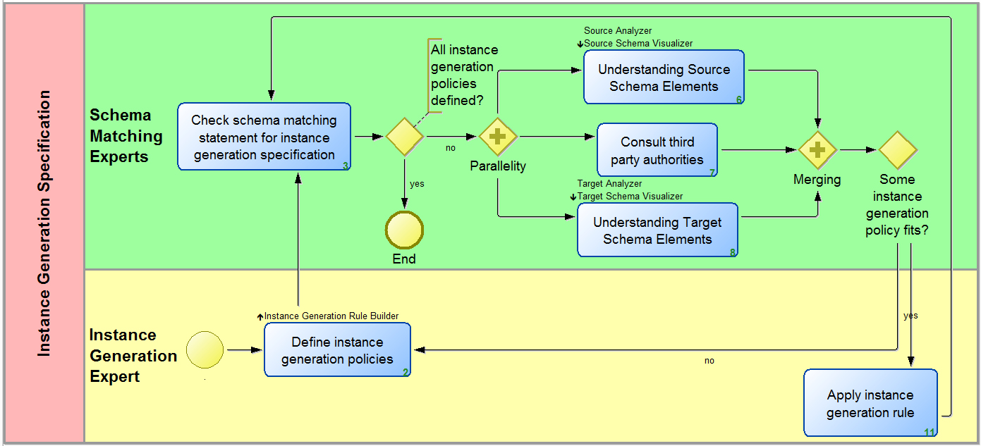
Instance Generation Specification
An appropriate URI schema must be applied for each target class instance. The instance generation policies complement the schema matching definition file into a mapping definition file.
Notes:
After the schema matching, the URI generation policies must be defined for each instance of the target class referred to in the matching, such as for persons, objects, events.
The URI generation policies complement the schema matching definition file into a mapping definition file.
During the URI generation process, we must examine each instance of the target schema class, to apply a URI generation rule.
In order to so, both source and target schema must be well understood. Some URI generation policies may include look-up of on-line resources about persons or places.

Slide 25
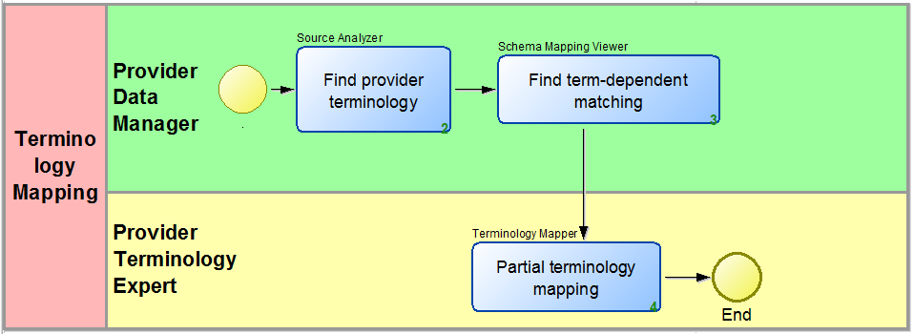
Terminology Mapping
Extract from the schema matching definition the terms appearing in mapping conditions. We are only interested in the consistency of the mapping process when the choice of a target class or property depends on a term.

Slide 26
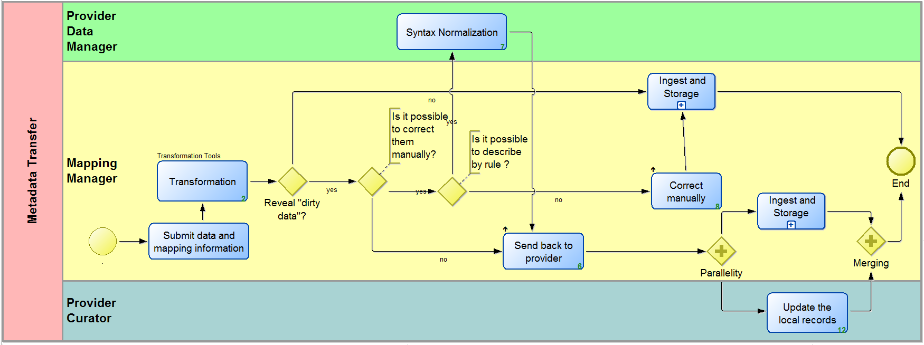
Metadata Transfer
The result of the transformation process is a set of valid records, ready to be ingested to the target system. The transformation process itself may run completely automatically.

Slide 27
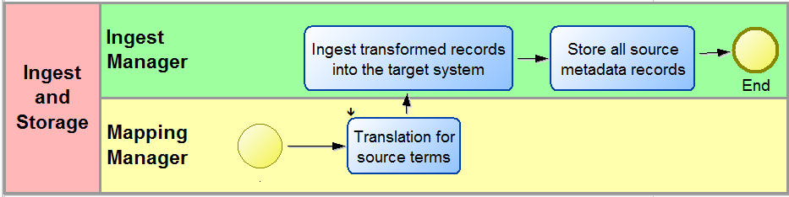
Ingest and Storage
Once records are transformed, an automated translation for source terms using a terminology map may follow. The transformed records will then, be ingested into the target system.

Slide 28
Provider
Institution
Raw Metadata
Provider Schema Definition
Raw Metadata
Source Statistics
Source Analyzer
Syntax Normalizer
Target Schema Definition
Target Schema Validator
Effective Provider Schema
Source Syntax Report
Normalized Provider Metadata
Mapping Memory
Target Schema Visualizer
Source Schema Validator
Mapping Suggester
Source Schema Visualizer
Source Statistics
Source Analyzer
3Meditor
Schema Matcher
Provider Terminology
Aggregator Terminology
Schema Mapping Viewer
Schema Matching Definition
Instance Generation Rule Builder
Terminology Mapper
Mapping Definition
Terminology Mapping
Mapping Validation Report
Metadata Validator Transformer
Source To Target URI Association Table
Aggregator Format Records
Aggregator Statistics Report
Target Analyzer
Aggregator
Institution

Slide 29
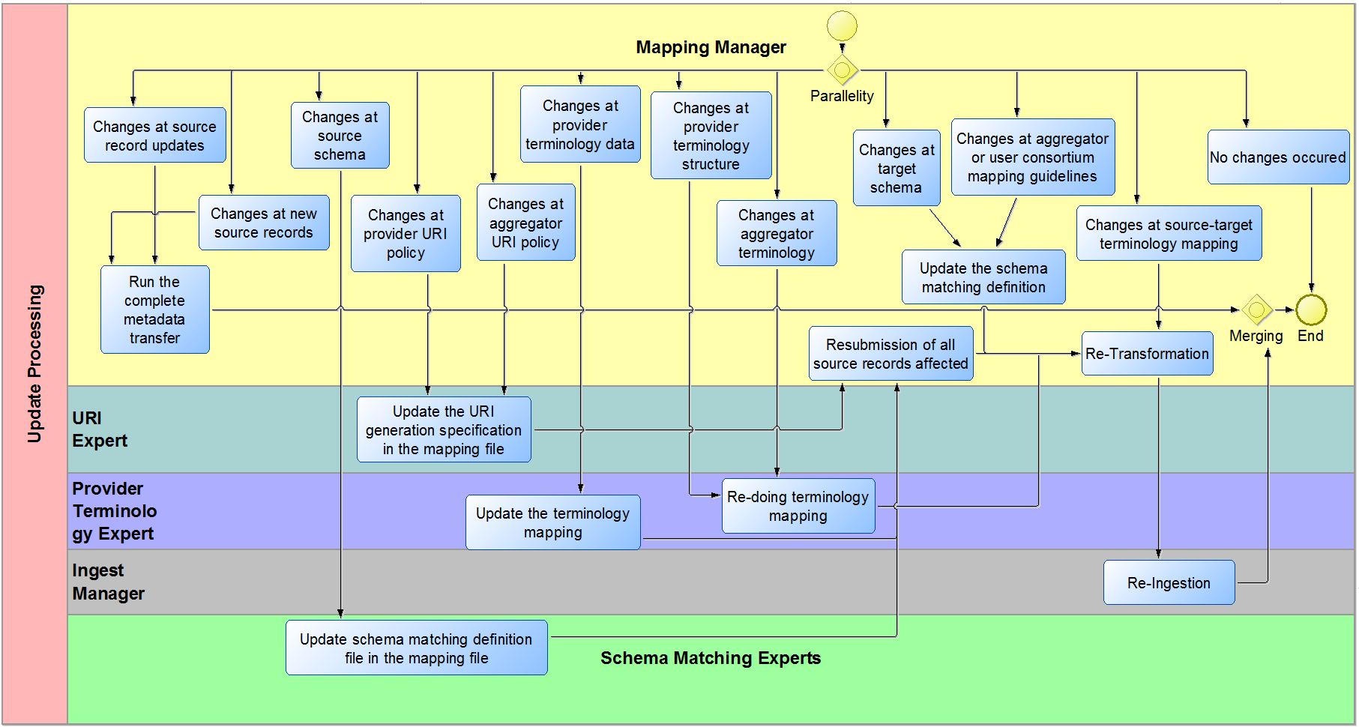
Update Processing
The mapping manager must monitor all changes that may affect the consistency of provider and aggregator data.

Slide 30
New Source Records or Source Records Update
1. Run the complete metadata transfer using the existing Mapping Definition
Provider
Institution
Provider Schema Definition
Raw Metadata
Source Analyzer
Syntax Normalizer
Source Syntax Report
Target Schema Definition
Effective Provider Schema
Provider Terminology
Aggregator Terminology
Normalized Provider Metadata
Mapper
Mapping Definition
Terminology Mapping
Metadata Validator Transformer
Mapping Validation Report
Source To Target URI Association Table
Aggregator Format Records
Aggregator Statistics Report
Target Analyzer
Aggregator
Institution

Slide 31
Source Schema Changes
Update the mapping definition
Resubmission of source records affected
Transformation and Ingestion
Provider
Institution
Provider Schema Definition
Raw Metadata
Source Analyzer
Syntax Normalizer
Source Syntax Report
Target Schema Definition
Effective Provider Schema
Provider Terminology
Aggregator Terminology
Normalized Provider Metadata
Mapper
Mapping Definition
Terminology Mapping
Metadata Validator Transformer
Mapping Validation Report
Source To Target URI Association Table
Aggregator Format Records
Aggregator Statistics Report
Target Analyzer
Aggregator
Institution

Slide 32
Provider changes URI policies
Updates the URI generation specification the mapping file
Resubmission of all source records affected
Transformation and Ingestion
Provider
Institution
Provider Schema Definition
Raw Metadata
Source Analyzer
Syntax Normalizer
Source Syntax Report
Target Schema Definition
Effective Provider Schema
Provider Terminology
Aggregator Terminology
Normalized Provider Metadata
Mapper
Mapping Definition
Terminology Mapping
Metadata Validator Transformer
Mapping Validation Report
Source To Target URI Association Table
Aggregator Format Records
Aggregator Statistics Report
Target Analyzer
Aggregator
Institution

Slide 33
Provider or Aggregator Changes Terminology Data
Update the terminology Mapping
Resubmission, Transformation and ingestions
Provider
Institution
Provider Schema Definition
Raw Metadata
Source Analyzer
Syntax Normalizer
Source Syntax Report
Target Schema Definition
Effective Provider Schema
Provider Terminology
Aggregator Terminology
Normalized Provider Metadata
Mapper
Mapping Definition
Terminology Mapping
Metadata Validator Transformer
Mapping Validation Report
Source To Target URI Association Table
Aggregator Format Records
Aggregator Statistics Report
Target Analyzer
Aggregator
Institution

Slide 34
Provider Changes Terminology Structure
Update the terminology Mapping
Transformation and ingestions
Provider
Institution
Provider Schema Definition
Raw Metadata
Source Analyzer
Syntax Normalizer
Source Syntax Report
Target Schema Definition
Effective Provider Schema
Provider Terminology
Aggregator Terminology
Normalized Provider Metadata
Mapper
Mapping Definition
Terminology Mapping
Metadata Validator Transformer
Mapping Validation Report
Source To Target URI Association Table
Aggregator Format Records
Aggregator Statistics Report
Target Analyzer
Aggregator
Institution

Slide 35
Target Schema Changes or Aggregator changes mapping Guidelines
Update the mapping definition
Retransformation and reingestion of all source records
Provider
Institution
Provider Schema Definition
Raw Metadata
Source Analyzer
Syntax Normalizer
Source Syntax Report
Target Schema Definition
Effective Provider Schema
Provider Terminology
Aggregator Terminology
Normalized Provider Metadata
Mapper
Mapping Definition
Terminology Mapping
Metadata Validator Transformer
Mapping Validation Report
Source To Target URI Association Table
Aggregator Format Records
Aggregator Statistics Report
Target Analyzer
Aggregator
Institution

Slide 36
Aggregator Changes URI Policy
Updates the mapping file
Retransformation and reingestion of source records
Provider
Institution
Provider Schema Definition
Raw Metadata
Source Analyzer
Syntax Normalizer
Source Syntax Report
Target Schema Definition
Effective Provider Schema
Provider Terminology
Aggregator Terminology
Normalized Provider Metadata
Mapper
Mapping Definition
Terminology Mapping
Metadata Validator Transformer
Mapping Validation Report
Source To Target URI Association Table
Aggregator Format Records
Aggregator Statistics Report
Target Analyzer
Aggregator
Institution

Slide 37
Source target terminology mapping changes
1. Retransformation and reingestion of source records
Provider
Institution
Provider Schema Definition
Raw Metadata
Source Analyzer
Syntax Normalizer
Source Syntax Report
Target Schema Definition
Effective Provider Schema
Provider Terminology
Aggregator Terminology
Normalized Provider Metadata
Mapper
Mapping Definition
Terminology Mapping
Metadata Validator Transformer
Mapping Validation Report
Source To Target URI Association Table
Aggregator Format Records
Aggregator Statistics Report
Target Analyzer
Aggregator
Institution

Slide 38
Process Model
Data Objects

Slide 39
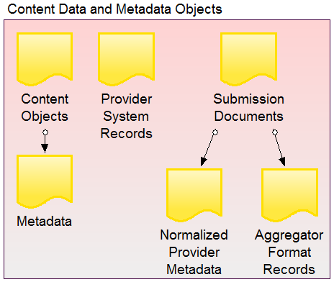
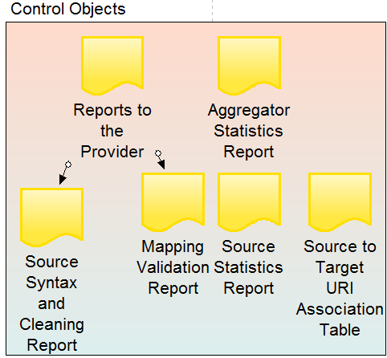
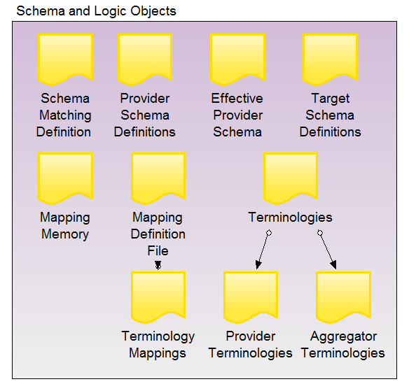
Data Objects (1/5)
Three categories of information objects that take part in the data provisioning process are defined:
  Content Data and Metadata Objects
  Schema and Logic Objects
  Control Objects

Slide 40
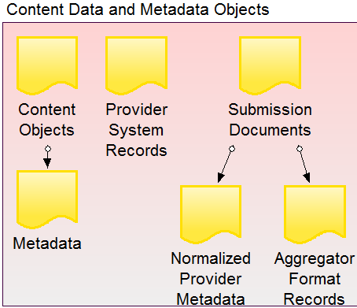
Data Objects (2/5)
Content Data and Metadata Objects: Consist of all the raw data and metadata of the source system. In detail they include:
  Content Objects: Individual files or information units with an internal structure that is not described in terms of schema elements of the source or target systems. These are typically images or text documents.
  Metadata: Information units with an internal structure that is described in terms of schema elements of the source or target systems. In our context, these are often data records describing content object (therefore the term “metadata”).
  Normalized Provider Metadata: The result of formalizing (“cleaning”) Raw Metadata by extending the provider schema.
  Provider System Records: Records of the Local Information System (source system).
  Submission Documents: The well-formed documents that come-up either after the syntax normalization process, or from the transformation process.
  Aggregator Format Records: Records in the form to be ingested into the target system.

Slide 41
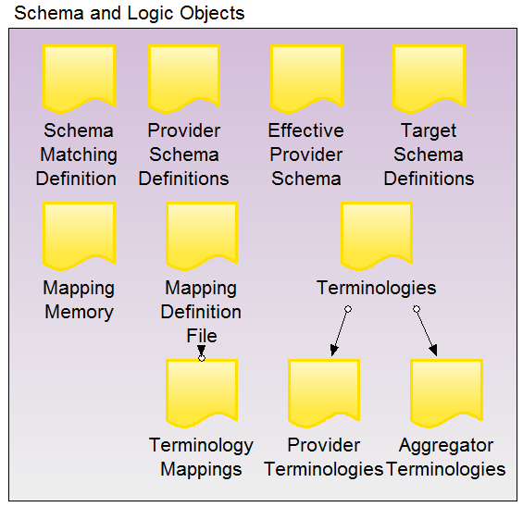
Data Objects (3/5)
Schema and Logic Objects: Consists of the schemata, mappings and terminologies of both the source and the target systems. In detail they include:
  Schema Matching Definition: The schema matching definition file contains the mappings of the source schema elements to the target schema paths. This file must be human and machine readable and is the ultimate communication means on the semantic correctness of the mapping.
  Effective Provider Schema: The new source schema definition that contains the formal description of the local syntax rules.
  Target Schema Definition: Data dictionaries, XML schemata, RDFS/OWL files etc. describing the data structures that are managed and can be searched by associative queries in the source or systems.
  Mapping Memory: A collection of mapping histories of analogous cases collected from the user community.
  Mapping Definition File: The mapping definition file comes up by the addition of the URI generation policies to the schema matching definition file.

Slide 42
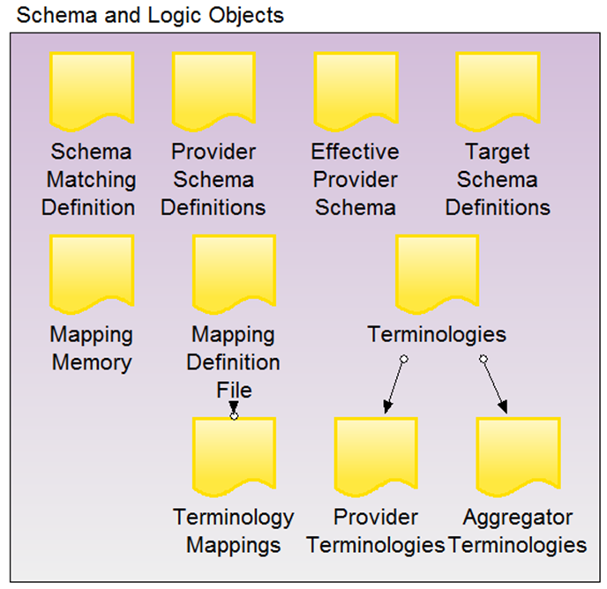
Data Objects (4/5)
  Schema and Logic Objects:
    Terminologies: Controlled vocabularies of terms that appear as individual data values in the source or target systems. Terminologies may be flat list of words or be described and organized in more elaborate structures as so-called “thesauri” or “knowledge organization systems”.
  Aggregator Terminologies: The terminologies used by the aggregator as a reference in the integrated access system.
  Provider Terminologies: The terminologies used by the provider as reference in the local system.
  Terminology Mappings: Expressions of exact or inexact (broader/narrower) equivalence between terms from different vocabularies. In this context, we are primarily interested in the mapping of terms that appear directly or indirectly in mapping conditions of a schema matching definition. In such a Mapping condition, a term in the source record is equal to or unequal to a constant, or a narrower term of a constant. This may be expressed in terms of source or target terminology.
  Provider Schema Definition: Data dictionaries, XML schemata, RDFS/OWL files etc. describing the data structures that is managed and can be searched by associative queries in the source or systems.

Slide 43
Data Objects (5/5)
Control Objects: Consists of the reports and documents that support the data provisioning process and are the products of its different sub-processes. In detail they include:
  Reports to the Provider: Reports useful to the provider in order to monitor the result of the various tasks and to announce all individual inconsistencies in the processed source data which the provider may or should correct.
  Source Syntax and Cleaning Report: The output report of the syntax normalizer tool. Contains inconsistencies and errors that occurred during the syntax normalization process.
  Provider Statistics Report: The output statistics of the source analyzer tool, used as input to the source schema visualizer and also to the Instance Generation Rule Builder . It contains statistic information useful for understanding the source schema.
  Mapping Validation Report: The output report of the metadata validator transformer tool. It contains errors and inconsistencies that occurred during the transformation process.
  Aggregator Statistics Report: The output statistics of the target analyzer tool. It contains statistic information useful for understanding the target schema.
  Source to Target URI Association Table: The output report of the metadata validator transformer tool. It contains the source to target URI associations.

Slide 44
Process Model
IT Objects

Slide 45
Provider
Institution
Raw Metadata
Provider Schema Definition
Raw Metadata
Source Statistics
Source Analyzer
Syntax Normalizer
Target Schema Definition
Target Schema Validator
Effective Provider Schema
Source Syntax Report
Normalized Provider Metadata
Mapping Memory
Target Schema Visualizer
Source Schema Validator
Mapping Suggester
Source Schema Visualizer
Source Statistics
Source Analyzer
3Meditor
Schema Matcher
Provider Terminology
Aggregator Terminology
Schema Mapping Viewer
Schema Matching Definition
Instance Generation Rule Builder
Terminology Mapper
Mapping Definition
Terminology Mapping
Mapping Validation Report
Metadata Validator Transformer
Source To Target URI Association Table
Aggregator Format Records
Aggregator Statistics Report
Target Analyzer
Aggregator
Institution

Slide 46
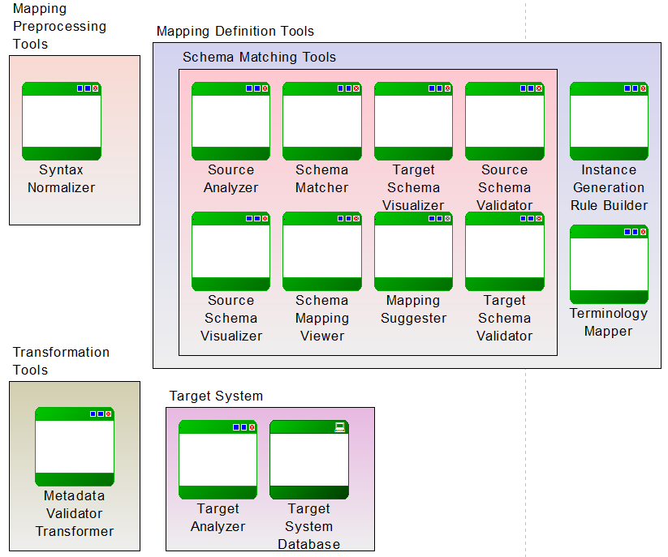
IT Objects

Slide 47
3Meditor
  Overview: Combines several components into one user interface providing the simplest possible solution
Components:
  Schema Matcher
  Schema Mapping Viewer
  Instance Generation Builder
  Target Schema Visualizer
Input compatibility requirements:
  Load mapping definitions files in X3ML format
  Source schema in xsd/dtd/XML-template format
  Target schema in rdfs format
  Enable/Disable Source Schema Validator
  Enable/Disable Source Schema Visualizer
  Enable/Disable Target Schema Validator
  Enable/Disable Mapping Suggester
Output compatibility requirements
  Store mapping definitions files in X3ML format

Slide 48

Provider
Institution
Raw Metadata
Provider Schema Definition
Raw Metadata
Source Statistics
Source Analyzer
Syntax Normalizer
Target Schema Definition
Target Schema Validator
Effective Provider Schema
Source Syntax Report
Normalized Provider Metadata
Mapping Memory
Target Schema Visualizer
Source Schema Validator
Mapping Suggester
Source Analyzer
Source Schema Visualizer
Source Statistics
Source Analyzer
3Meditor
Schema Matcher
Provider Terminology
Aggregator Terminology
Schema Mapping Viewer
Instance Generation Rule Builder
Schema Matching Definition
Terminology Mapper
Mapping Definition
Terminology Mapping
Mapping Validation Report
Metadata Validator Transformer
Source To Target URI Association Table
Aggregator Format Records
Aggregator Statistics Report
Target Analyzer
Aggregator
Institution

Slide 49
Function Signatures
Source Analyzer: Provides useful information about the source schema and the raw metadata
getValueList()
  Functionality Description: Return a number of values for a specific field.
  Function Signature: getValueList(provider_ schema, provider_metadata, field, limit_num, mode)
    Input Parameters:
    provider_ schema: A file describing the provider schema
    provider_metadata : The file with the provider metadata
    field: The current field we are processing
    limit_num: The number of data we need to return. In case limit_num has the value zero, we return all the values
    mode: Sample (random, alphabetic, most frequent, etc.)
    Return Value: A list which contains the values and frequencies of the specific field
getTerminologies()
  Functionality Description: Return an XML file containing the terminologies of the provider.
  Function Signature: getTerminologies (provider_ schema, provider_metadata)
    Input Parameters:
    provider_ schema: A file describing the provider schema
    provider_matadata : The file with the provider metadata
    Return Value: An XML file containing the terminologies of the provider

Slide 50
Function Signatures
Source Analyzer
getStatistics()
  Functionality Description: Provide statistics for each field
  Function Signature: getStatistics(provider_ schema, provider_metadata)
    Input Parameters:
    provider_ schema: A file describing the provider schema
    provider_matadata : The file with the provider metadata
    Return Value: An XML file containing the statistics of the source schema.

Slide 51
Provider
Institution
Raw Metadata
Provider Schema Definition
Raw Metadata
Source Statistics
Source Analyzer
Syntax Normalizer
Target Schema Definition
Target Schema Validator
Effective Provider Schema
Source Syntax Report
Normalized Provider Metadata
Mapping Memory
Target Schema Visualizer
Source Schema Validator
Mapping Suggester
Source Schema Visualizer
Source Analyzer
Source Schema Visualizer
Source Statistics
3Meditor
Schema Matcher
Provider Terminology
Aggregator Terminology
Schema Mapping Viewer
Instance Generation Rule Builder
Schema Matching Definition
Terminology Mapper
Mapping Definition
Terminology Mapping
Mapping Validation Report
Metadata Validator Transformer
Source To Target URI Association Table
Aggregator Format Records
Aggregator Statistics Report
Target Analyzer
Aggregator
Institution

Slide 52
Function Signatures
Source Visualizer: Visualize the source schema definition file and the source metadata records
init()
  Functionality Description: Loads the provider’s schema definition file.
  Function Signature: init(provider_schema)
    Input Parameters:
    provider_ schema: A file describing the provider schema
    Return Value: void
getPath()
  Functionality Description: This is a blocking routine. It returns on each user click the path in focus.
  Function Signature: getPath()
    Input Parameters: -
    Return Value: A string representing the path of the current field.

Slide 53
Function Signatures
Source Schema Visualizer
enableGet()
  Functionality Description: It enables and disables the communication of the source visualizer, with external tools.
  Function Signature: enableGet(mode)
    Input Parameters:
    mode: 0-disable , 1-enable
    Return Value: void
setFocus()
  Functionality Description: Set focus to the specified field path
  Function Signature: setFocus(field_path,mode)
    Input Parameters:
    field_path: The path we need to set focus on
    mode:
    Return value: Return false if path is invalid or true otherwise

Slide 54
Function Signatures
Source Schema Visualizer
getDescription()
  Functionality Description: Return the annotations provided with the source schema for a specific field path.
  Function Signature: getDescription(field_path)
    Input Parameters:
    field_path: The current field we are processing
    Return value: A string with the annotations provided for the specific field

Slide 55
Provider
Institution
Raw Metadata
Provider Schema Definition
Raw Metadata
Source Statistics
Source Analyzer
Syntax Normalizer
Target Schema Definition
Target Schema Validator
Effective Provider Schema
Source Syntax Report
Normalized Provider Metadata
Mapping Memory
Target Schema Visualizer
Source Schema Validator
Source Schema Validator
Mapping Suggester
Source Schema Visualizer
Source Statistics
Source Analyzer
3Meditor
Schema Matcher
Provider Terminology
Aggregator Terminology
Schema Mapping Viewer
Instance Generation Rule Builder
Schema Matching Definition
Terminology Mapper
Mapping Definition
Terminology Mapping
Mapping Validation Report
Metadata Validator Transformer
Source To Target URI Association Table
Aggregator Format Records
Aggregator Statistics Report
Target Analyzer
Aggregator
Institution

Slide 56
Function Signatures
  Source Schema Validator: Validates a specific path according to the source schema
validatePath ()
  Functionality Description: Validates a specific path according to the source schema
  Function Signature: validatePath (provider_schema, path)
    Input Parameters:
    provider_schema: A file describing the provider schema
    path: A string representing the path we need to validate according to the source schema
    Return Value: Return true if the path is valid or false in case the path is invalid.

Slide 57
Provider
Institution
Raw Metadata
Provider Schema Definition
Raw Metadata
Source Statistics
Source Analyzer
Syntax Normalizer
Target Schema Definition
Target Schema Validator
Effective Provider Schema
Source Syntax Report
Normalized Provider Metadata
Target Schema Visualizer
Mapping Memory
Target Schema Visualizer
Source Schema Validator
Mapping Suggester
Source Schema Visualizer
Source Statistics
Source Analyzer
3Meditor
Schema Matcher
Provider Terminology
Aggregator Terminology
Schema Mapping Viewer
Instance Generation Rule Builder
Schema Matching Definition
Terminology Mapper
Mapping Definition
Terminology Mapping
Mapping Validation Report
Metadata Validator Transformer
Source To Target URI Association Table
Aggregator Format Records
Aggregator Statistics Report
Target Analyzer
Aggregator
Institution

Slide 58
Function Signatures
Target Schema Visualizer: Visualize the target schema definition
init()
  Functionality Description: Loads the target’s schema definition file.
  Function Signature: init(target_schema)
    Input Parameters:
    target_ schema: A file describing the target schema
    Return Value: void
getPath()
  Functionality Description: This is a blocking routine. It returns on each user click the path in the focus of the user click.
  Function Signature: getPath()
    Input Parameters: -
    Return Value: A string representing the path of the current field.

Slide 59
Function Signatures
Target Schema Visualizer
enableGet()
  Functionality Description: It enables and disables the communication of the target visualizer, with external tools.
  Function Signature: enableGet(mode)
    Input Parameters:
    mode: Set mode for 0 to disable and set mode to 1 to enable
    Return Value: void
setFocus()
  Functionality Description: Set focus to the specified field
  Function Signature: setFocus(field_path,mode)
    Input Parameters:
    field_path: The path we need to set focus on
    mode:
    Return value: Return false if path is invalid or true otherwise

Slide 60
Provider
Institution
Raw Metadata
Provider Schema Definition
Raw Metadata
Source Statistics
Source Analyzer
Syntax Normalizer
Target Schema Validator
Target Schema Definition
Target Schema Validator
Effective Provider Schema
Source Syntax Report
Normalized Provider Metadata
Mapping Memory
Target Schema Visualizer
Source Schema Validator
Mapping Suggester
Source Schema Visualizer
Source Statistics
Source Analyzer
3Meditor
Schema Matcher
Provider Terminology
Aggregator Terminology
Schema Mapping Viewer
Instance Generation Rule Builder
Schema Matching Definition
Terminology Mapper
Mapping Definition
Terminology Mapping
Mapping Validation Report
Metadata Validator Transformer
Source To Target URI Association Table
Aggregator Format Records
Aggregator Statistics Report
Target Analyzer
Aggregator
Institution

Slide 61
Function Signatures
  Target Schema Validator: Validates a specific path according to the target schema
validatePath ()
  Functionality Description: Validates a specific path according to the target schema
  Function Signature: validatePath (target_schema, path)
    Input Parameters:
    target_schema: A file describing the target schema
    path: A string representing the path we need to validate according to the target schema
    Return Value: Return true if the path is valid or false in case the path is invalid.

Slide 62
Provider
Institution
Raw Metadata
Provider Schema Definition
Raw Metadata
Source Statistics
Source Analyzer
Syntax Normalizer
Target Schema Definition
Target Schema Validator
Effective Provider Schema
Source Syntax Report
Normalized Provider Metadata
Mapping Memory
Target Schema Visualizer
Source Schema Validator
Mapping Suggester
Source Schema Visualizer
Source Statistics
Source Analyzer
3Meditor
Schema Matcher
Schema Matcher
Provider Terminology
Aggregator Terminology
Schema Mapping Viewer
Instance Generation Rule Builder
Schema Matching Definition
Terminology Mapper
Mapping Definition
Terminology Mapping
Mapping Validation Report
Metadata Validator Transformer
Source To Target URI Association Table
Aggregator Format Records
Aggregator Statistics Report
Target Analyzer
Aggregator
Institution

Slide 63
Function Signatures
Schema Matcher: Maps source schema elements to target schema paths
init()
  Functionality Description: Loads the schema matching definition file for edit purposes
  Function Signature: init(schema_matching_definition)
    Input Parameters:
    schema_matching_definition: The schema matching definition file
    Return Value: void

Slide 64
Provider
Institution
Raw Metadata
Provider Schema Definition
Raw Metadata
Source Statistics
Source Analyzer
Syntax Normalizer
Target Schema Definition
Target Schema Validator
Effective Provider Schema
Source Syntax Report
Normalized Provider Metadata
Mapping Memory
Target Schema Visualizer
Source Schema Validator
Mapping Suggester
Mapping Suggester
Source Schema Visualizer
Source Statistics
Source Analyzer
3Meditor
Schema Matcher
Provider Terminology
Aggregator Terminology
Schema Mapping Viewer
Instance Generation Rule Builder
Schema Matching Definition
Terminology Mapper
Mapping Definition
Terminology Mapping
Mapping Validation Report
Metadata Validator Transformer
Source To Target URI Association Table
Aggregator Format Records
Aggregator Statistics Report
Target Analyzer
Aggregator
Institution

Slide 65
Function Signatures
Mapping Suggester: Suggests mappings, by taking into account “mapping memories” of analogous cases collected from the user community
init()
  Functionality Description: Loads the available mapping definition files
  Function Signature: init(mapping_memory)
    Input Parameters:
    mapping_memory: A collection of the available mapping histories
    Return Value: void
setProviderSchema()
  Functionality Description: Sets the current provider schema
  Function Signature: setProviderSchema (provider_schema)
    Input Parameters:
    provider_schema: A file describing the provider schema
    Return Value: void

Slide 66
Function Signatures
Mapping Suggester
setTargetSchema()
  Functionality Description: Sets the current target schema
  Function Signature: setTargetSchema (target_schema)
    Input Parameters:
    target_schema : A file describing the target schema
    Return Value: void
enableMS()
  Functionality Description: It enables and disables the communication of the mapping suggester with external tools.
  Function Signature: enableMS(mode)
    Input Parameters:
    mode: Set mode for 0 to disable and set mode to 1 to enable
    Return Value: void

Slide 67
Function Signatures
Mapping Suggester
makeSuggestions()
  Functionality Description: Suggests target paths for a specific element in the provider schema
  Function Signature: makeSuggestions (provider_path)
    Input Parameters:
    provider_path: The path in the provider schema
    Return Value: A list of suggested paths of the target schema
getSuggestion()
  Functionality Description: This is a blocking routine. It returns on the user click the preferred suggestion
  Function Signature: getSuggestion()
    Input Parameters: -
    Return Value: A path in the X3ML format

Slide 68
Provider
Institution
Raw Metadata
Provider Schema Definition
Raw Metadata
Source Statistics
Source Analyzer
Syntax Normalizer
Target Schema Definition
Target Schema Validator
Effective Provider Schema
Source Syntax Report
Normalized Provider Metadata
Mapping Memory
Target Schema Visualizer
Source Schema Validator
Mapping Suggester
Source Schema Visualizer
Source Statistics
Source Analyzer
3Meditor
Schema Matcher
Provider Terminology
Aggregator Terminology
Schema Mapping Viewer
Schema Mapping Viewer
Instance Generation Rule Builder
Schema Matching Definition
Terminology Mapper
Mapping Definition
Terminology Mapping
Mapping Validation Report
Metadata Validator Transformer
Source To Target URI Association Table
Aggregator Format Records
Aggregator Statistics Report
Target Analyzer
Aggregator
Institution

Slide 69
Function Signatures
Schema Mapping Viewer: Visualize the schema matching definition file
init()
  Functionality Description: Loads the schema matching definition file for view purposes
  Function Signature: init(schema_matching_definition)
    Input Parameters:
    schema_matching_definition: The schema matching definition file
    Return Value: void

Slide 70
Provider
Institution
Raw Metadata
Provider Schema Definition
Raw Metadata
Source Statistics
Source Analyzer
Syntax Normalizer
Target Schema Definition
Target Schema Validator
Effective Provider Schema
Source Syntax Report
Normalized Provider Metadata
Mapping Memory
Target Schema Visualizer
Source Schema Validator
Mapping Suggester
Source Schema Visualizer
Source Statistics
Source Analyzer
3Meditor
Schema Matcher
Provider Terminology
Aggregator Terminology
Schema Mapping Viewer
Instance Generation Rule Builder
Schema Matching Definition
Instance Generation Rule Builder
Terminology Mapper
Mapping Definition
Terminology Mapping
Mapping Validation Report
Metadata Validator Transformer
Source To Target URI Association Table
Aggregator Format Records
Aggregator Statistics Report
Target Analyzer
Aggregator
Institution

Slide 71
Function Signatures
Instance Generation Rule Builder : Defines new URI rules for each independent node
init()
  Functionality Description: Loads the schema matching definition file and the generator policy file
  Function Signature: init(schema_matching_definition, generator_policy)
    Input Parameters:
    schema_matching_definition: The schema matching definition file
    generator_policy : An XML file describing the rules defined for the generation of the URIs
    Return value: The mapping definition file

Slide 72
Provider
Institution
Raw Metadata
Provider Schema Definition
Raw Metadata
Source Statistics
Source Analyzer
Syntax Normalizer
Target Schema Definition
Target Schema Validator
Effective Provider Schema
Source Syntax Report
Normalized Provider Metadata
Mapping Memory
Target Schema Visualizer
Source Schema Validator
Mapping Suggester
Source Schema Visualizer
Source Statistics
Source Analyzer
3Meditor
Schema Matcher
Provider Terminology
Aggregator Terminology
Schema Mapping Viewer
Instance Generation Rule Builder
Schema Matching Definition
Terminology Mapper
Terminology Mapper
Mapping Definition
Terminology Mapping
Mapping Validation Report
Metadata Validator Transformer
Source To Target URI Association Table
Aggregator Format Records
Aggregator Statistics Report
Target Analyzer
Aggregator
Institution

Slide 73
Function Signatures
Terminology Mapper: Maps source terms to target terms
init()
  Functionality Description: Loads the provider’s terminology, the aggregator’s terminology and also the mapping definition file
  Function Signature: init(provider_terminology, aggregator_terminology)
    Input Parameters:
    provider_terminology : An XML file containing the provider’s terminology
    aggregator_terminology : An XML file containing the aggregator’s terminology
    Return value: The terminology mapping definition file

Slide 74
Provider
Institution
Raw Metadata
Provider Schema Definition
Raw Metadata
Syntax Normalizer
Source Statistics
Source Analyzer
Syntax Normalizer
Target Schema Definition
Target Schema Validator
Effective Provider Schema
Source Syntax Report
Normalized Provider Metadata
Mapping Memory
Target Schema Visualizer
Source Schema Validator
Mapping Suggester
Source Schema Visualizer
Source Statistics
Source Analyzer
3Meditor
Schema Matcher
Provider Terminology
Aggregator Terminology
Schema Mapping Viewer
Instance Generation Rule Builder
Schema Matching Definition
Terminology Mapper
Mapping Definition
Terminology Mapping
Mapping Validation Report
Metadata Validator Transformer
Source To Target URI Association Table
Aggregator Format Records
Aggregator Statistics Report
Target Analyzer
Aggregator
Institution

Slide 75
Function Signatures
Syntax Normalizer: Converts any data structure that has no standard format to a standard one, like XML, RDF, OWL, RDBMS or at least spreadsheets
normalizeSyntax()
  Functionality Description: Converts the Provider Institution’s data structure that has no standard format to a standard one, like XML.
  Function Signature: normalizeSyntax(raw_metadata, provider_schema)
    Input Parameters:
    raw_metadata: A file containing the raw metadata
    provider_schema: A file describing the provider schema
    Return Value: A struct that contains:
    The Effective Provider Schema file
    The Source Syntax and Cleaning Report file
    The file with the normalized provider metadata

Slide 76
Provider
Institution
Raw Metadata
Provider Schema Definition
Raw Metadata
Source Statistics
Source Analyzer
Syntax Normalizer
Target Schema Definition
Target Schema Validator
Effective Provider Schema
Source Syntax Report
Normalized Provider Metadata
Mapping Memory
Target Schema Visualizer
Source Schema Validator
Mapping Suggester
Source Schema Visualizer
Source Statistics
Source Analyzer
3Meditor
Schema Matcher
Provider Terminology
Aggregator Terminology
Schema Mapping Viewer
Instance Generation Rule Builder
Schema Matching Definition
Terminology Mapper
Mapping Definition
Terminology Mapping
Metadata Validator Transformer
Mapping Validation Report
Metadata Validator Transformer
Source To Target URI Association Table
Aggregator Format Records
Aggregator Statistics Report
Target Analyzer
Aggregator
Institution

Slide 77
Function Signatures
Metadata Validator Transformer: Performs the transformation process and validates the transformed records before their ingestion at the target system
transform()
  Functionality Description: Converts Provider’s Institution records to the aggregator’s format
  Function Signature: transform(mapping_definition, normalized_provider_metadata, generator_policy)
    Input Parameters:
    mapping_definition: The mapping definition file
    normalized_provider_matadata : The file with the normalized provider metadata
    generator_policy : An XML file describing the rules defined for the generation of the URIs
    Return Value: A struct that contains:
    The mapping validation report file
    An XML file with source to target URI association
    The file with the aggregator format records

Slide 78
Provider
Institution
Raw Metadata
Provider Schema Definition
Raw Metadata
Source Statistics
Source Analyzer
Syntax Normalizer
Target Schema Definition
Target Schema Validator
Effective Provider Schema
Source Syntax Report
Normalized Provider Metadata
Mapping Memory
Target Schema Visualizer
Source Schema Validator
Mapping Suggester
Source Schema Visualizer
Source Statistics
Source Analyzer
3Meditor
Schema Matcher
Provider Terminology
Aggregator Terminology
Schema Mapping Viewer
Instance Generation Rule Builder
Schema Matching Definition
Terminology Mapper
Mapping Definition
Terminology Mapping
Mapping Validation Report
Metadata Validator Transformer
Source To Target URI Association Table
Aggregator Format Records
Target Analyzer
Aggregator Statistics Report
Target Analyzer
Aggregator
Institution

Slide 79
Function Signatures
Target Analyzer: Provides useful information about the target schema
getValueList()
  Functionality Description: Return a number of values for a specific field.
  Function Signature: getValueList(target_ schema, aggregator_format_records, field, limit_num, mode)
    Input Parameters:
    target_ schema: A file describing the target schema
    aggregator_format_records : The file with the aggregator format records
    field: The current field we are processing
    limit_num: The number of data we need to return. In case limit_num has the value zero, we return all the values
    mode: Sample (random, alphabetic, most frequent, etc.)
    Return Value: A list which contains the values and frequencies of the specific field
getStatistics()
  Functionality Description: Provide statistics for each field.
  Function Signature: getStatistics(getValueList(target_ schema, aggregator_format_records)
    Input Parameters:
    target_ schema: A file describing the target schema
    aggregator_format_records : The file with the aggregator format records
    Return Value: An XML file containing the statistics of the target schema

Slide 80
Function Signatures
Target Analyzer
getTerminologies()
  Functionality Description: Return an XML file containing the terminologies of the aggregator
  Function Signature: getTerminologies (target_schema, aggregator_records)
    Input Parameters:
    target_schema : A file describing the aggregator schema
    aggregator_records : The file with the aggregator records
    Return Value: An XML file containing the terminologies of the aggregator

Slide 81

Questions

