Slide 1
Mapping Memory Manager
Use Case: Mapping the dFMRÖ coin database to CIDOC-CRM
Martin Doerr, Maria Theodoridou
Foundation for Research and Technology – Hellas
Institute of Computer Science
Edeltraud Aspöck, Klaus Vondrovec
ÖAW, Austrian Academy of Sciences

Slide 2

Advanced Research Infrastructure for Archaeological Dataset Networking in Europe
FP7-INFRASTRUCTURES-2012-1 EU project , no: 313193
http://www.ariadne-infrastructure.eu/
Primary goals
  To integrate existing archaeological research infrastructures
  To enable the use of distributed datasets and services
  To develop new and powerful technologies as an integral component of the archaeological research methodology

Slide 3
  CIDOC-CRM was chosen as ARIADNE’s integration platform since its primary role is to enable information exchange and integration between heterogeneous sources of cultural heritage information.
  During the first year of ARIADNE, several mapping activities were initiated trying to convert existing schemata of archaeological data to CIDOC-CRM
  Content providers were supported by FORTH
  ÖAW worked on the mapping of four data bases:
    dFMRÖ, a relational database of ancient Roman coin finds from Austria and Romania
    UK Material Pool Database (Site DB)
    UK Thunau Database (Image DB)
    Franzhausen Kokoron Database (Cemetery DB)

Slide 4

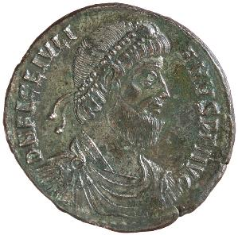

dFMRÖ
digitale FundMünzen der Römischen Zeit in Österreich
Austrian Academy of Sciences
Numismatic Commission
Klaus Vondrovec
klaus.vondrovec@khm.at
Access DB since 1999
MySQL DB online since 2007
http://www.oeaw.ac.at/numismatik/projekte/dfmroe/dfmroe.html
Notes:
Elmer: VO 27. Juni 1928, 70. Geburtstag Kubitscheks

Slide 5
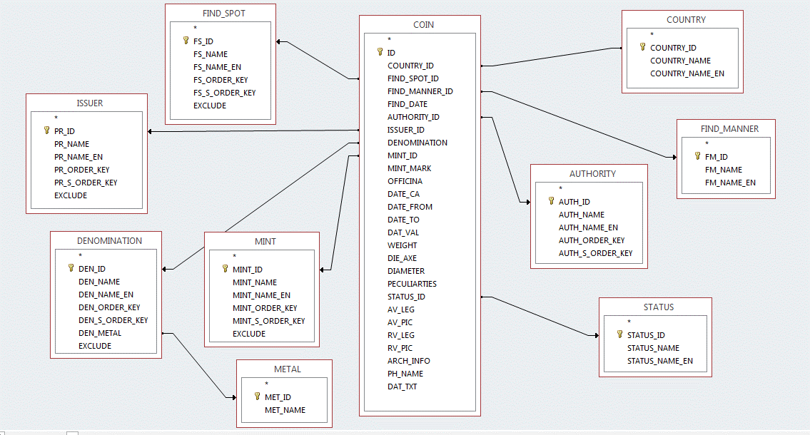
Tables

Slide 6
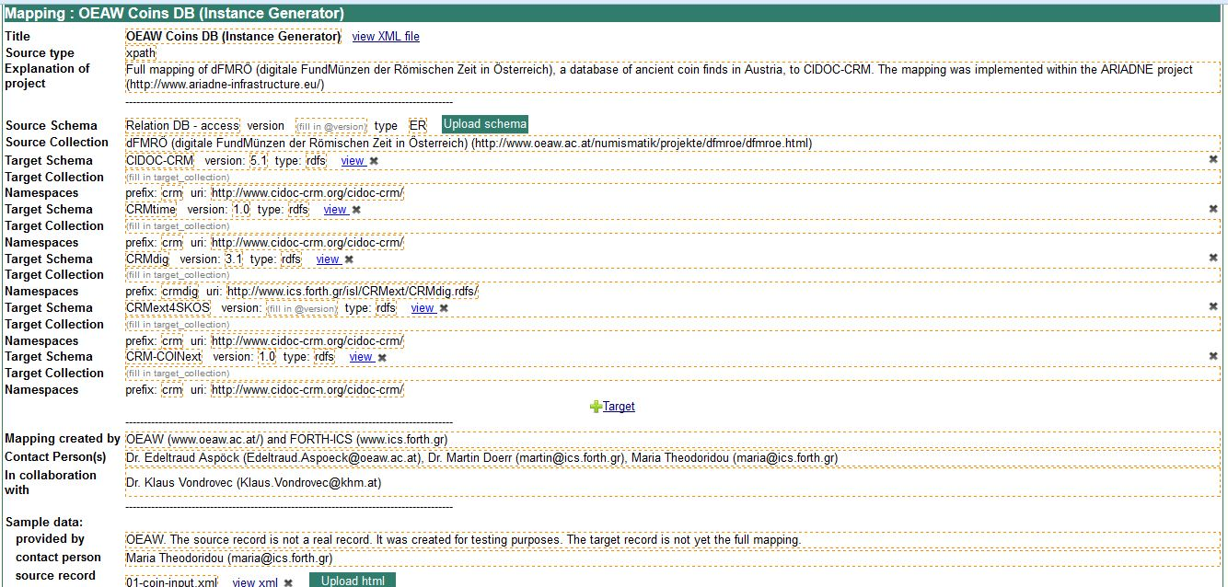
dFMRÖ coin db

Slide 7
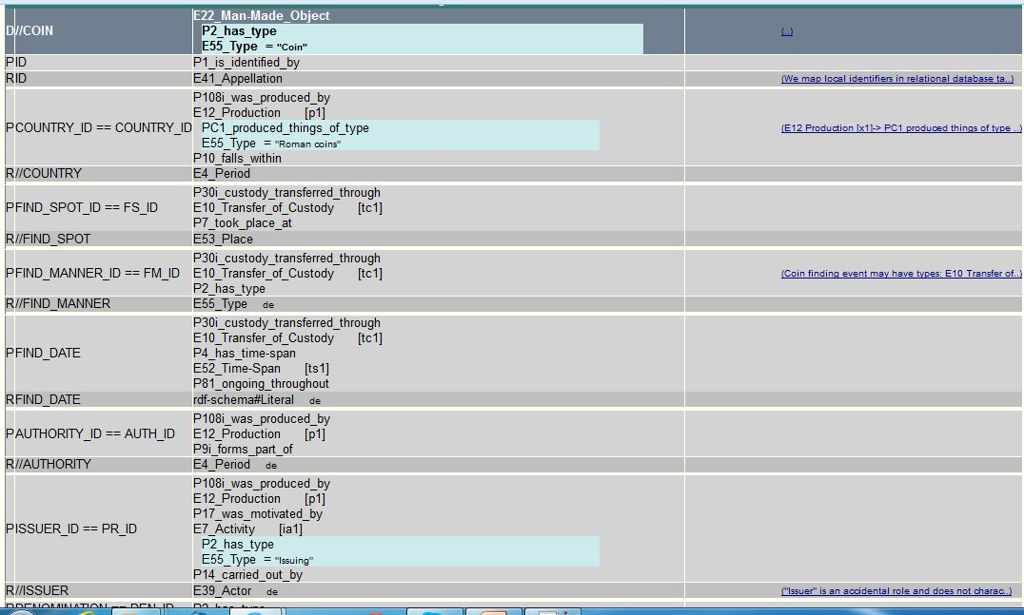
dFMRÖ coin db

Slide 8
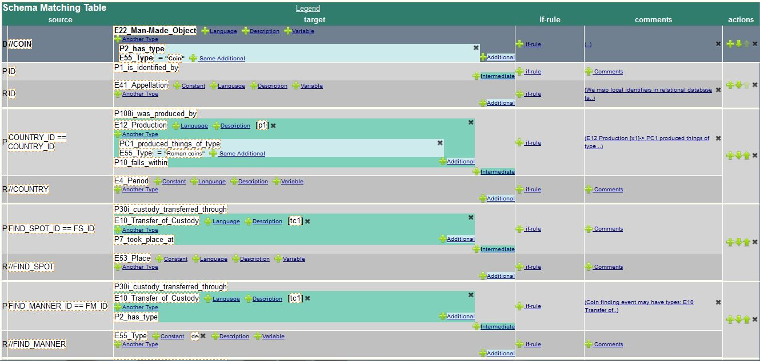
dFMRÖ coin db

Slide 9
CIDOC CRM Mapping Repository
Published schema matching definitions are available at:
http://139.91.183.3:9080/mapping_technology/
The schema matching definition (Version 1.0) format is available:
http://139.91.183.3:9080/mapping_technology/xsd/x3ml/x3ml_v1.0.xsd
The Mapping Memory Manager (3M) is available:
http://139.91.183.3:9080/3M/
Domain experts are able to easily understand & edit X3ML mapping files
You are kindly invited to send us your schema matching definition.

